Slide 1




BIODIVERSITY ASSESSMENT TRAINING
FOR OKOMU NATIONAL PARK SUPPORT ZONE COMMUNITIES’ VOLUNTEERS
POWERED BY: SUSTAINABILITY AND CONSERVATION EDUCATION FOR RURAL AREAS (SCERA)

Slide 2
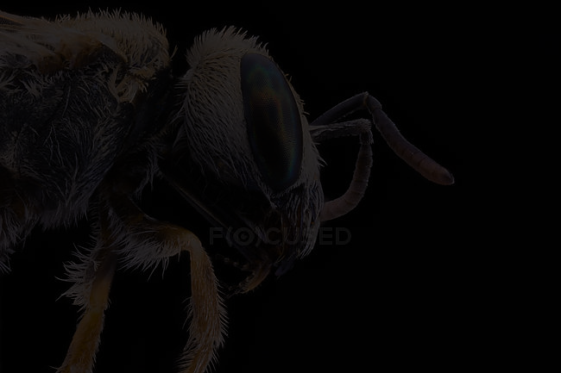
Insects Assessment
In a Tropical Ecosystem;
Needs And Protocols For Effective Assessment
SIMON, O. G.
December 1st 2021

Slide 3
What are insects ?
What is assessment and where is tropical ecosystem?
Outline
Needs for insects assessment
Methods of assessing insects
Recap and conclusion

Slide 4
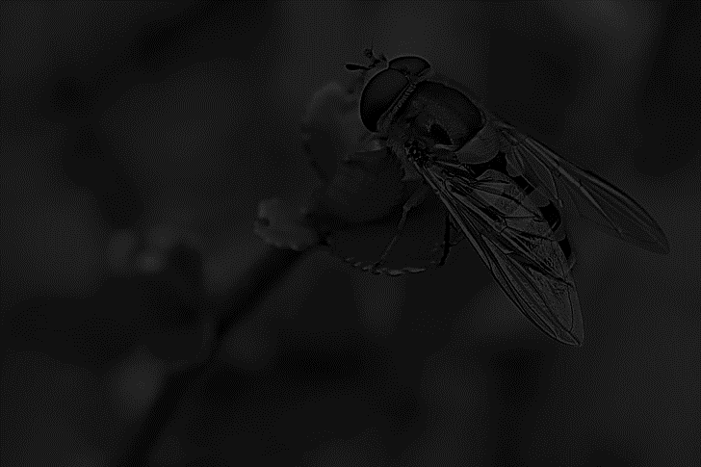
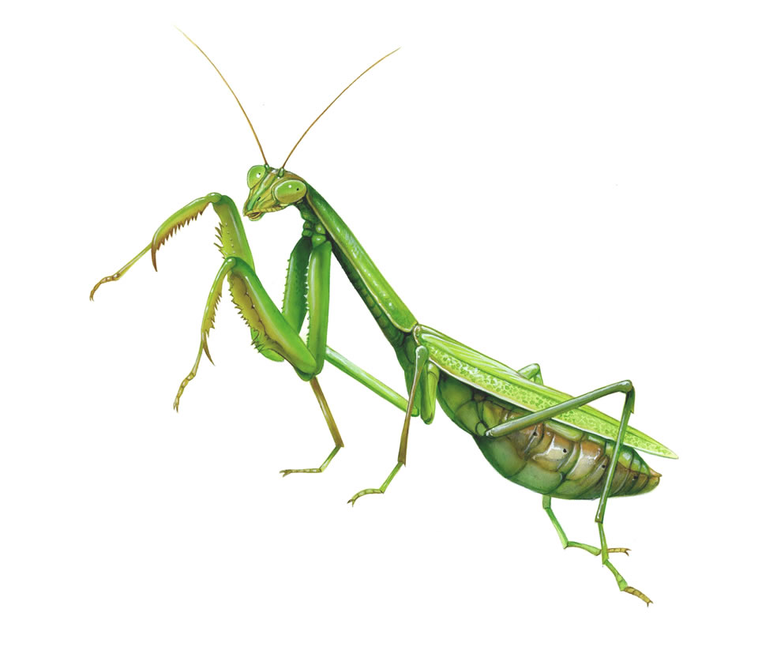
They are animals (Animalia)
Invertebrates with outer skeleton (Arthropods)
Have wings ( some are wingless)
Have three body parts; head, thorax and abdomen
Have jointed legs and antennae
Have 3 pairs of legs (6 legs) & have different groups
What
are
insects?

Slide 5
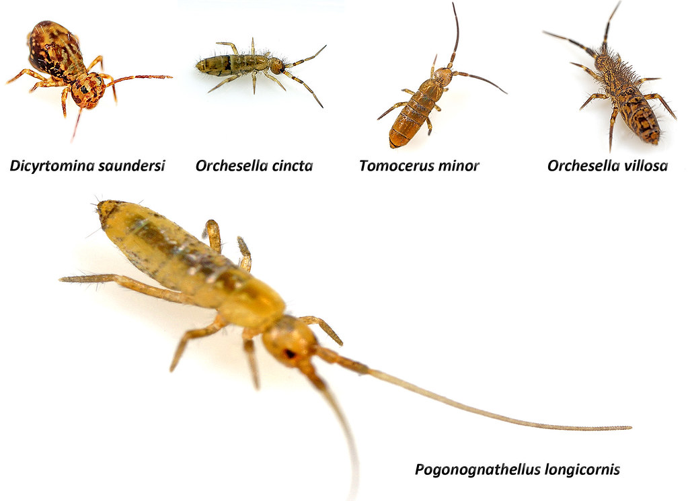
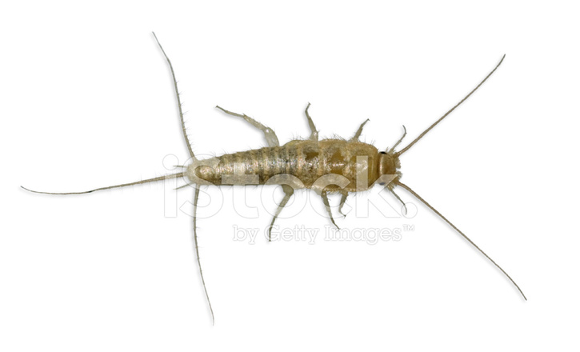
Those without wings
Collembola;
springtails
Groups/orders
of
insects
2. Thysanura;
Bristletails

Slide 6

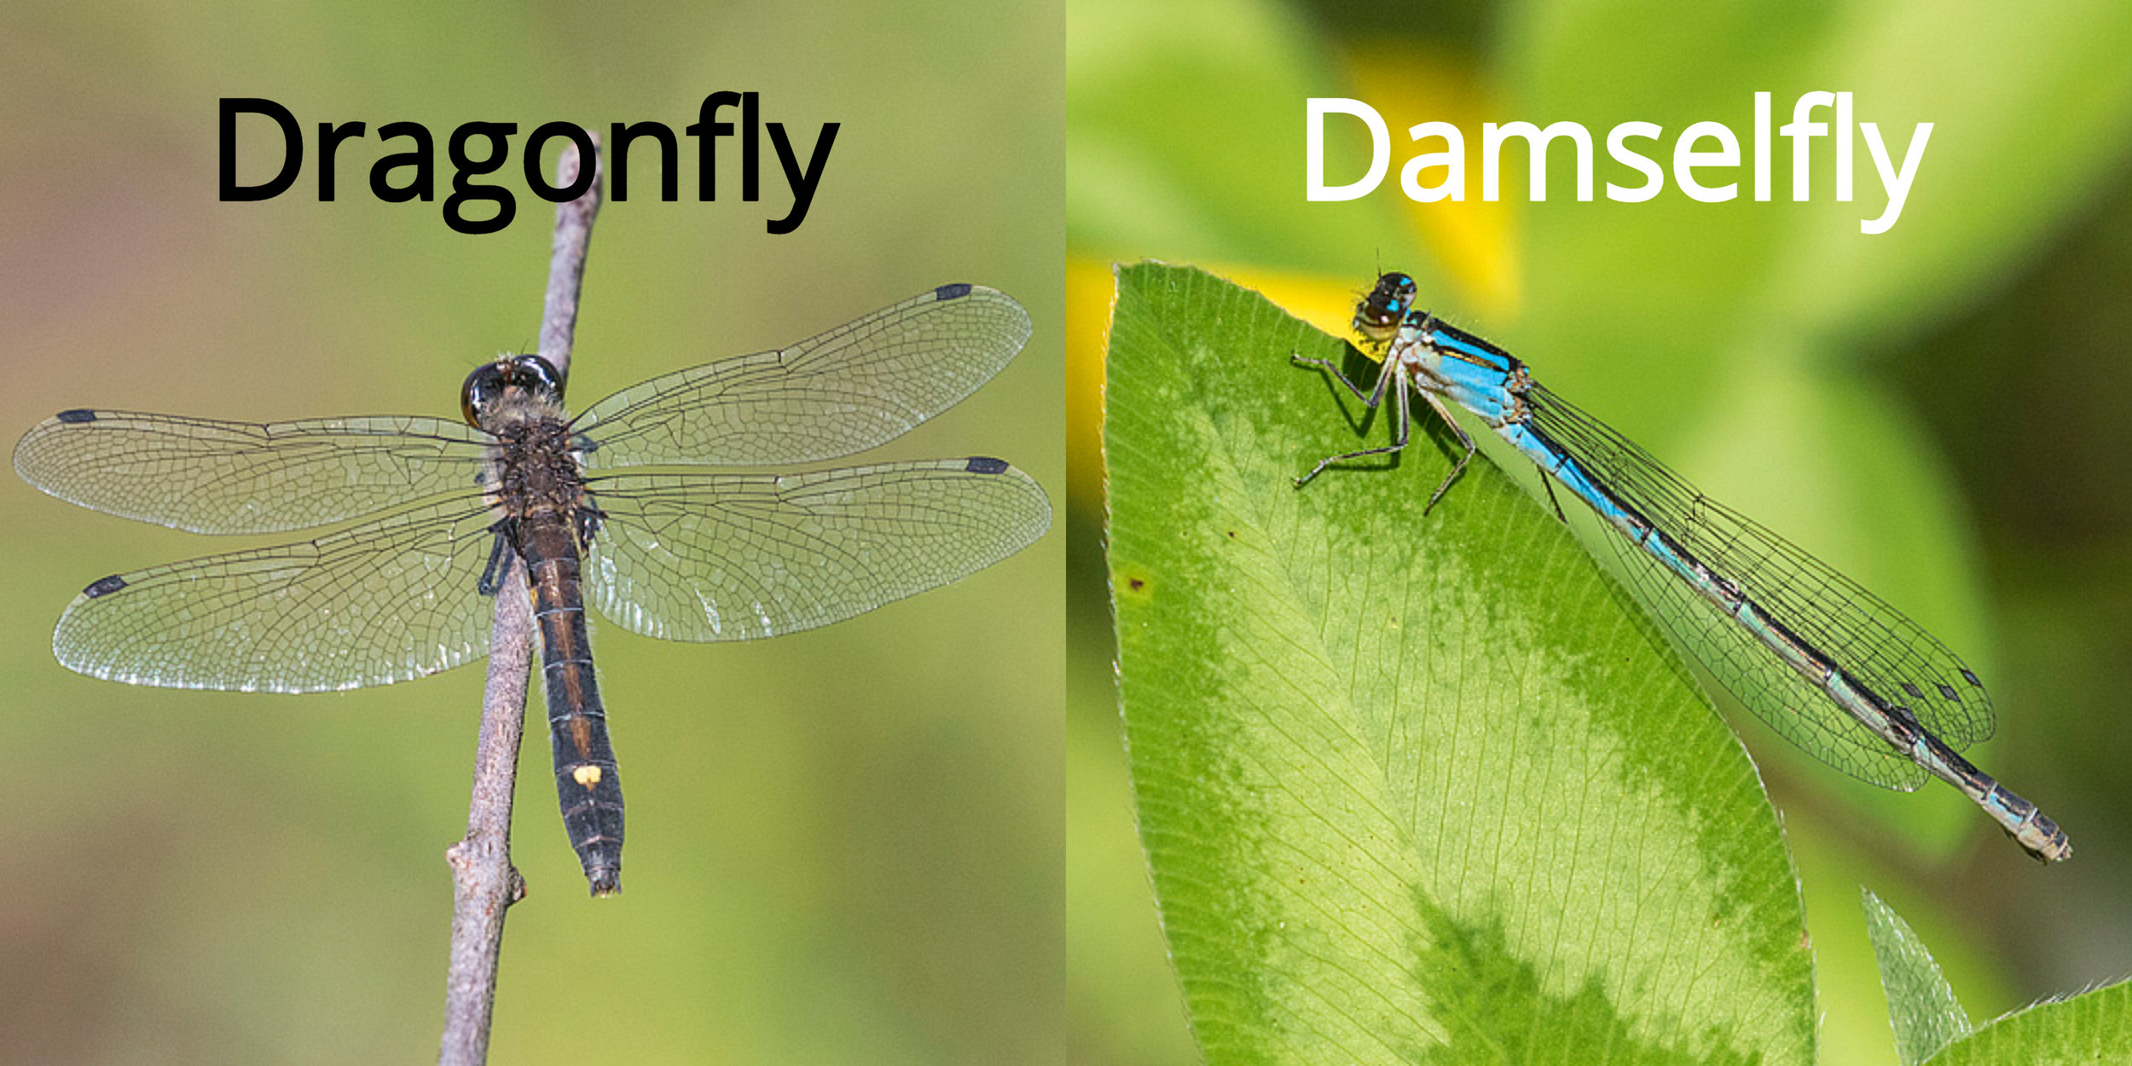
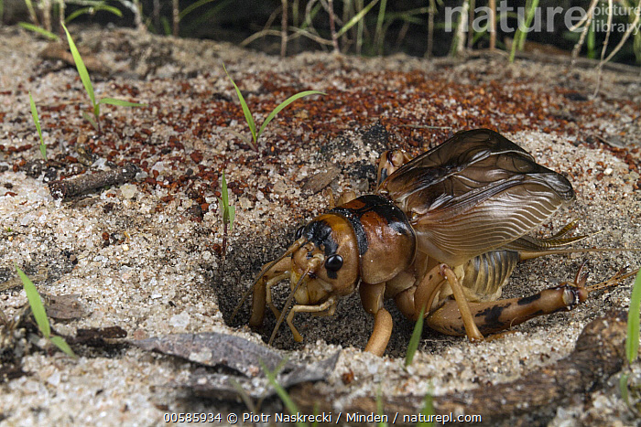
Those with wings
Odonata;
Dragon fly
damselfly
Orders
of
Insects cont’d
2. Orthoptera;
Cricket
Grasshopper

Slide 7
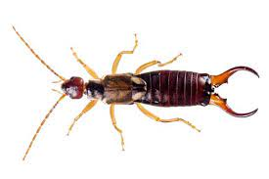
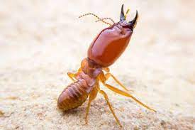
Those with wings
3. Dermaptera;
Earwigs
Orders
of
Insects cont’d
4. Isoptera;
Termites

Slide 8
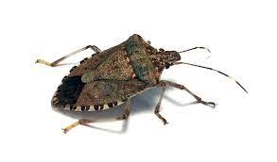
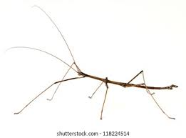
Those with wings
5. Hemiptera;
True Bugs
Orders
of
Insects cont’d
6. Phasmida;
Stick insects
leaf insects

Slide 9
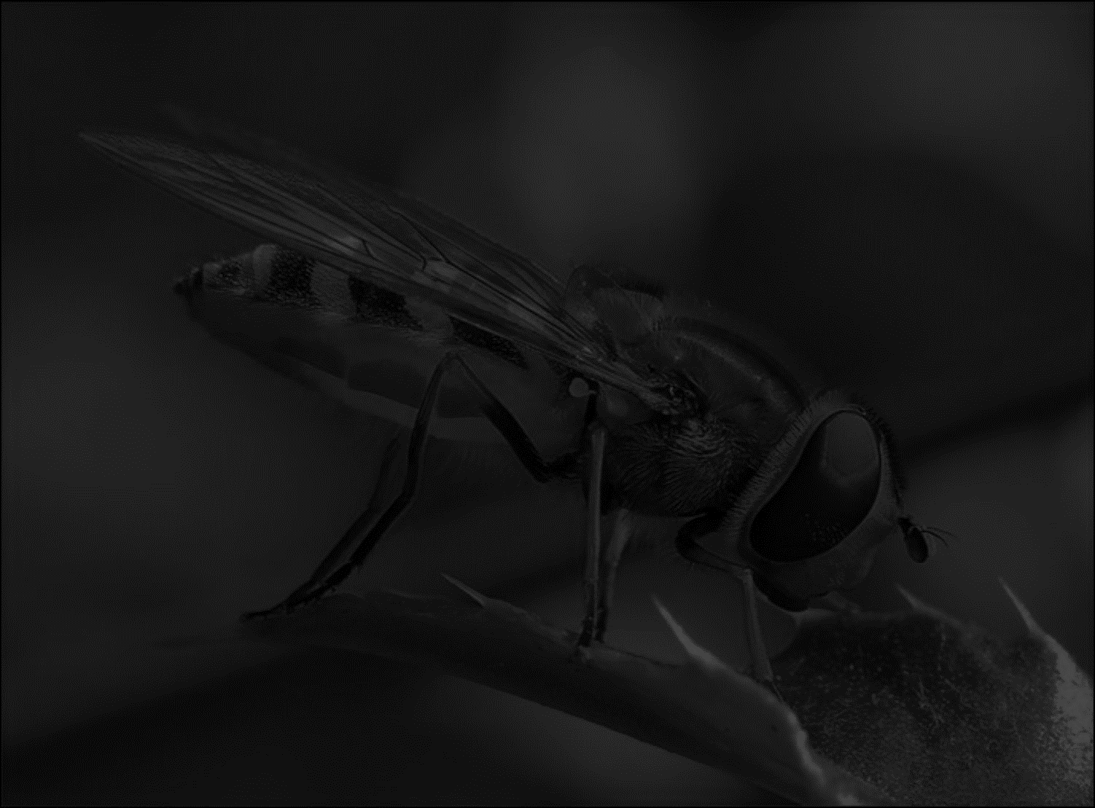
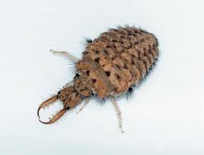
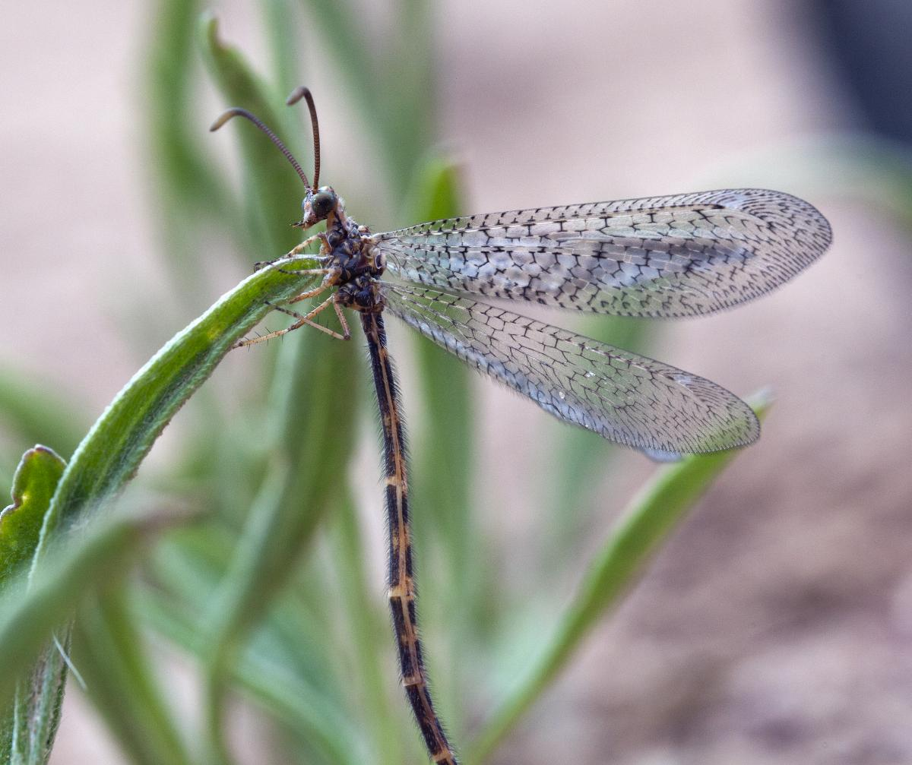
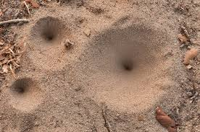
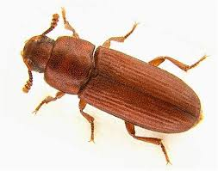
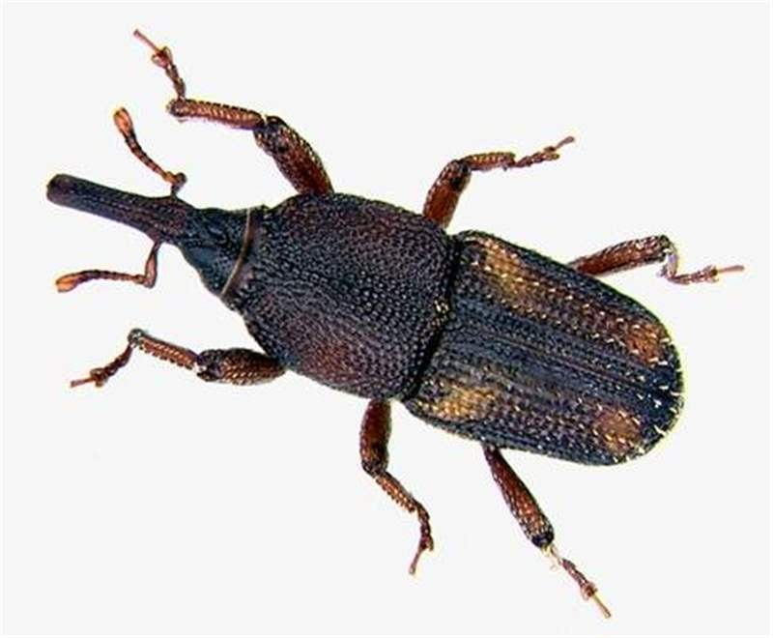
Those with wings
7. Neuroptera;
Antilions
Aphidlion
Orders
of
Insects cont’d
8. Coleoptera;
Beetles
Weevils

Slide 10
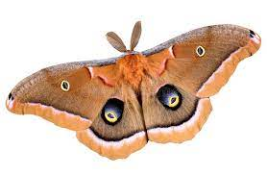
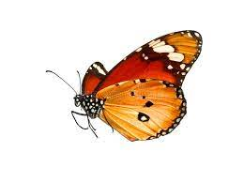
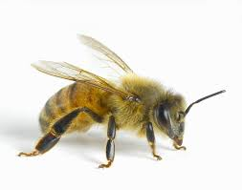
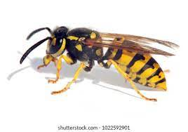
Those with wings
9. Lepidoptera;
Butterflies
Moths
Orders
of
Insects cont’d
10. Hymenoptera;
Bees, ants, wasp

Slide 11
Those with wings
Orders
of
Insects cont’d
11. Diptera;
True flies

Slide 12
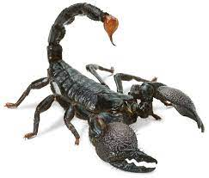
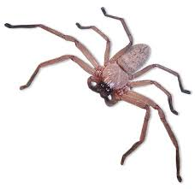
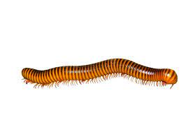
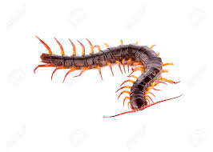
A quick one!
Are
these
animals
Insects?

Slide 13
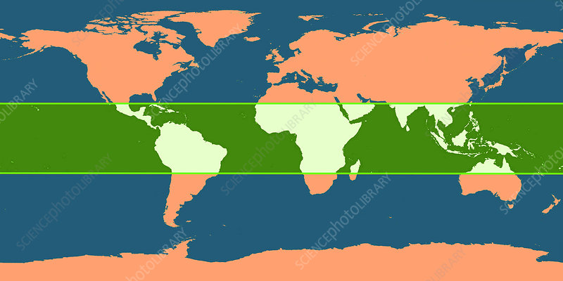

Defining Assessment;
a process by which information is obtained relative to some known goal
A quick one!
Are
these
animals
Insects?
Tropical region
Nigeria

Slide 14
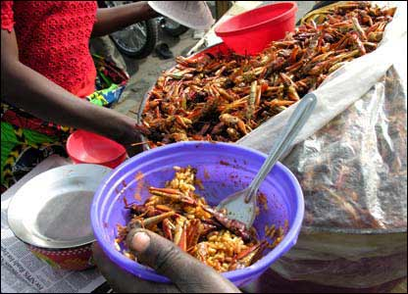
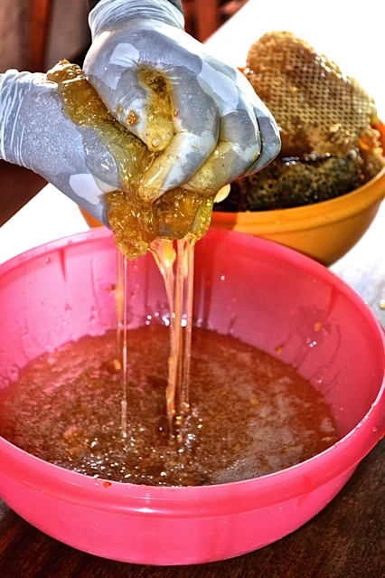
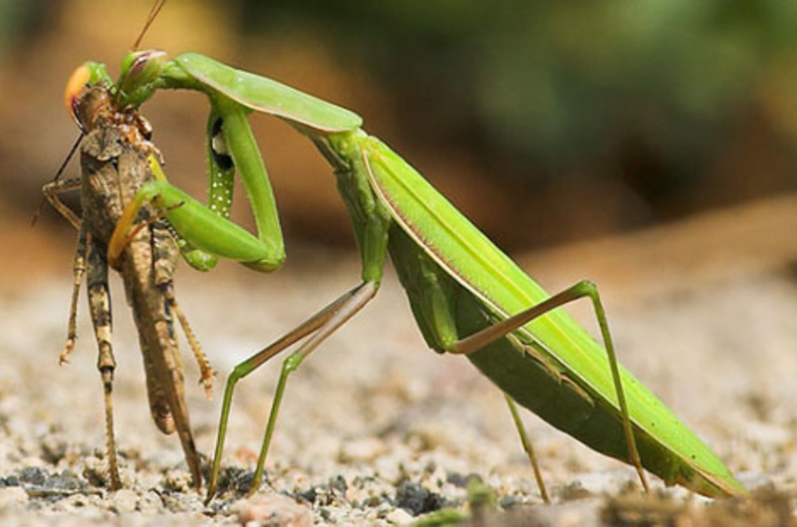
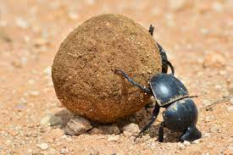
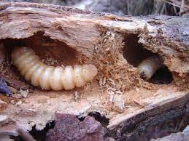
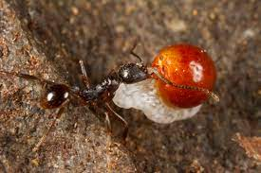
Why Should We Assess Insects?
Food
Pollination
Predation
Decomposition
Soil formation
Seed dispersal
Indicators of good ecosystem

Slide 15
Different methods exist but can either be active or passive
Methods/protocols
for
Insects
Assessment
Some methods are effective in assessing some groups of insects than others e.g. night insects, flying insects, soil insects etc.

Slide 16
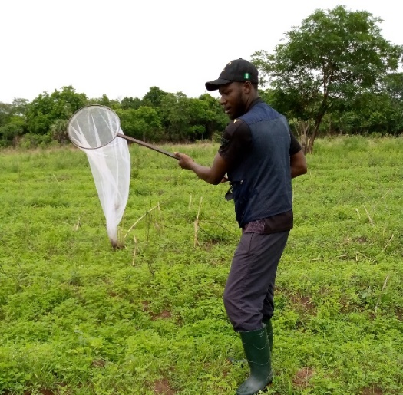
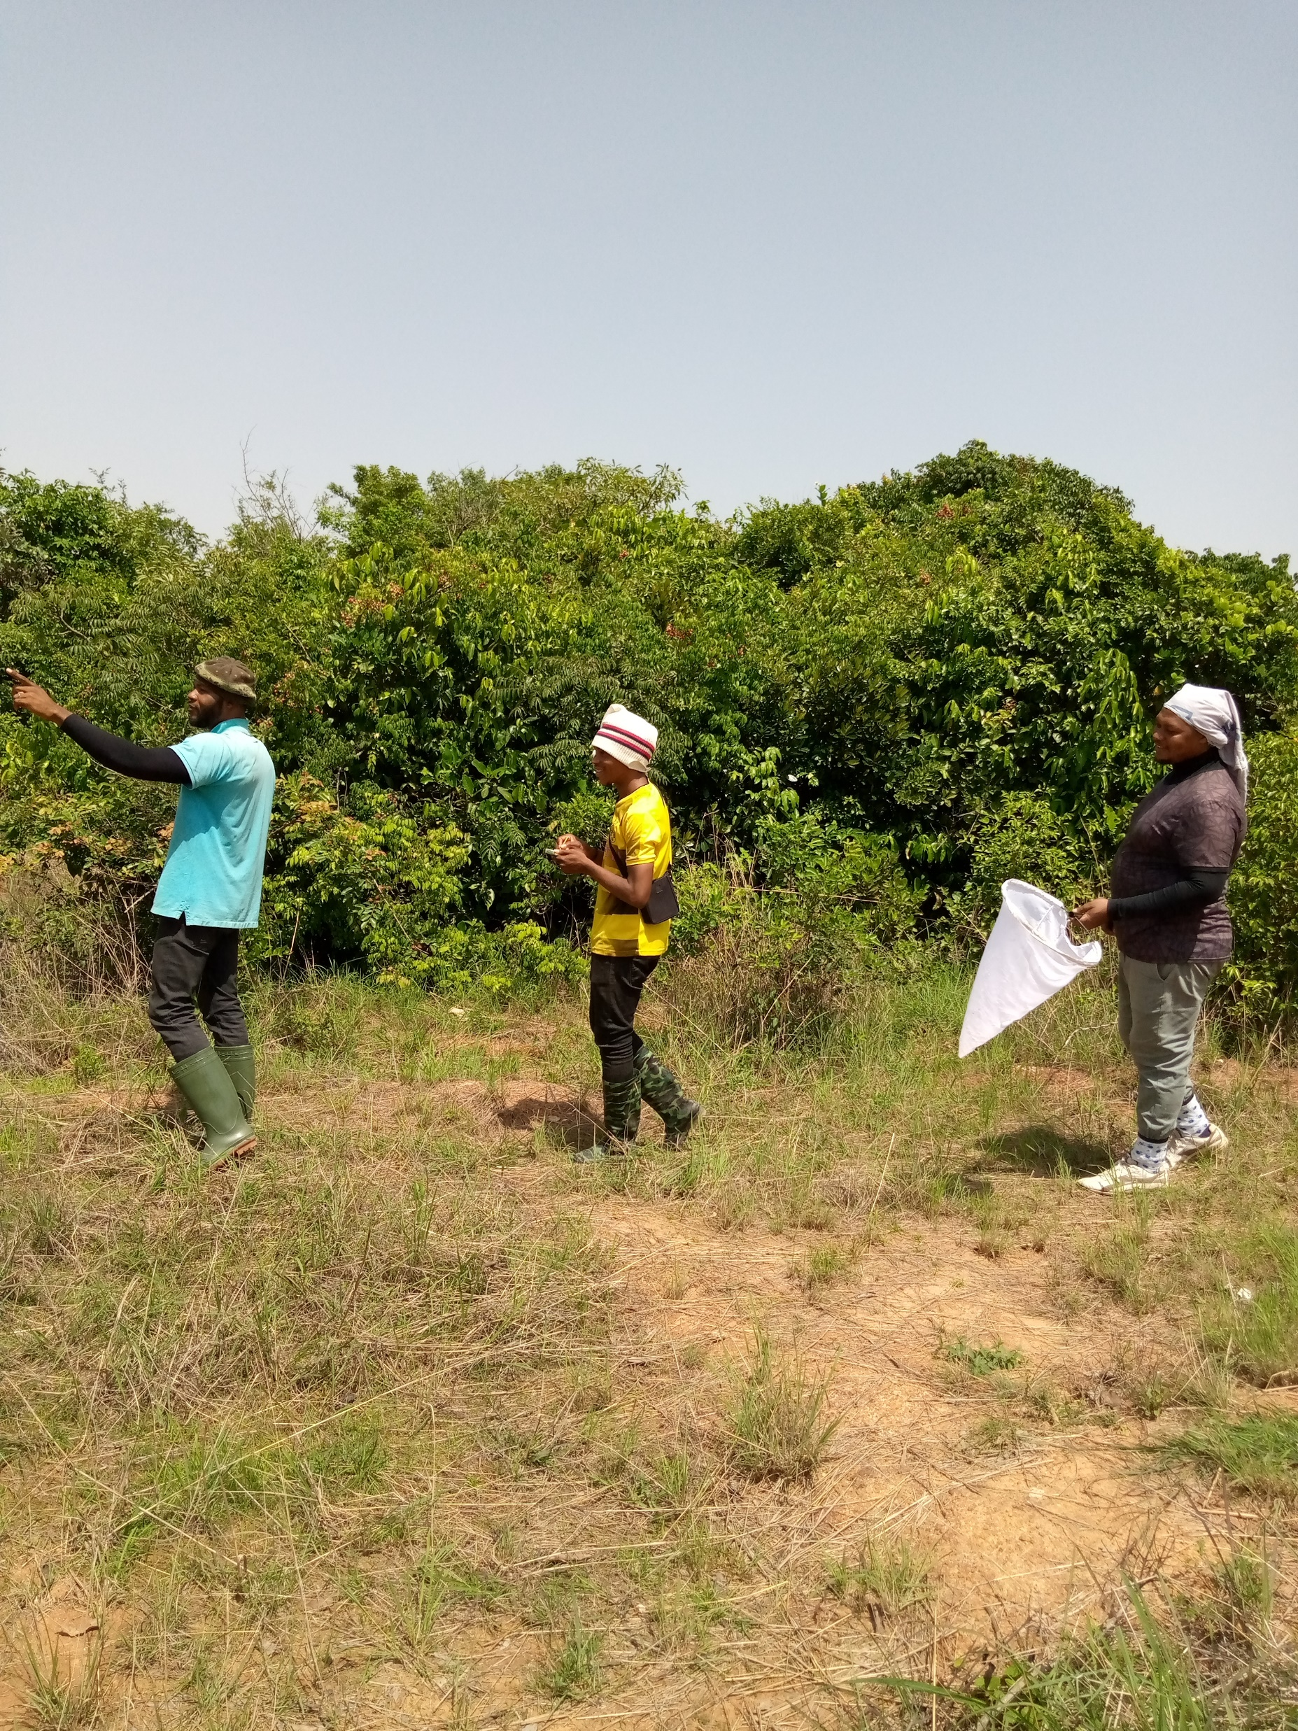
Active Methods
Sweep net;
flying insects
Methods/protocols
for
Insects
Assessment
2. Line transect;
Big insects

Slide 17
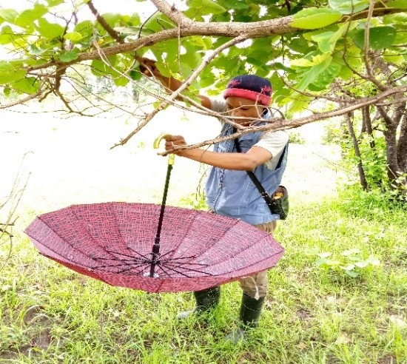
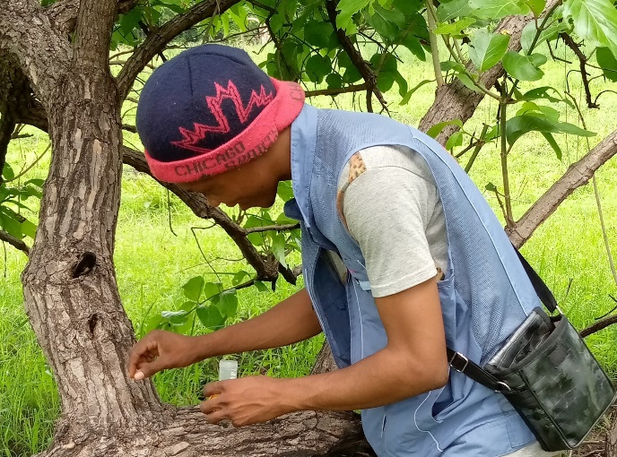
Active Methods
3. Foliage tapping;
Beetles, bugs,
larva
Methods/protocols
for
Insects
Assessment
Cont’d
4. Hand-picking;
crawling insects,
larva

Slide 18
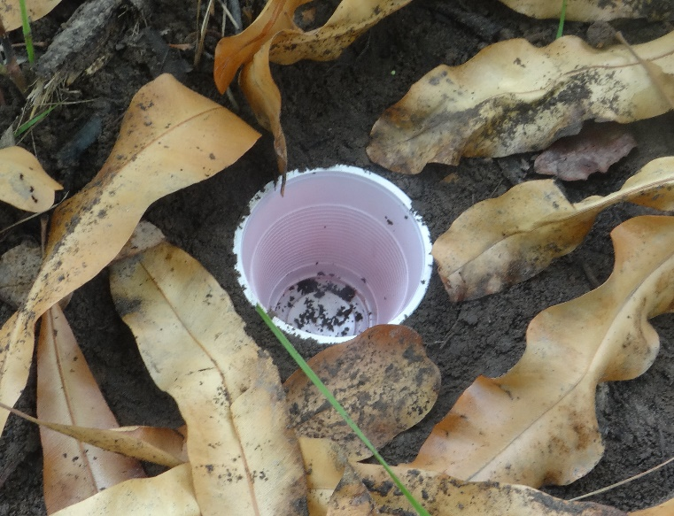
Passive Methods
Pitt fall traps;
ground crawling
insects
Methods/protocols
for
Insects
Assessment
Cont’d
2. Coloured bowl
trap;
flying insects

Slide 19
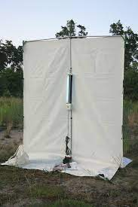
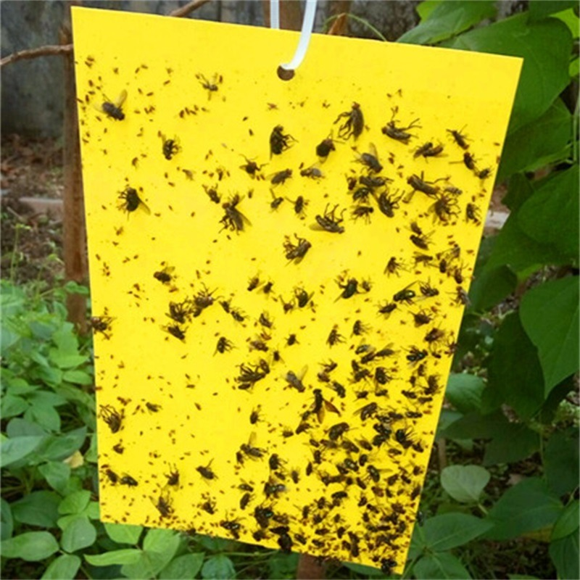
Passive Methods
3. Light traps;
night
insects
Methods/protocols
for
Insects
Assessment
Cont’d
4. Sticky trap

Slide 20
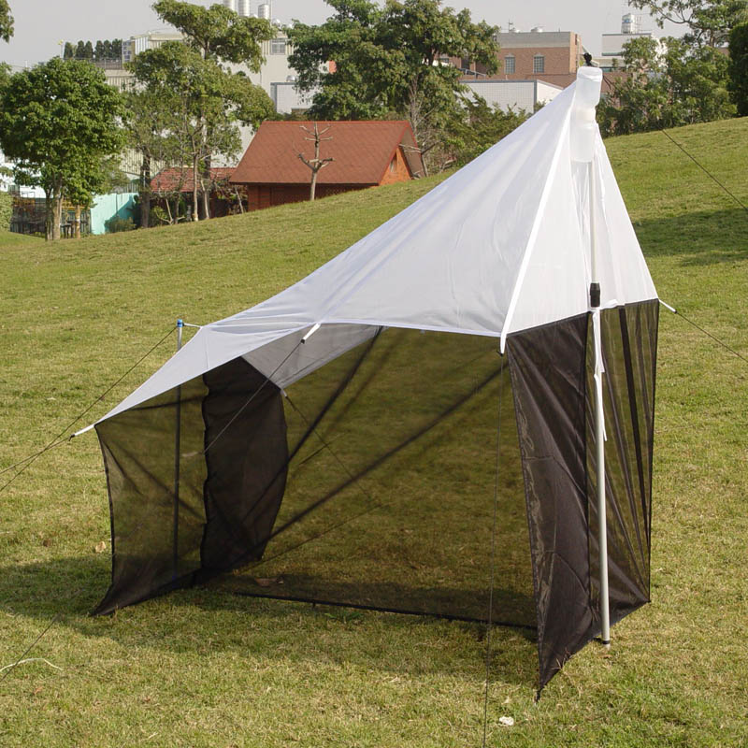
Passive Methods
Methods/protocols
for
Insects
Assessment
Cont’d
5. Malaise trap;
flying
insects

Slide 21
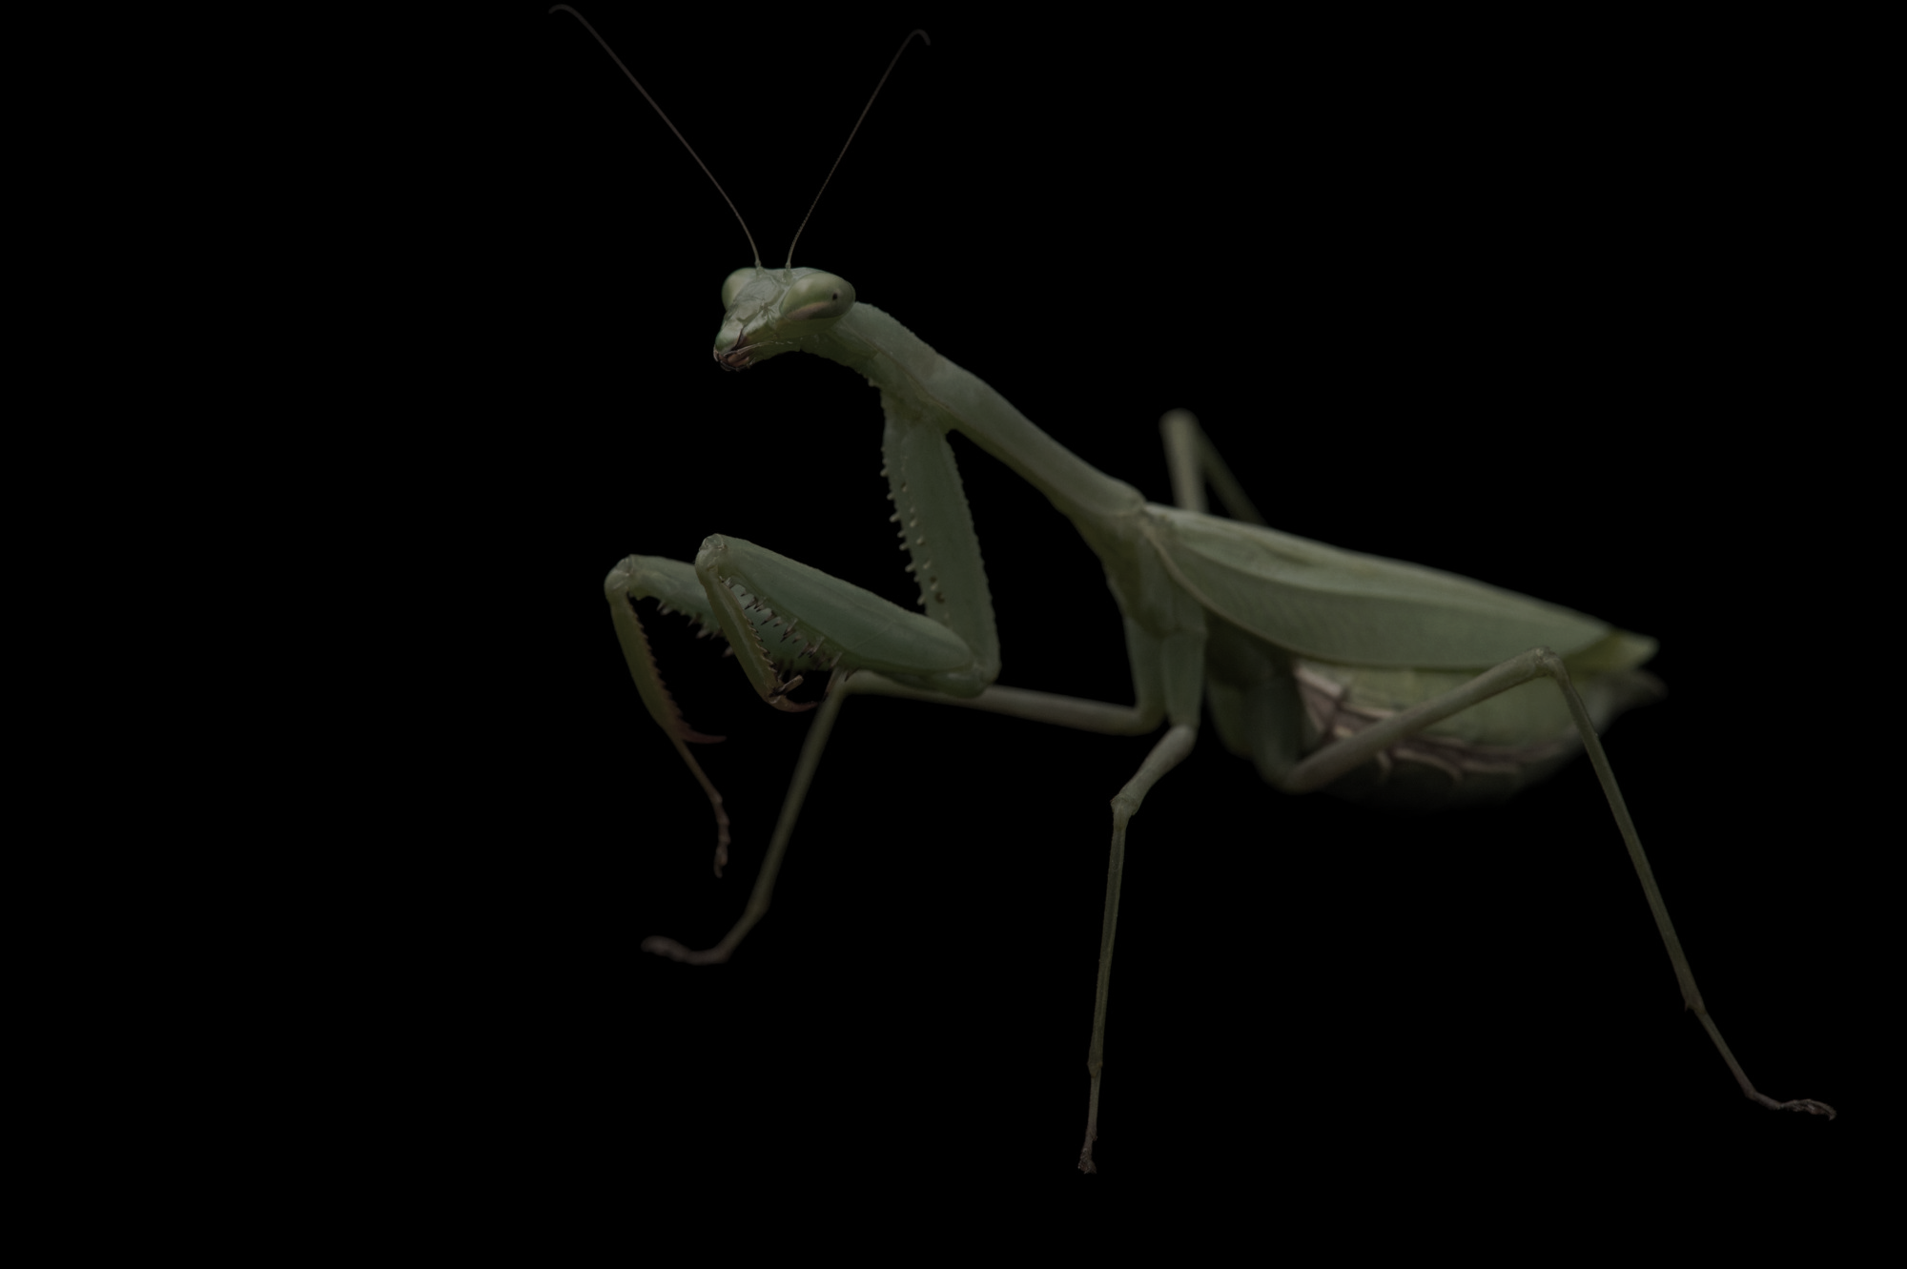
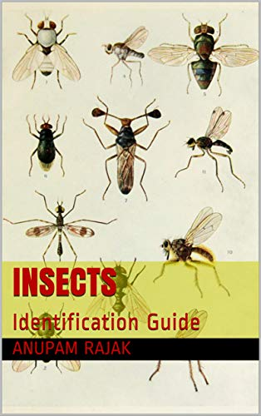
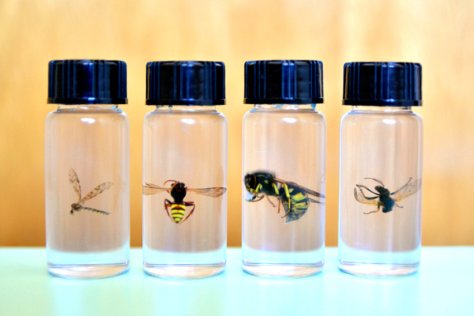
What should you do after insects collection?
Store in appropriate sample bottles with preservative
Sort stored insects, identify them and record abundance of each group

Slide 22
What can we work with?
Hand on practical

Slide 23
Recap
&
Conclusion
What are insects ?
What is assessment and where is tropical ecosystem?
Needs for insects assessment
Methods of assessing insects
Recap and conclusion
Assessment of Insects in a tropical ecosystem like Okomu National park is importance because insects play vital roles in our environment

Slide 24
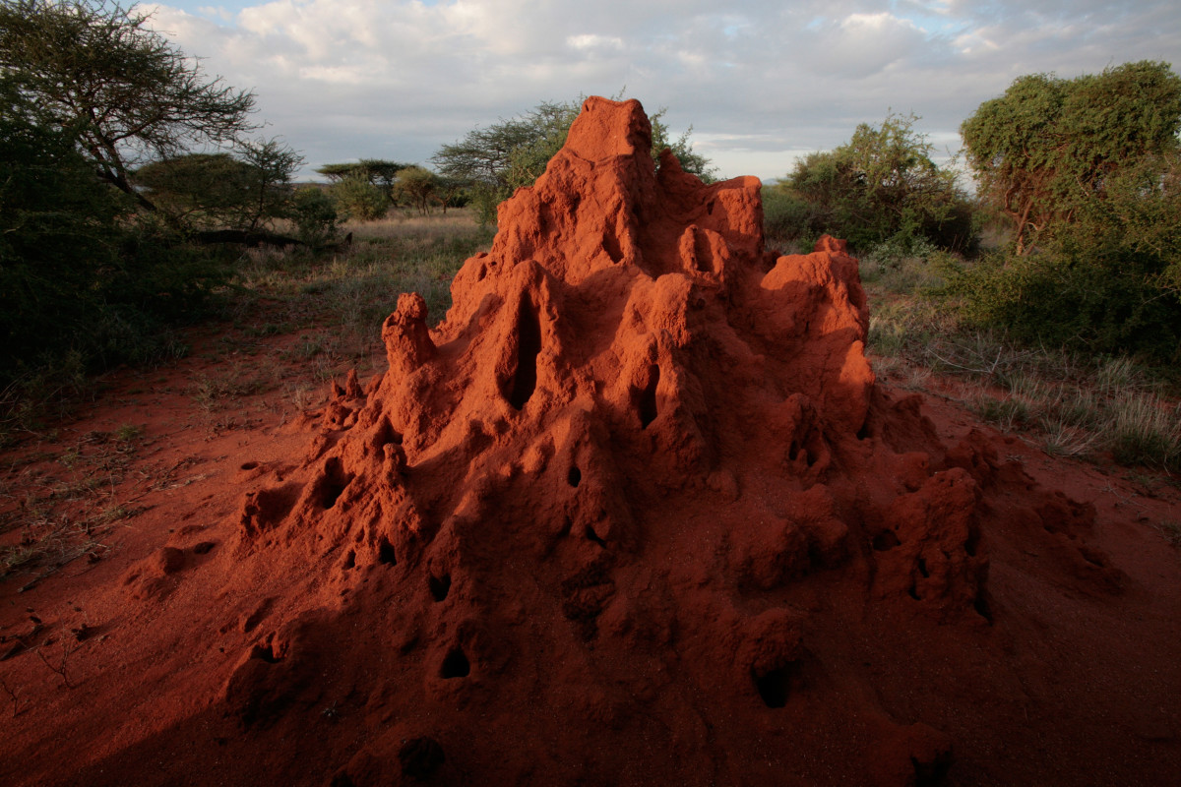
THANK YOU

Slide 25
food and agriculture organization of the united nations, Rome, 2016
Kenneth, 2018
Kok-Boon et al., 2017
David, 2016
Yves et al., 2020
Olivier et al., 2009
Ishaya et al., 2018

