Slide 1
BIODIVERSITY ASSESSMENT TRAINING
FOR OKOMU NATIONAL PARK SUPPORT ZONE COMMUNITIES’ VOLUNTEERS
POWERED BY: SUSTAINABILITY AND CONSERVATION EDUCATION FOR RURAL AREAS (SCERA)

Slide 2
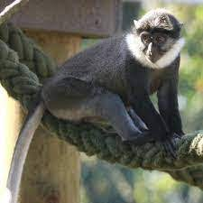
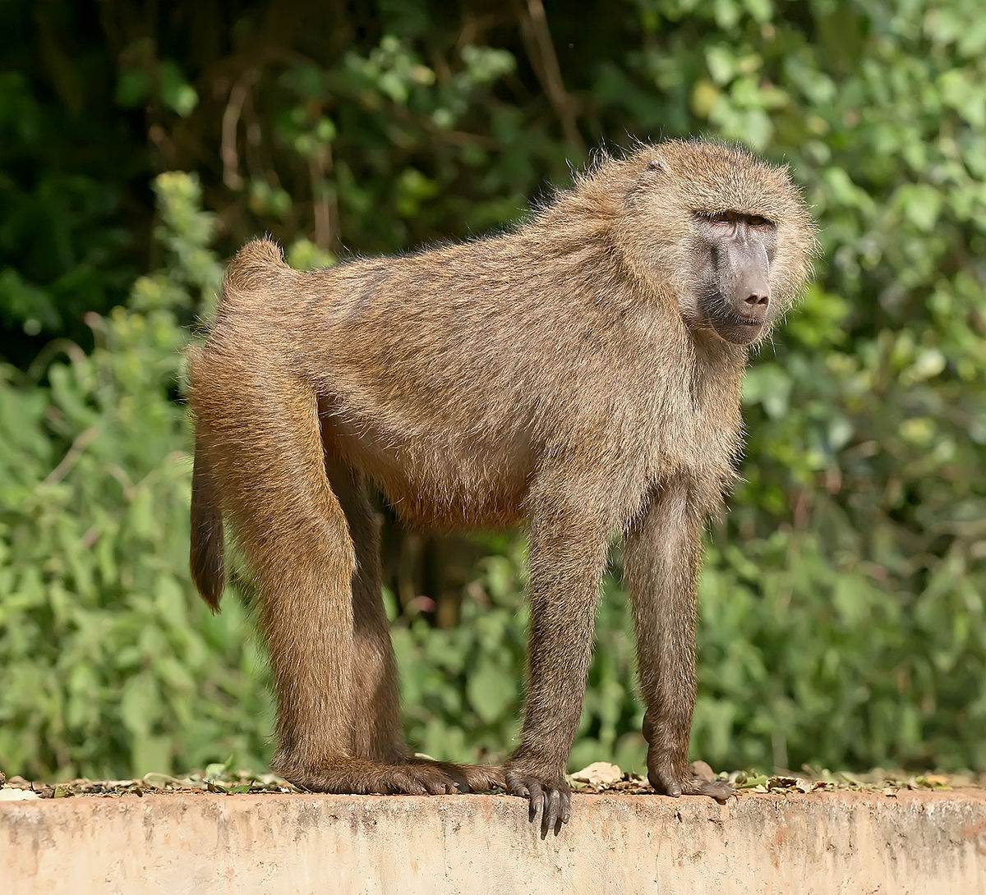
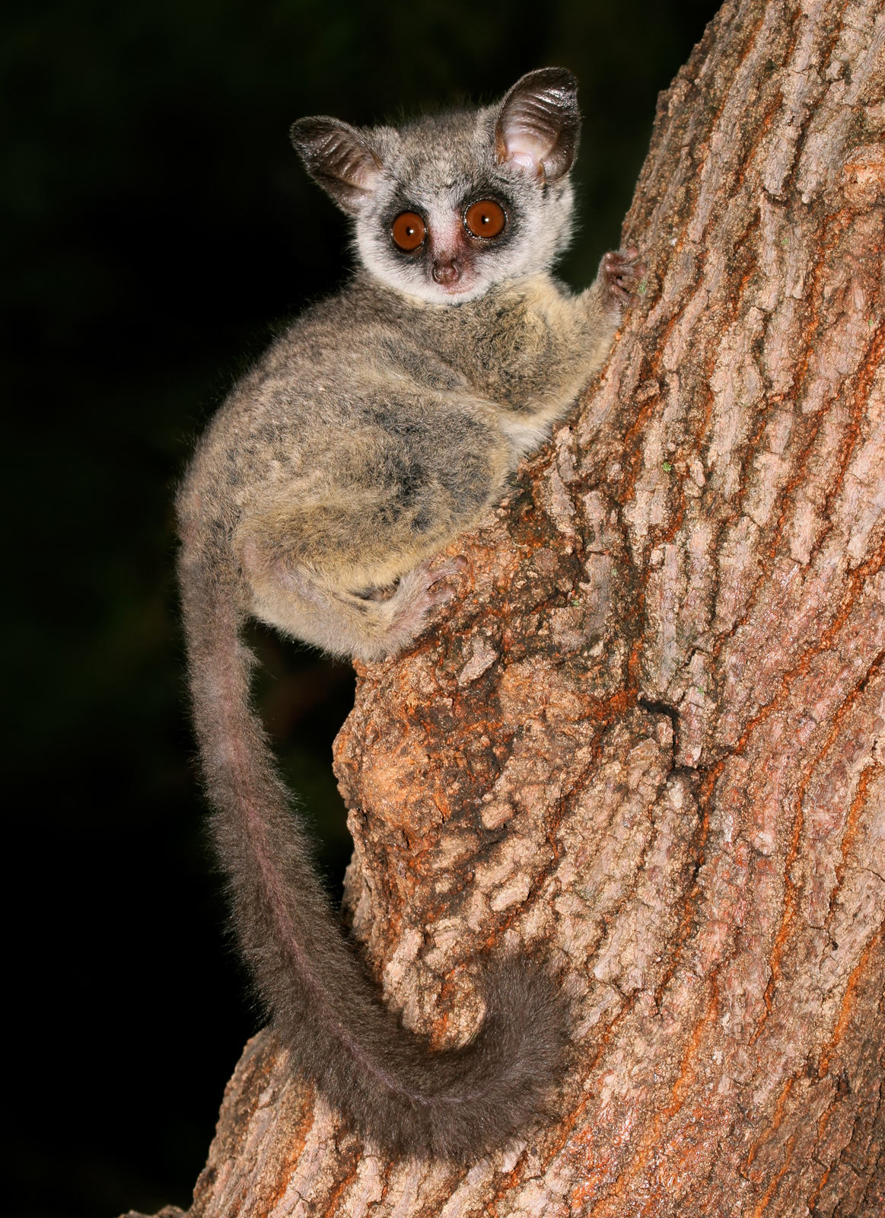
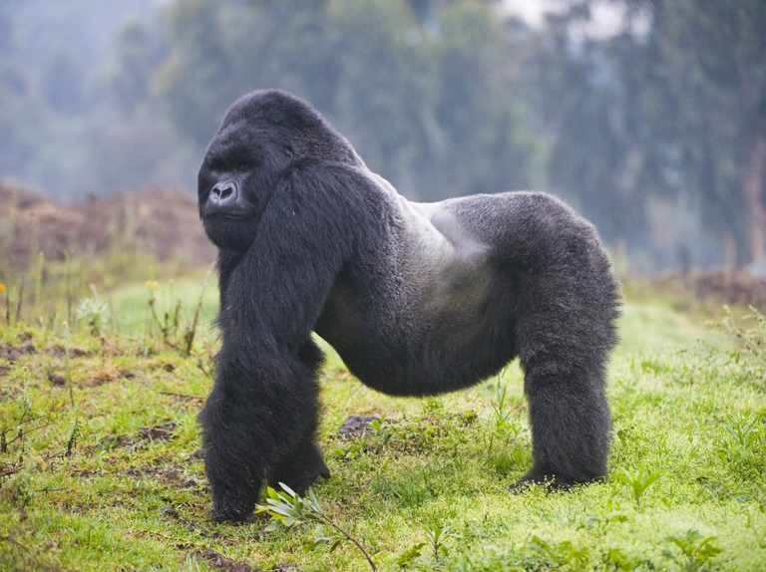
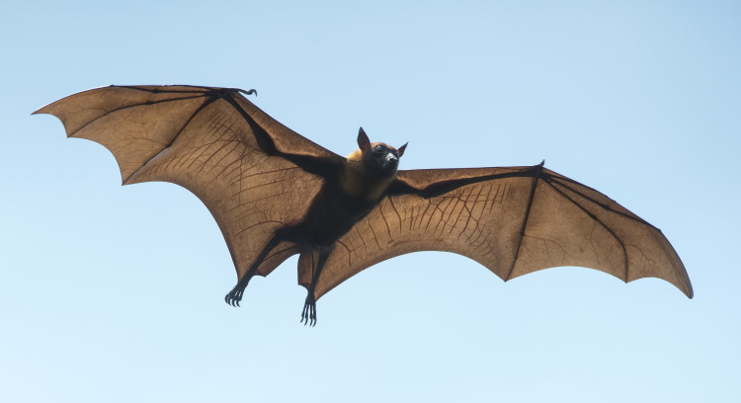
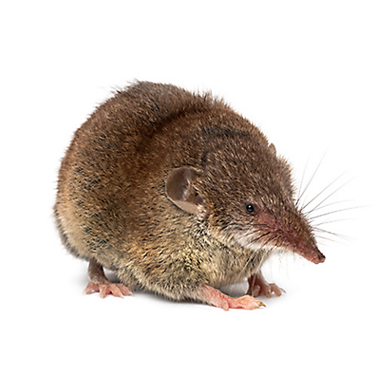
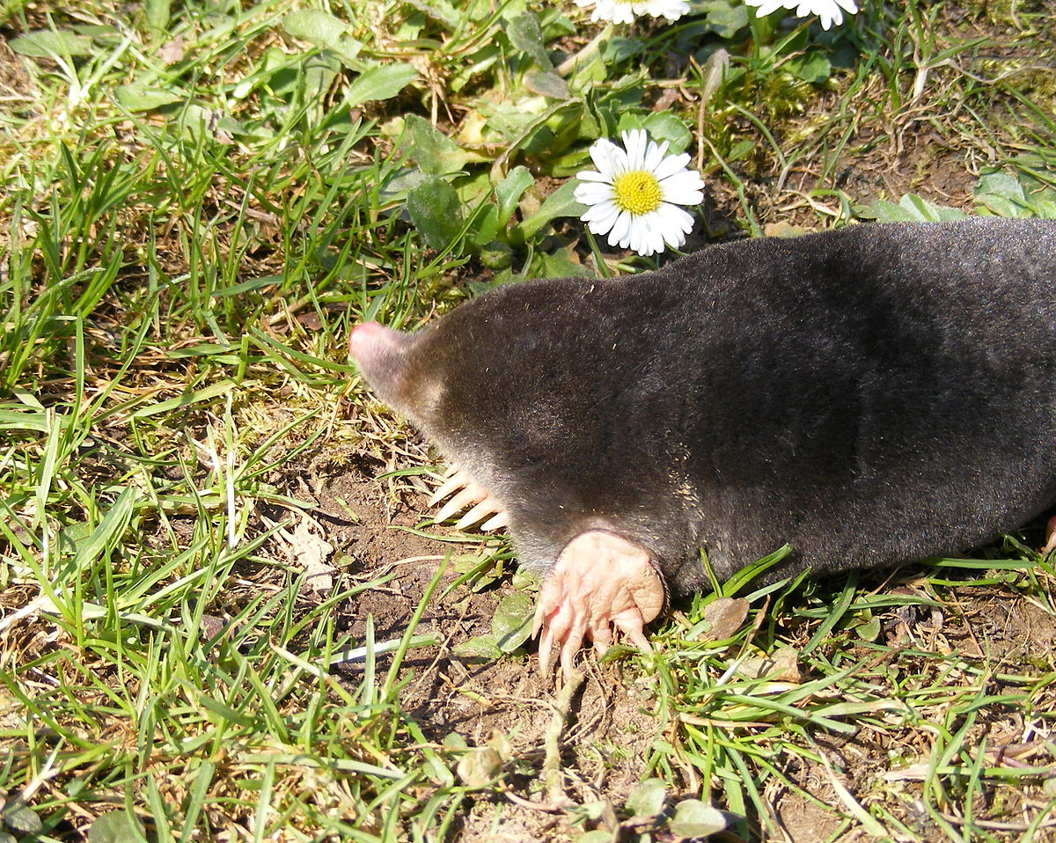
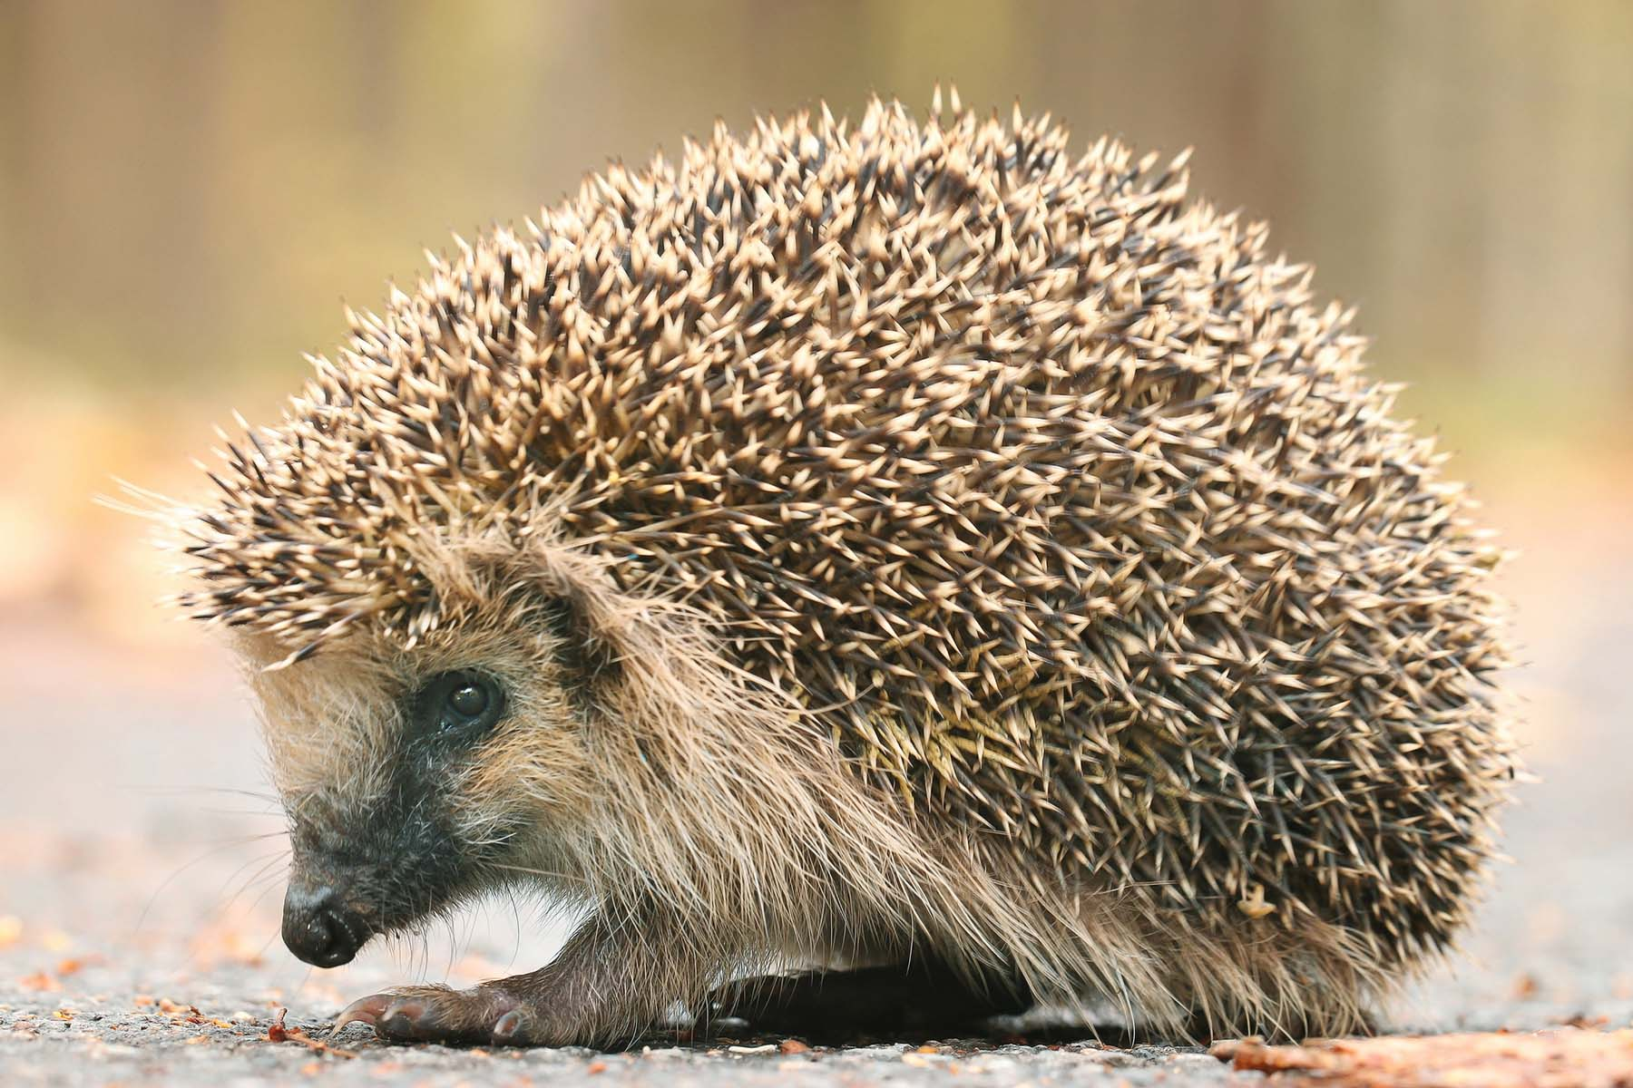
MAMMALS
ORDER 1: PRIMATES (MONKEYS, BABOONS, BUSH BABIES, GORILLAS)
ORDER 2: CHIROPTERA (BATS)
ORDER 3: INSECTIVORA (INSECTIVORES- shrews, moles, hedgehogs)

Slide 3
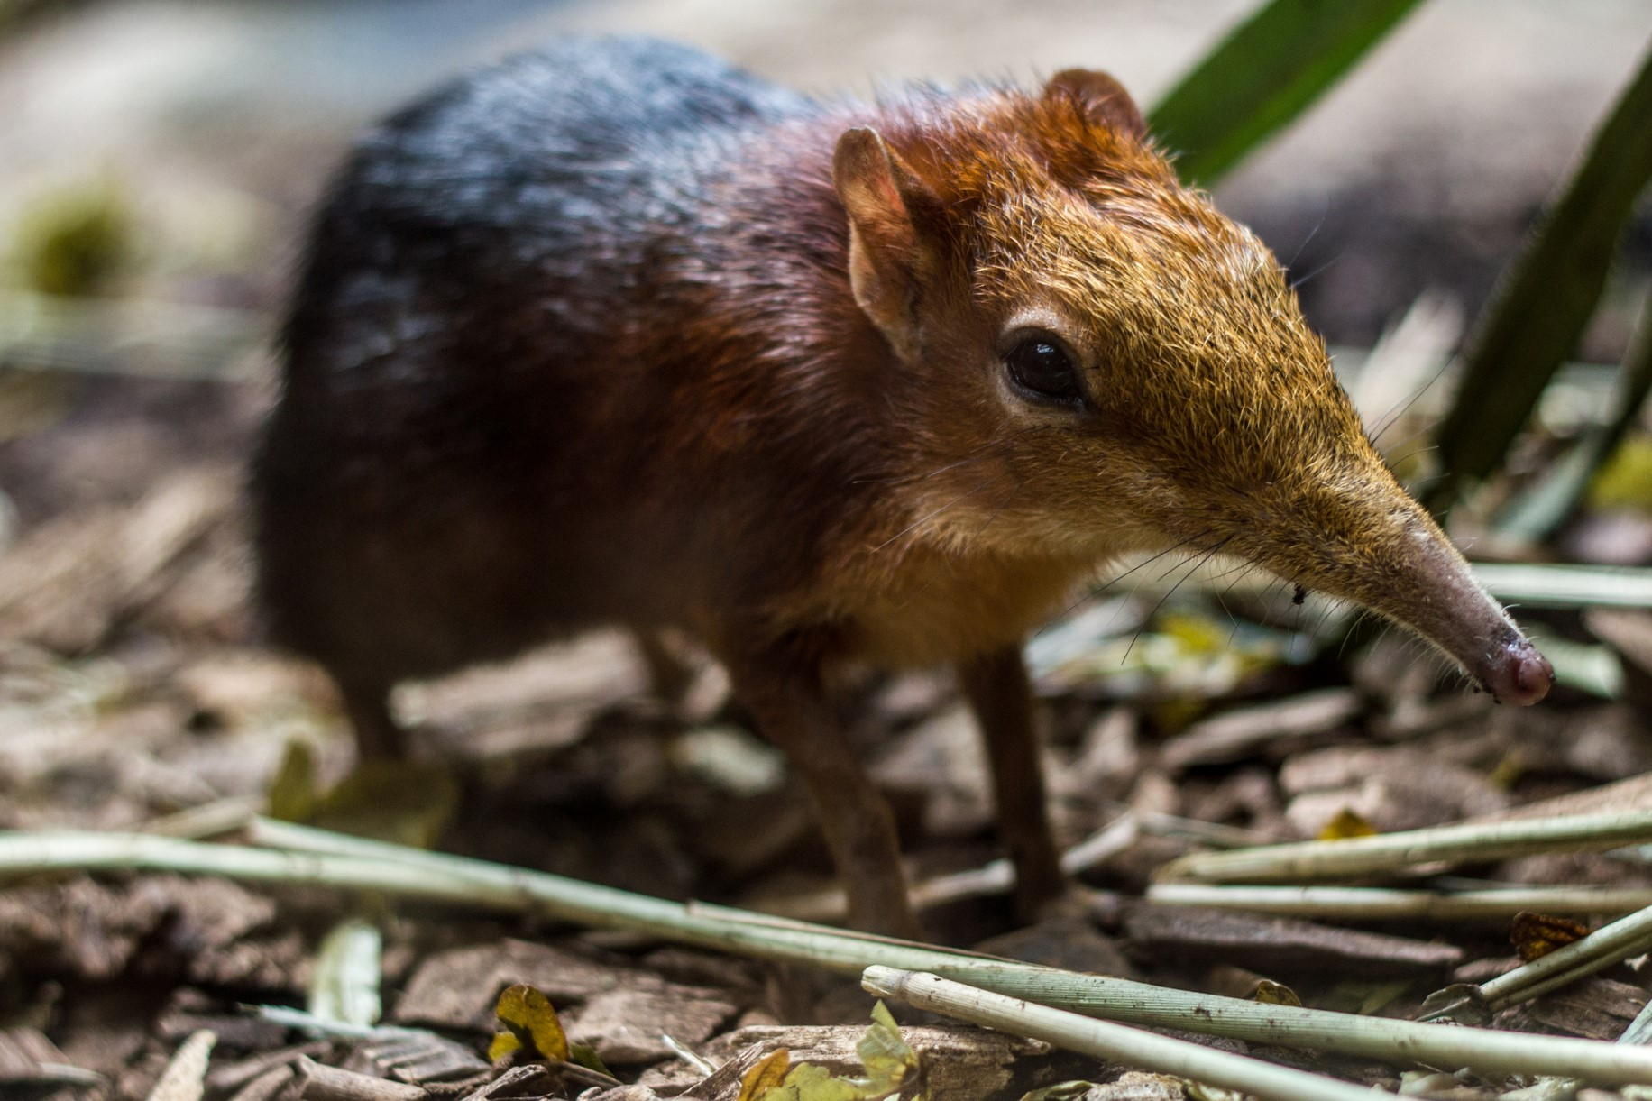
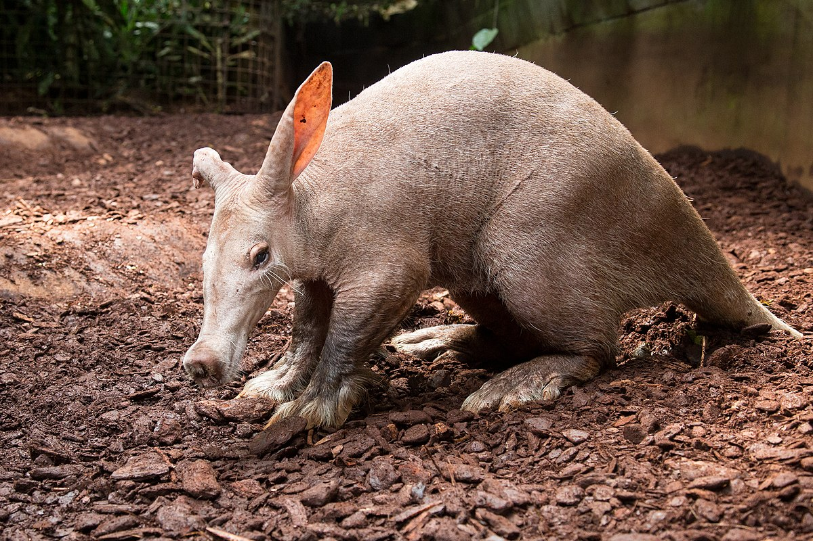
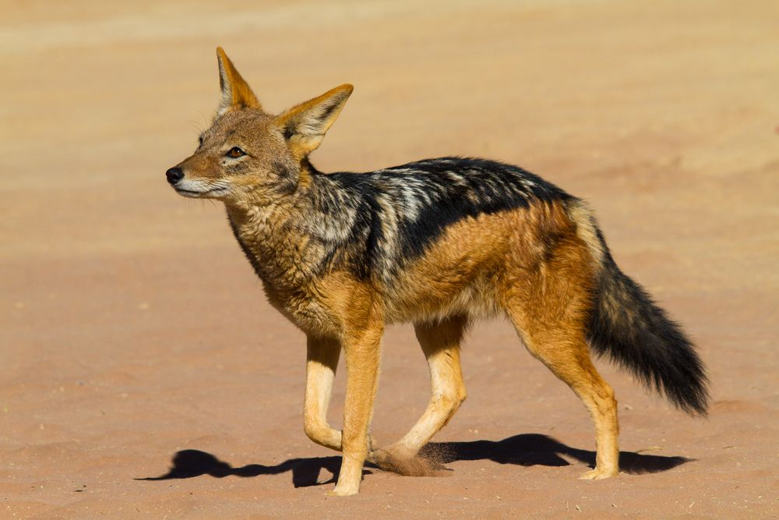
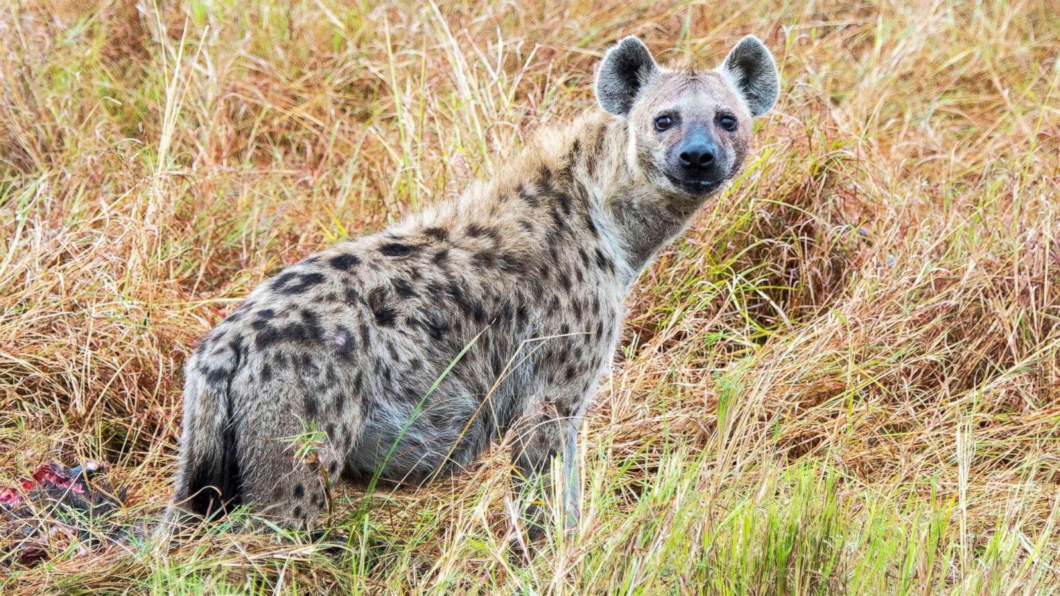
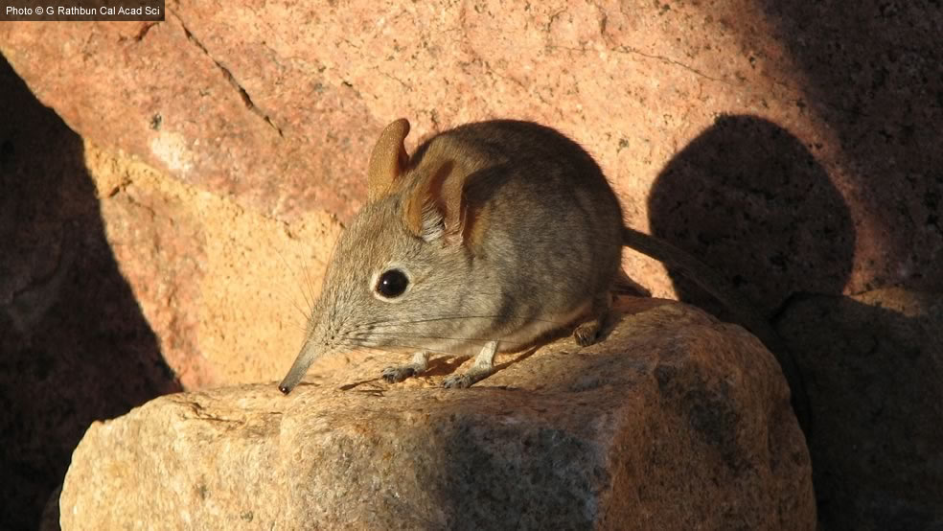
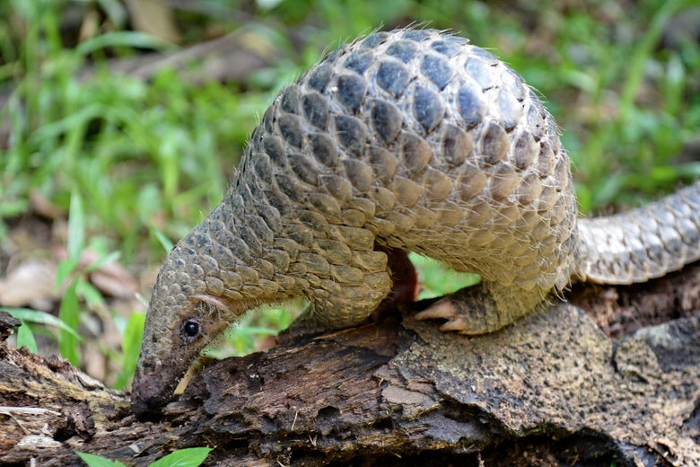
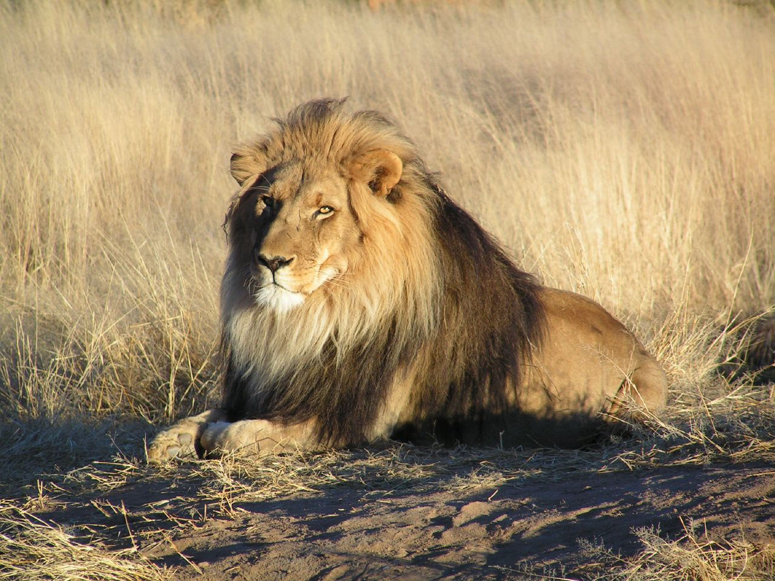
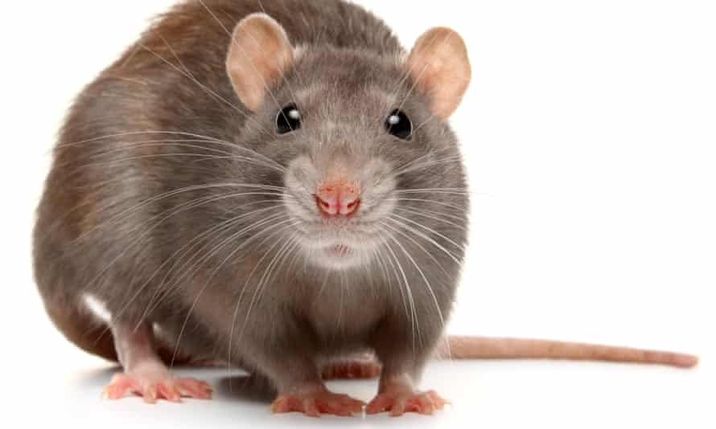
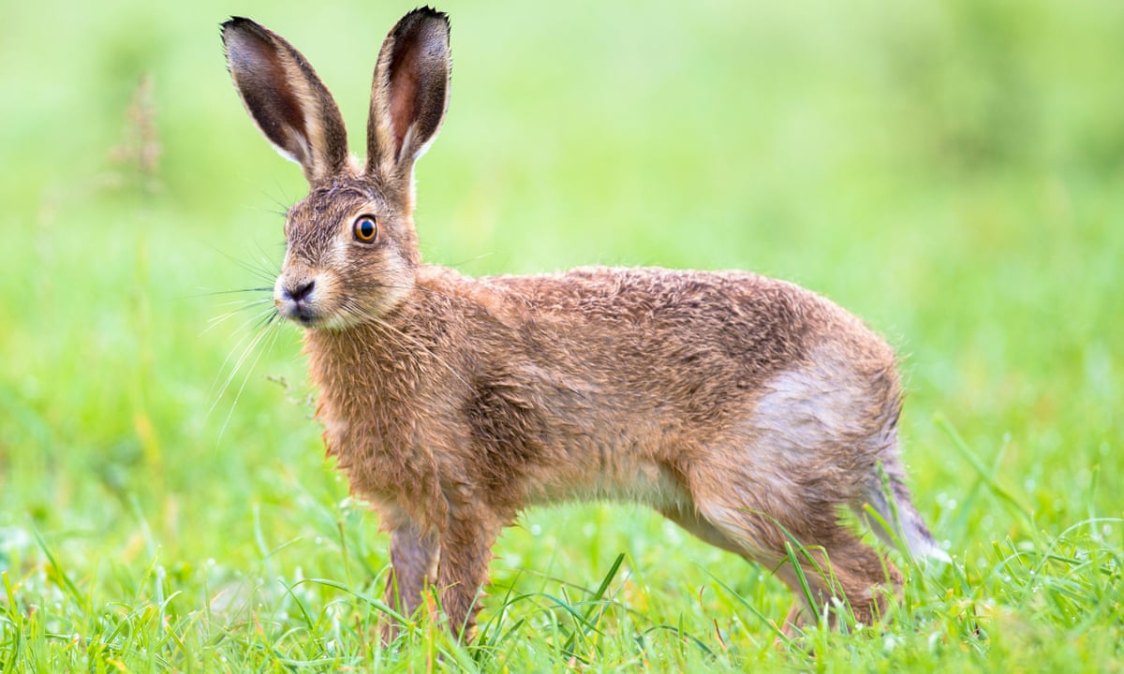
MAMMALS
ORDER 4: MACROSCELIDEA (ELEPHANT SHREWS or SENGIS)
ORDER 5: LAGOMORPHA (HARE)
ORDER 6: RODENTIA (RODENTS)
ORDER 7: CARNIVORA (CARNIVORES- Hyena, lion, jackal etc)
ORDER 8: PHOLIDOTA (SCALY-ANEATERS)
ORDER 9: TUBULIDENTATA (AARDVARK)

Slide 4
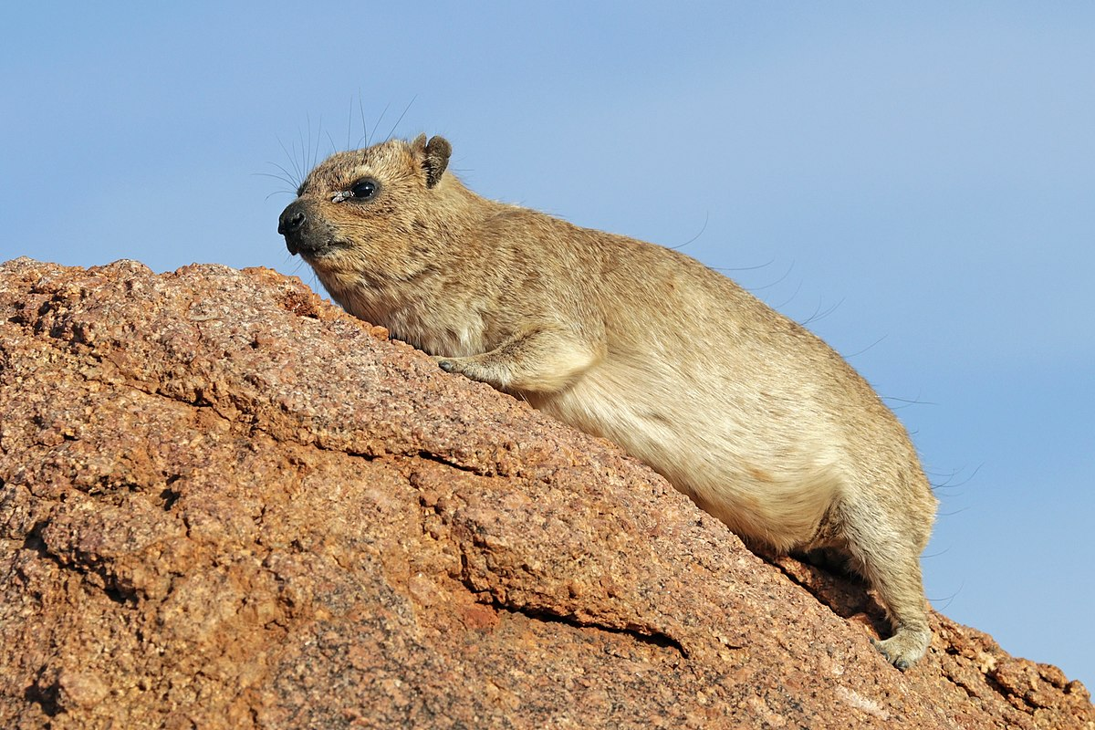
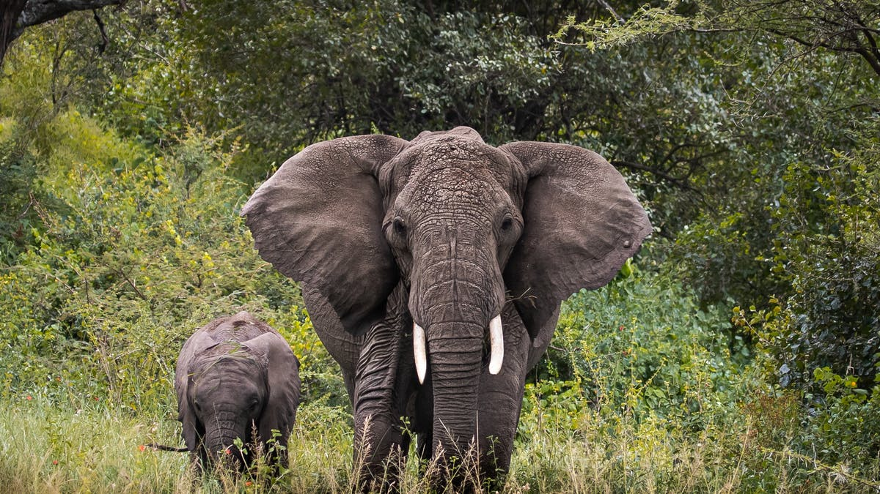
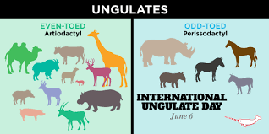
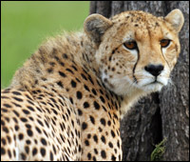
MAMMALS
ORDER 10: HYRACOIDEA (HYRAXES)
ORDER 11: PROBOCIDEA (PROBOCIDS- Elephants)
ORDER 12: PERISSOODACTYLA (ODD-TOED UNGULATES)
ORDER 13: ARTIODACTYLA (EVEN-TOED UNGULATES- goats, horses, cows, pigs etc)

Slide 5
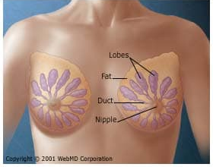
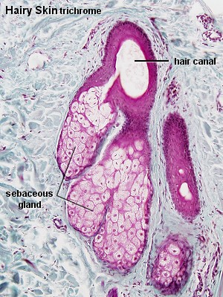
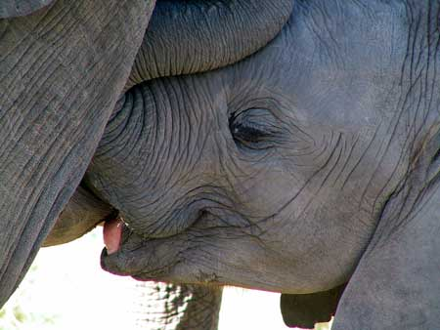
Mammals
Features Shared by Mammals:
1) Lactation:
Mammary glands → milk for feeding the young
Benefits = Production of offspring dissociated from seasonal food supply
Females need not rely on paternal care (Males - who needs them…)
Viviparity less strenuous (young born underdeveloped…)
Evolution of Lactation:
Mammary glands similar to sebaceous glands (hair follicles)
1) Glands secreted pheromones – offspring → mother recognition
2) Glands secreted anti-microbial proteins; protected eggs in nest
Suckling = unique mammalian feature
Fleshy seal (tongue / epiglottis)
Allow for breathing while suckling

Slide 6
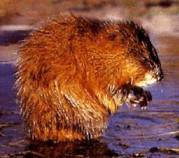
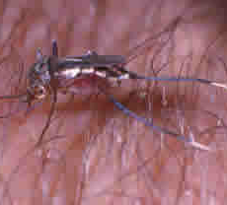
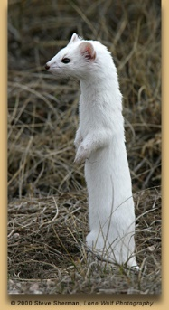
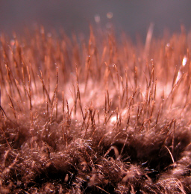
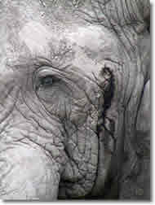
Mammals
Features Shared by Mammals:
2) Hair (Fur = hairy covering):
Composed of keratin; functions in insulation, communication, and sensation
Color = quality / quantity of melanin placed in developing hair
Replacement = continued growth / molting (loss & replacement of hairs)
Hypothesized origin of fur:
Sensory bristles between “reptilian” scales
Bristles increased in size; scales decreased in size
Guard hairs (protective – longer / stronger); underfur (insulation)
3) Skin: Specialized Glands in skin
A) Sweat Glands – release water on skin for cooling (evaporation)
B) Apocrine Glands – Scent; pheromonal signals
C) Sebaceous Glands – lubricate fur / hairs & protect skin

Slide 7
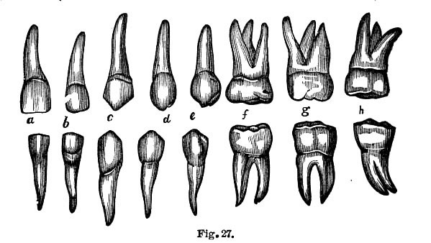
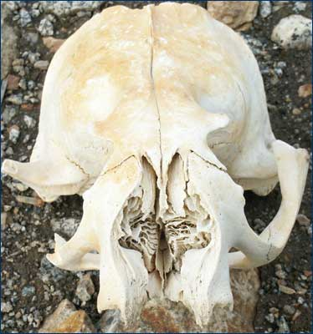
Mammals
Features Shared by Mammals:
4) Teeth Features:
Heterodonts: Elaborate shapes / functions within single species
Increased dietary specializations
Multicuspid – broader / flatter
Diphyodonts: 2 sets of teeth; no continuous replacement
Allows for continual occlusion (contact between upper / lower teeth)
Allows for crushing / grinding food (mastication = chewing)
5) Turbinates (Nasal Conchae) in Nasal Cavity:
Whorls (twist) of bones covered with mucous epithelium
Adds moisture to air (prevents desiccation of lungs)
Warms air (prevents loss of body heat)
3) Improves filtering of air to keep airways clean (mucus)
4) Increases sense of smell (↑ surface area)

Slide 8
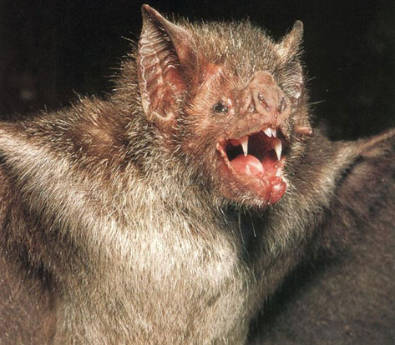
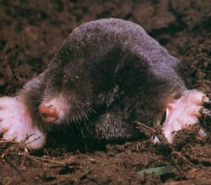
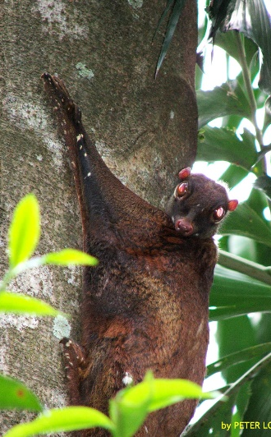
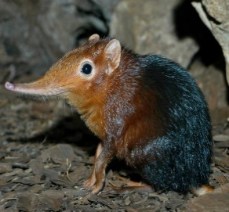
Three Broad Groups of Mammals (Small mammals, medium-sized mammals and large mammals).
Small mammals
Small mammals are divided into small terrestrial and volant mammals (bats).
Usually smaller than the largest rodents (capybara, nutria, grasscutter) or lagomorphs (hares, rabbits and pikas).
Although some authors include all mammal species whose weight or size are less than a hare (3-5 kg).
Chiroptera
Only flying mammals
Echolocation
(bats)
Insectivora
Primitive characteristics
Morphologically diverse
(e.g., mole, shrew, colugo)

Slide 9
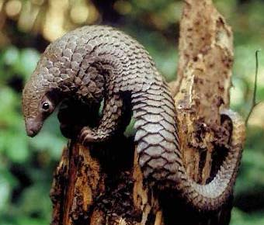
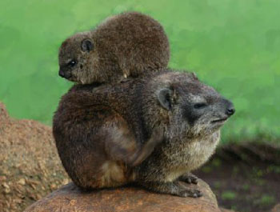
Three Broad Groups of Mammals (Small mammals, medium-sized mammals and large mammals).
Medium Size Mammals
They are small carnivores, small primates, large rodents, hyraxes, pangolins etc
These are not adequately covered by small mammal trapping arrays
They require larger traps or other traps such as camera traps.
Pholidota
Overlapping scales
(scaly anteaters)
Hyracoidea
closest relative = elephant
(Hyrax)

Slide 10
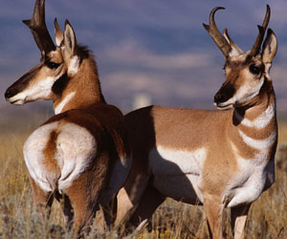
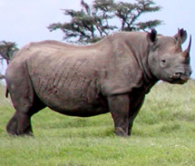
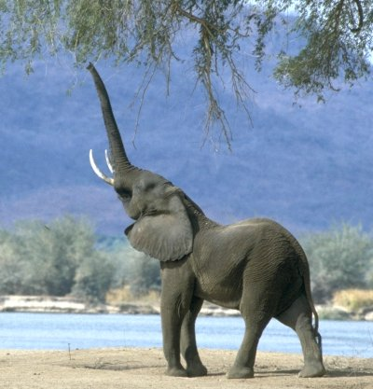
Three Broad Groups of Mammals (Small mammals, medium-sized mammals and large mammals).
Large Mammals
Large mammals include:
Most ungulates, diurnal primates, most carnivores larger than a fox or house cat
They are all perissodactyls (horses, rhinos, tapirs) and artiodactyls (including the relatively small duikers).
Artiodactyla
“even-toed”
Ruminating stomachs
(e.g., pigs, deer, hippopotamuses)
Perissodactyla
“odd-toed”
Hindgut fermenters
(e.g., horses, tapirs, rhinoceroses)
Proboscidea
Largest terrestrial mammals
(elephants)

Slide 11
Field Techniques: Observations, Species Identification, Field Notes and GPS
Observational Techniques
Field observation is necessary too learn about habits and behavior of a species of mammal,
Observation may include their normal activities under natural circumstances.
Observing mammals is not as easy as it sounds.
Most mammal species are secretive and nocturnal.
Many species are also small, inconspicuous, or fossorial (living underground).
Consequently, they often escape detection by human observers.

Slide 12
If we simply need to determine whether a particular species is present in a certain area, or utilizes a certain type of habitat, it is not always necessary to directly observe it.
Tracks, scat (scout), burrows, or other evidence can confirm its presence.
Muddy soil, sand, trails, and streamside habitat are often good places to look for the tracks of mammals.

Slide 13
Some popular methods include setting up arrays of live traps (or mist nets if the target species are bats),
walking or driving line transects, spotlighting mammals at night, playing tapes of calls and monitoring responses, and setting up bait stations equipped with trip cameras or a medium that records the tracks of mammals that visit the station.
While survey methods are useful for identifying habitat associations and relative abundances of species, they only permit brief glimpses of behaviors such as foraging patterns and social interactions.

Slide 14
FIELD NOTEBOOKS
Field observations of mammal species should be recorded in a field notebook.
A field note-book can be any type of notepad suitable for use in field conditions.
Ideally it should have bound waterproof pages and a protective cover.
Rite-in-the-rain notebooks and pens are perfect for taking field
Observations should be written in waterproof ink or pencil.
Waterproof ink is preferable because it doesn’t smudge or fade over time.

Slide 15
Site: |  | Observer: |  | Date:
No. of Observation | Time | Species | No. of Individuals | Location | Habitat
Record of Species
Detected During the
Visual Survey
Site: Location: |  | Observer: Trap type: |  | Date: Time:
Trap No. | Microhabitat description | Species | Age-class/Sex | sex | comments
Terrestrial
mammal trapping
data sheet
DATA SHEET

Slide 16
1. BOX TRAPS (Life Traps)
Box traps are the most effective way to capture small terrestrial mammals without harming them.
Box traps have a trip pan that causes spring-loaded doors at one or both ends of the trap to close when an animal touches it.
For optimal results, baits should be placed on the trip pan. Most small mammals can spend several hours in a box
Box traps come in a variety of styles and sizes.
The type of trap used should be appropriate for the species that are expected to be captured. Popular U.S. brands include the Sherman and Tomahawk traps. Havahart humane traps.

Slide 17
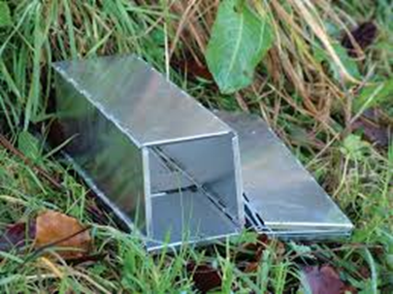
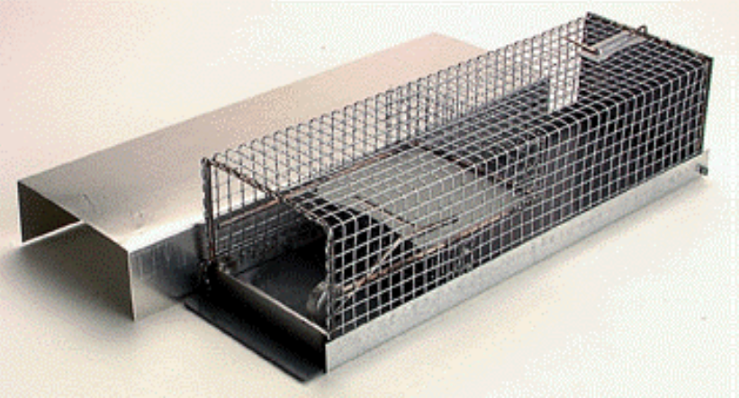
Sherman Trap
Ugglan Trap

Slide 18
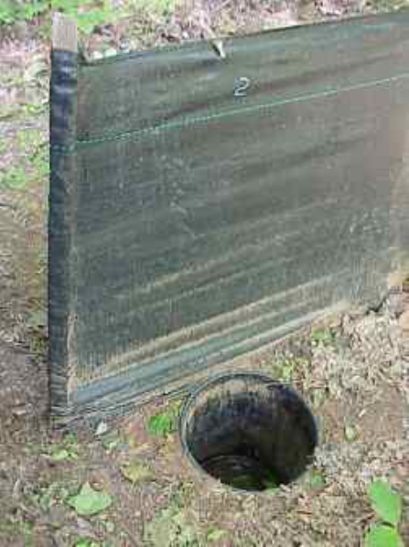
Pitfall trap
These are containers sunk into the ground where animals will fall and become trapped.
The traps can be constructed from readily available materials such as tin cans or plastic buckets.
Unbaited traps need regular checking as the captive is deprived of food, water and risk predation.
The traps can be closed off with lids and re-opened at a later date.

Slide 19
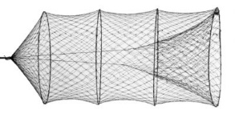
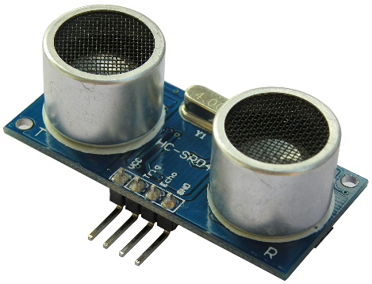
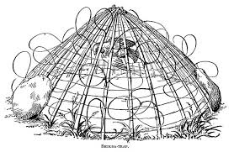
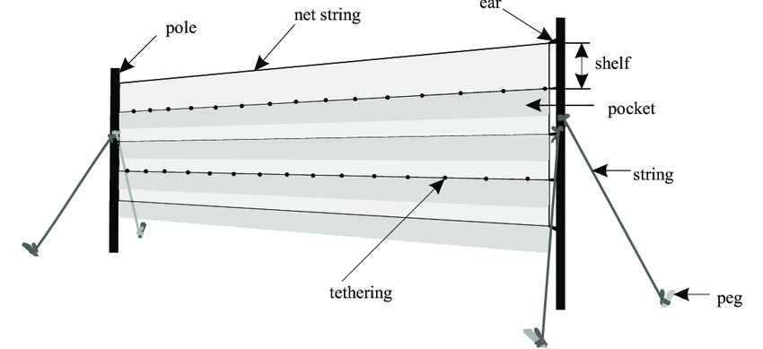
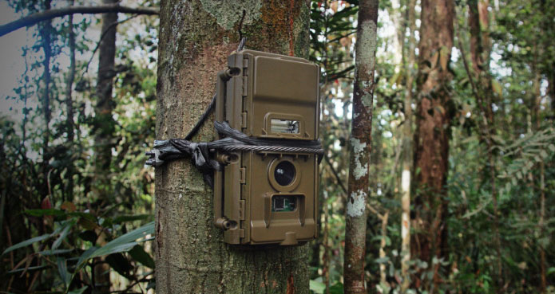
Mist nets
Hand capture
Noose trap
Bucket trap
Camera trap
Sound detection

