Slide 1
BIODIVERSITY ASSESSMENT TRAINING
FOR OKOMU NATIONAL PARK SUPPORT ZONE COMMUNITIES’ VOLUNTEERS
POWERED BY: SUSTAINABILITY AND CONSERVATION EDUCATION FOR RURAL AREAS (SCERA)

Slide 2
VEGETATION SAMPLING

Slide 3
Vegetation ecology
Vegetation- known as plant communities
Vegetation changes are often obvious to a casual observer
Spatial changes in species composition
Changes in spacing and height of plants
Changes in growth form
Changes in life form
Seasonal plant responses
Vegetation parameters for defining plant communities
Growth form
Life form
Species dominance
Presence and absence of some diagnostic species

Slide 4
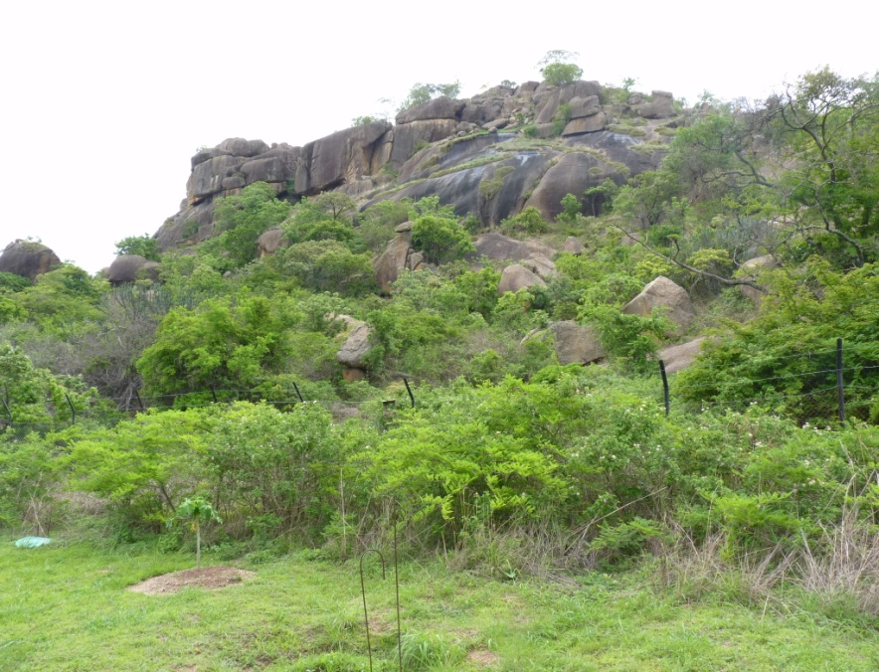
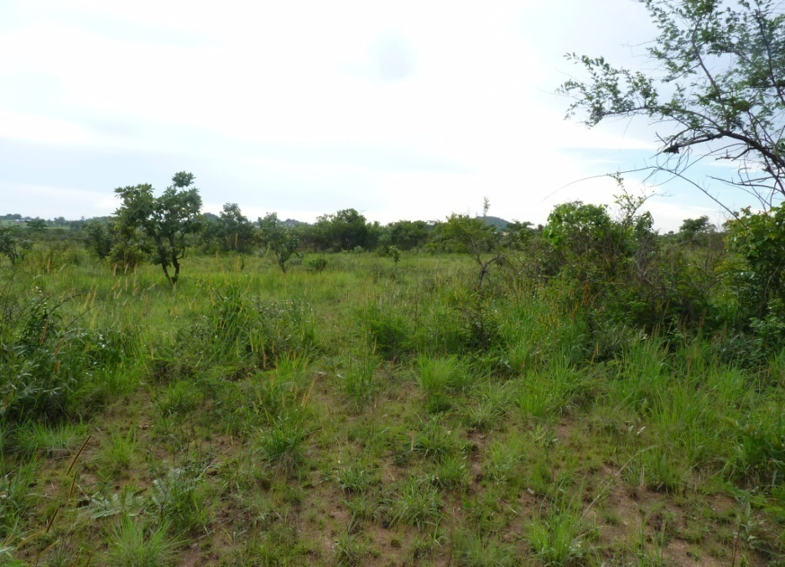
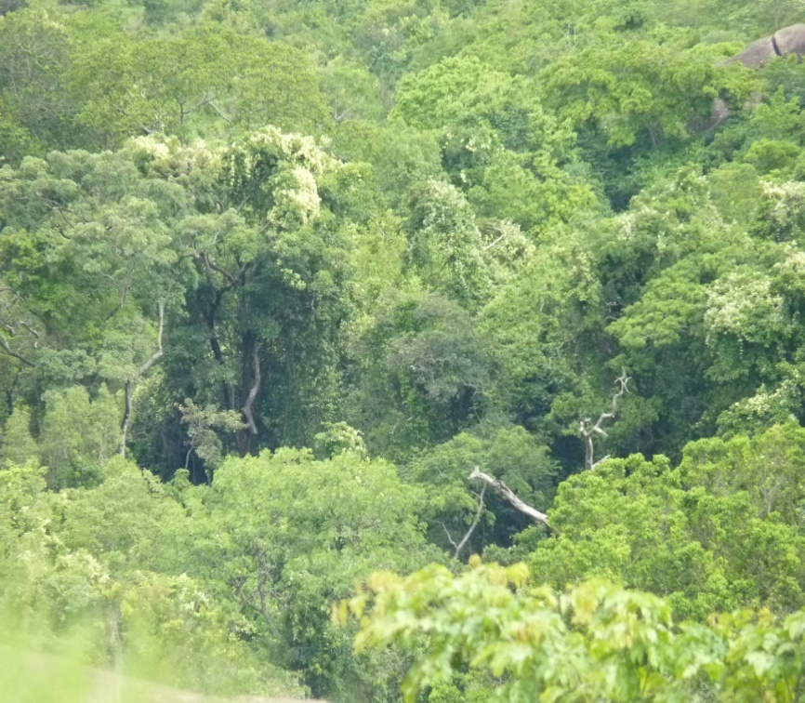
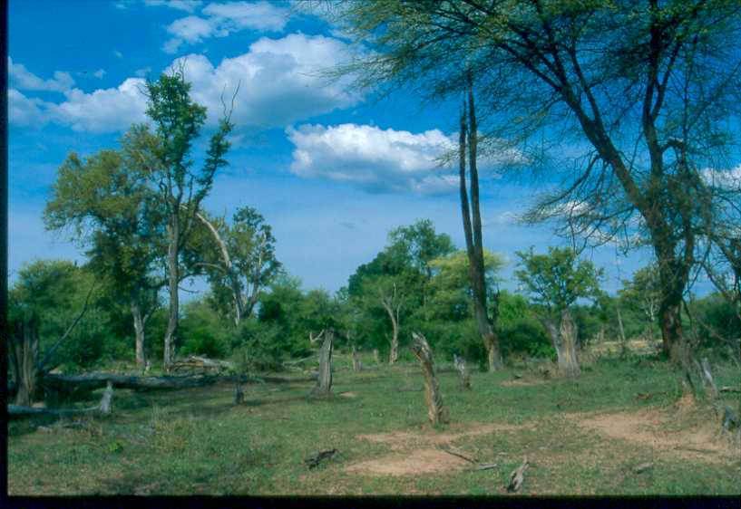

Slide 5
Vegetation sampling
Introduction
Description and investigation of plant communities
Sampled through analysis of representative subareas
Why sampling?
Too tedious to cover 100% of vegetation segments
Description must be based on samples

Slide 6
Steps in vegetation sampling
Segmentation or recognition of entities (what to study)
Selection of samples in the recognized entities
Size and shape of the sample should take
What to record within the sample/plots

Slide 7
Selection of sample stands
Random sampling
Systematic random sampling
Stratified sampling

Slide 8
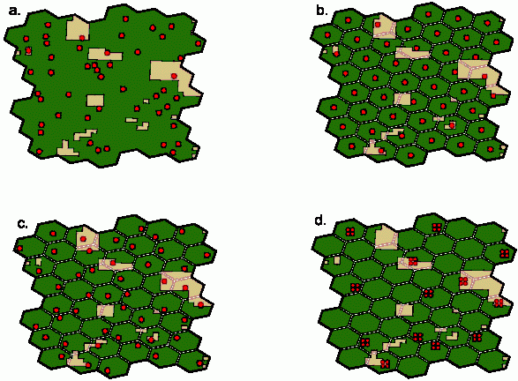
Figure 1. (a) simple random sample design, (b) aligned systematic sample design, (c) unaligned systematic sample design, (d) unaligned, clustered, systematic sample

Slide 9
Vegetation measurement techniques
Plot method: Count plot
Quadrat
Rectangular or square plots
Circular plots
Belt transects
Plotless method: Distance measurement
Point centred quarter
Nearest neighbor
Nearest individual

Slide 10
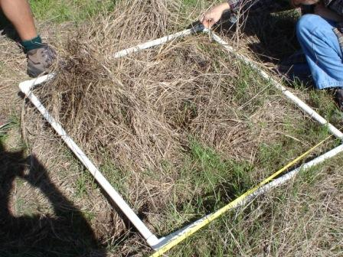
Quadrat or plot
A quadrat is typically a square frame constructed of plastic or pvc pipe, metal rod, or wood that is placed directly on top of the vegetation. Quadrats are also commonly called "plots."

Slide 11
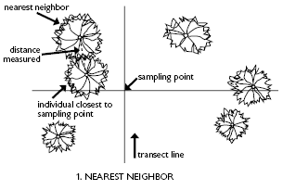
Nearest neighbor
The nearest tree to the point is selected and the distance between it and its nearest neighbor is measured

Slide 12
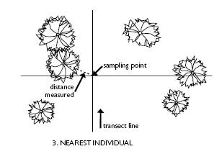
Nearest individual
Measure distance to the nearest tree at each point

Slide 13
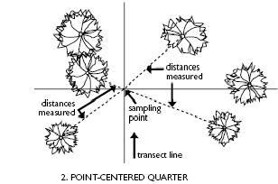
Pont-centered quarter
A pair of perpendicular lines are erected at the random point, forming a cross with four quadrants. The distances to the nearest tree in each quadrant are measured.

Slide 14
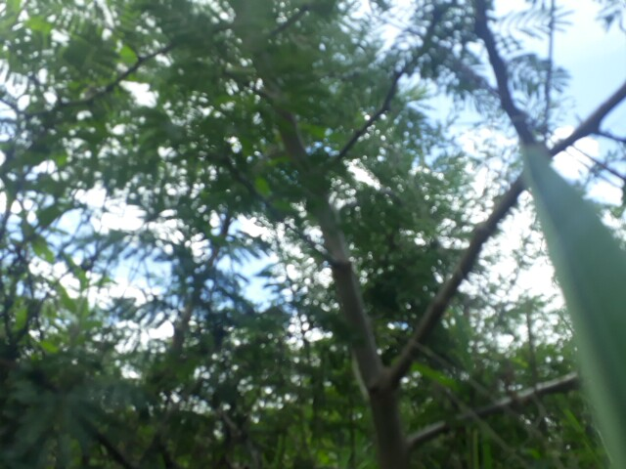
Plant cover measurement
Ground cover includes litter cover, grass cover, bare ground,
Canopy cover/leave area index
Diameter at breast height (DBH)
Basal cover

Slide 15
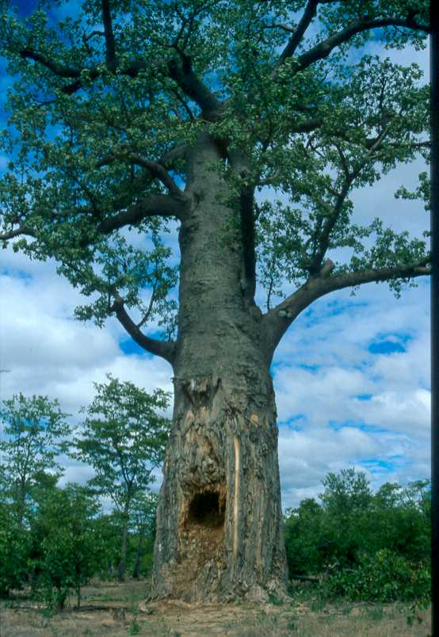
Plant checklist
Plant identification
Species abundance
Species diversity

