Slide 1
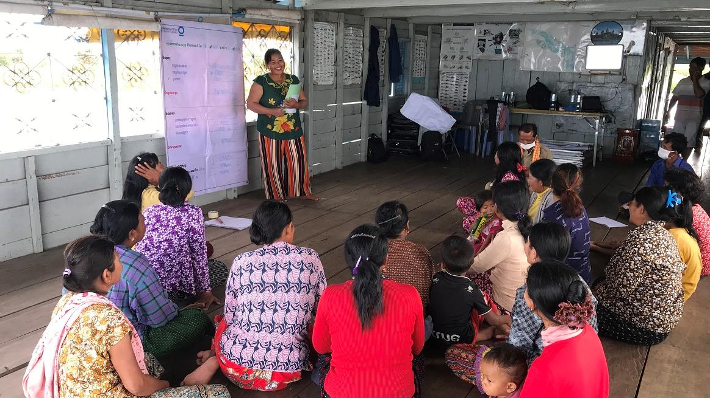
Women’s savings group meeting in Ou Akol, Cambodia. © Sokrith Heng, Conservation International
Empowering women in conservation
KNOWLEDGE PRODUCT
Keiruna
inc
TRAINING MODULES

Slide 2
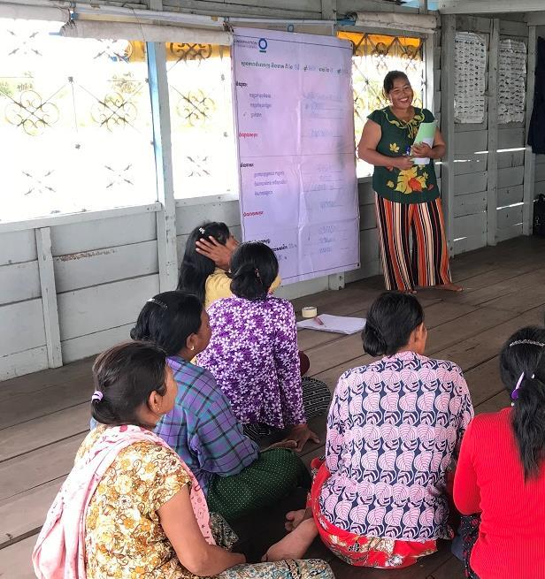
About
This knowledge product is based on experiences of CEPF Grantees in the Indo-Burma Hotspot, and is meant to provide useful information and guidelines for supporting women in conservation. Licensed under CC BY-NC 4.0.
Funded as a part of the CEPF "Building on Success" learning resource series, which aims to promote effective conservation practices across the planet.
Empowering women in conservation
How to use this knowledge product
This is a training with 3 modules that can be self-guided or delivered by a trainer to a group, with extra explanations in the optional Training Script document.
For more in-depth information on any of the topics covered, there are many useful references available, including those in the Annex (Further Learning).
CEPF is a joint initiative of l’Agence Française de Développement, Conservation International, the European Union, the Global Environment Facility, the Government of Japan and the World Bank.
Published 2021 | Author: Tara Sayuri Whitty, PhD. @ Keiruna Inc

Slide 3
EMPOWERING WOMEN IN CONSERVATION
Modules
Module 1
Module 2
Module 3
Annex
Why gender is important in conservation
Context, Rationale, and Key Considerations
Framework:
Working to empower women in conservation
Ways of thinking & Working in projects
Further learning:
Useful resources

Slide 4
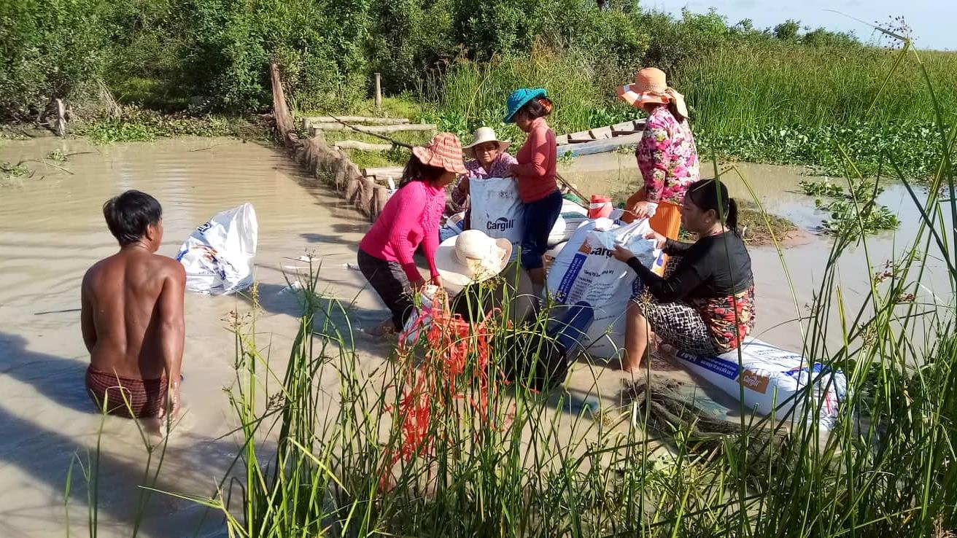
EMPOWERING WOMEN IN CONSERVATION
Ou Akol Women’s Group helping to repair a fisheries management barrage in Cambodia. © Conservation International
Module 2
Framework: Working to Empower Women in Conservation

Slide 5
MODULE 2 | FRAMEWORK
How can women’s involvement continue and grow into the future?
This framework is one way to guide how you think about gender mainstreaming in your projects.
We explain it with some examples from organizations and projects in the Indo-Burma Hotspot
How can we promote & support more meaningful inclusion of women?
What is the current situation for women here?
How can we make it more possible for women to be involved?
How can we build capacity for women’s involvement?
Goal: Women are actively involved in conservation

Slide 6
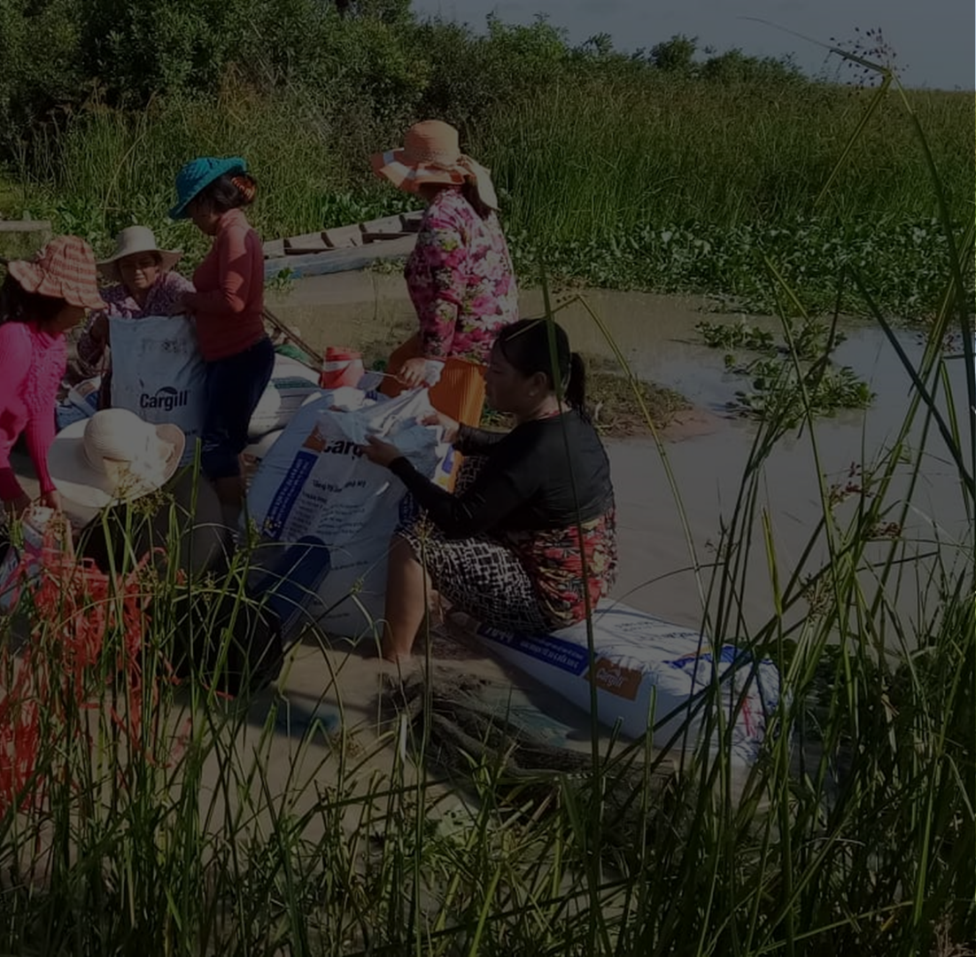
MODULE 2 | FRAMEWORK
Women’s involvement as a goal
How can women’s involvement continue and grow into the future?
Institutions & projects can develop goals for women’s involvement in conservation, including any policies, objectives, and guiding principles
How can we promote & support more meaningful inclusion of women?
Your goals for gender inclusion in conservation might be motivated by:
Your belief that women should be included
Your organization’s gender policy
Your donor/funding source’s requirements and interests
Your project community’s interests
No matter what the motivation is, it is important for your organization to clearly understand why involving women in conservation is important, and what your specific goals are for promoting gender inclusion in your work
What is the current situation for women here?
How can we make it more possible for women to be involved?
How can we build capacity for women’s involvement?
Goal: Women are actively involved in conservation

Slide 7
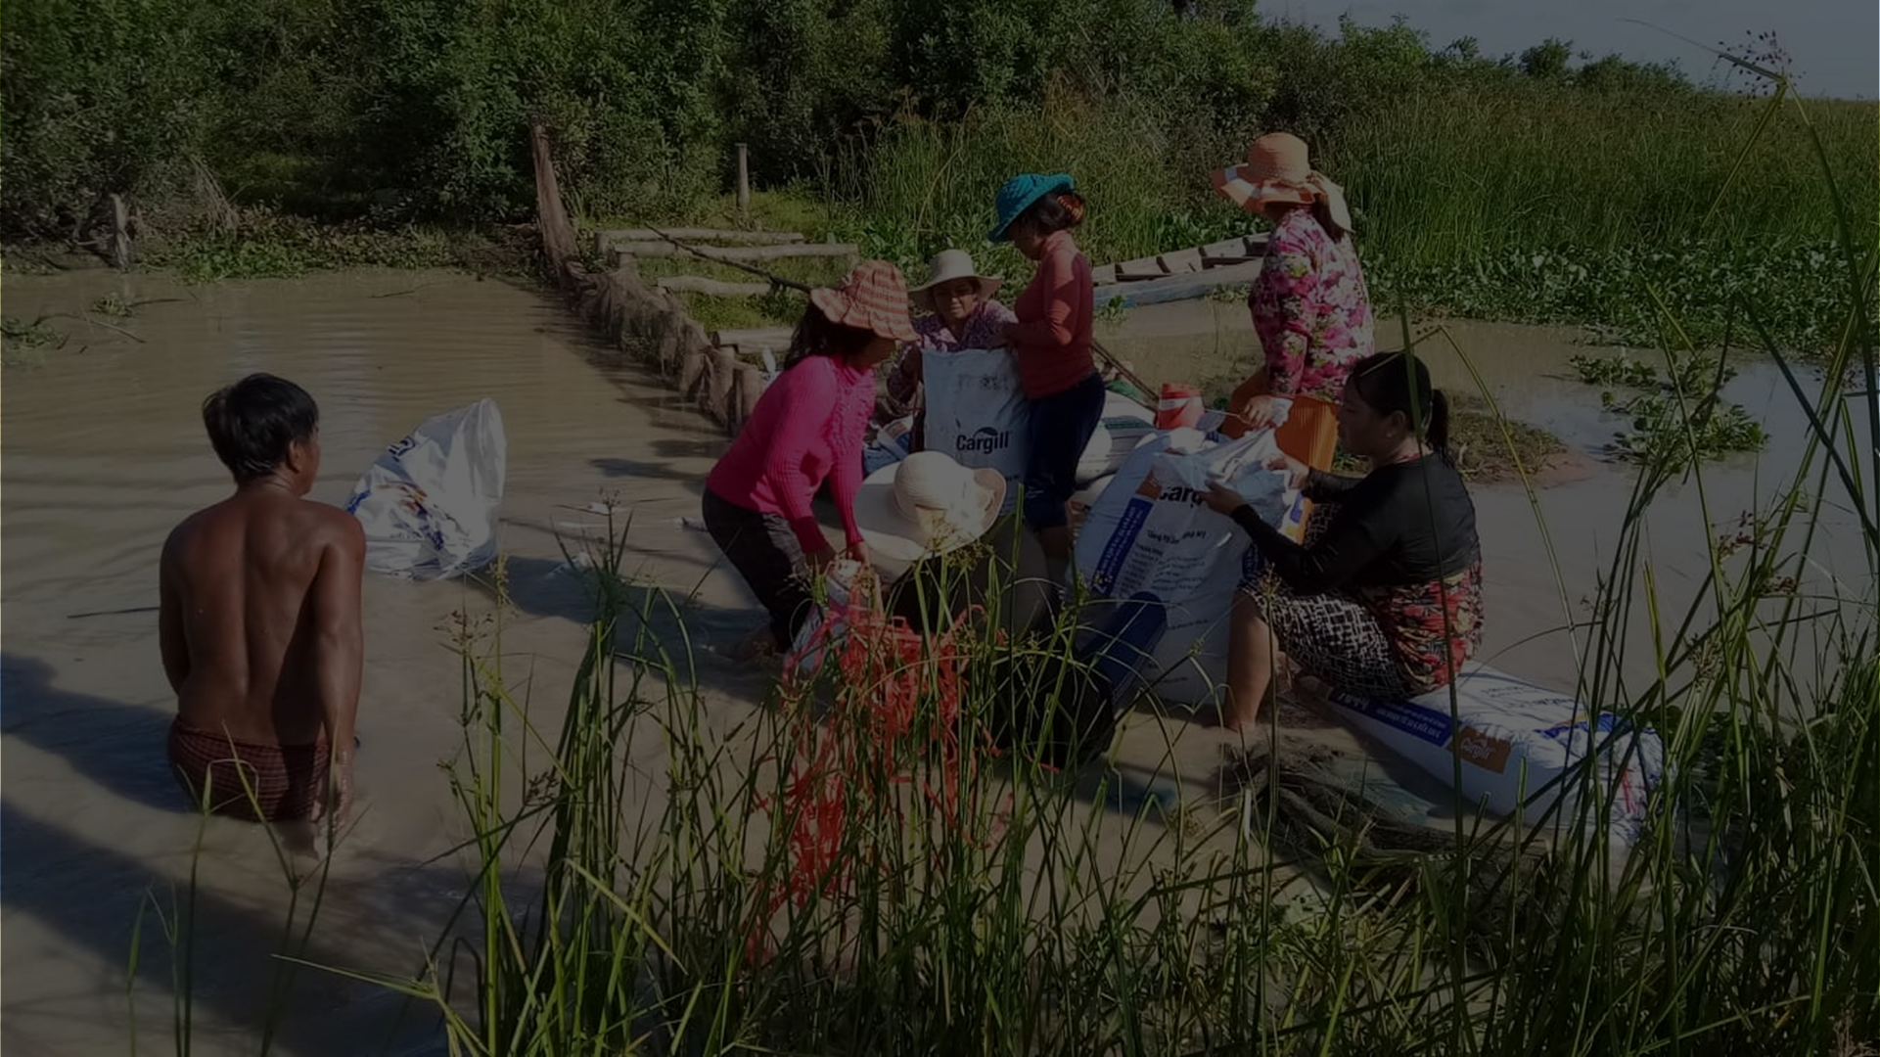
MODULE 2 | FRAMEWORK
Identifying goals
Connecting goals to actions
What gender-related goals/requirements do you need to include in your work?
What national policies related to gender must be incorporated in your organization and project?
If there are no gender-related goals for your project or organization, how will you work to develop them?
Does your team understand these goals and policies, and why they are relevant to your work?
Are your project and organization gender goals linked to clear, feasible objectives?
How will you assess whether you have achieved any of these goals?
Your organization’s goals and policies
Gender-related goals for your projects
Requirements from donors/funding sources for gender-related work
National policies that support or mandate women’s involvement and rights in conservation (and more generally in communities, education, employment)
Gender-related policies and strategies from any platforms, networks, consortium that you work with

Slide 8
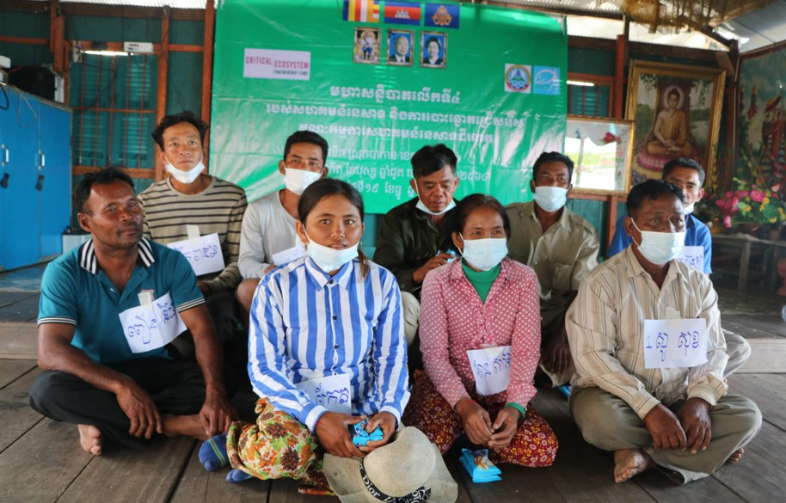
Examples
MODULE 2 | FRAMEWORK
National policy
Cambodia:
Organizations must provide maternity leave for female staff
Gender Mainstreaming Policy and Strategy in Fisheries Sector endorsed by Fisheries Administration, for “enhancement of gender equality in the fisheries sector through active cooperation of both women and men...”
Promoting gender policy development
In Cambodia, Fisheries Action Coalition Team (FACT) encouraged Community Fisheries Committees to develop gender policy about composition of committees and to also highlight the importance of women in natural resource management
Elected Community Fishery Committee members. © FACT

Slide 9
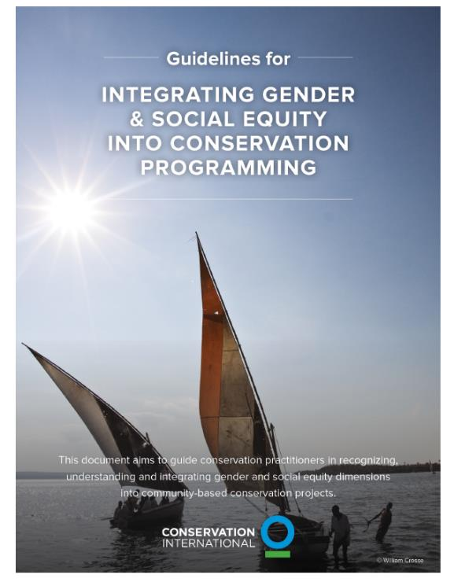
Examples
MODULE 2 | FRAMEWORK
Organizations’ Strategies + Policies
Highlander Association (HA) in Cambodia:
Gender policy with goal for equal (50:50) gender representation in activities + promoting women in leadership positions
Strategy from 2021-2025 includes goal of more women involved in decision-making
My Village in Cambodia developed a gender policy to guide staff on how to involve women & men in project management cycle
3S Rivers Protection Network (3SPN) in Thailand: Gender policy includes considering gender in staff recruitment, projects, and M&E, and how to apply their budget to gender mainstreaming
Conservation International’s guidelines for integrating gender equity in conservation projects

Slide 10
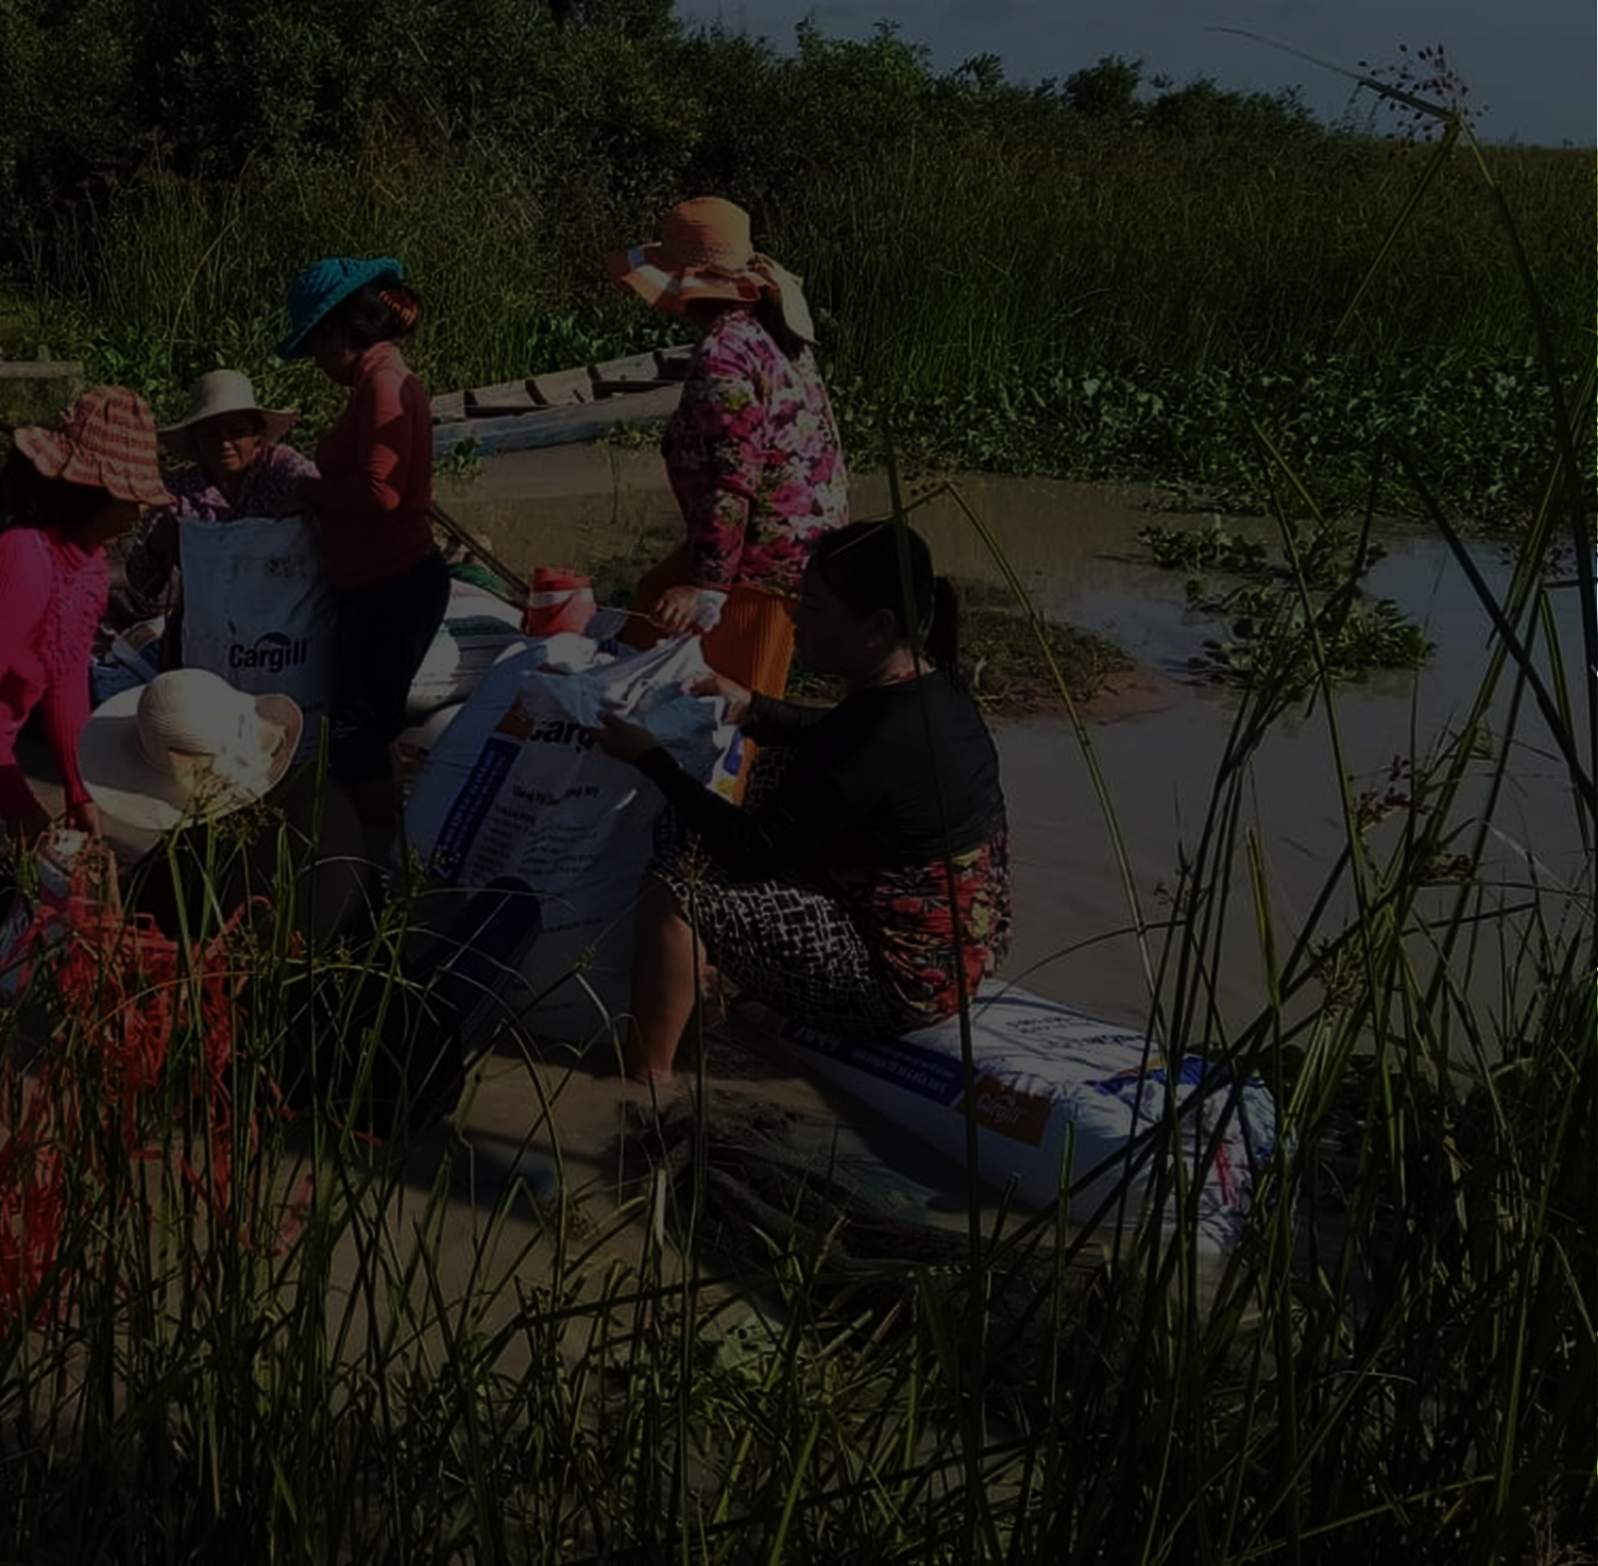
MODULE 2 | FRAMEWORK
Making involvement in conservation more accessible to women
How can women’s involvement continue and grow into the future?
How can we promote & support more meaningful inclusion of women?
Understanding the current context of gender and conservation
Working to create an enabling environment in communities and institutions
Building capacity for women’s involvement
What is the current situation for women here?
How can we make it more possible for women to be involved?
How can we build capacity for women’s involvement?
Goal: Women are actively involved in conservation

Slide 11
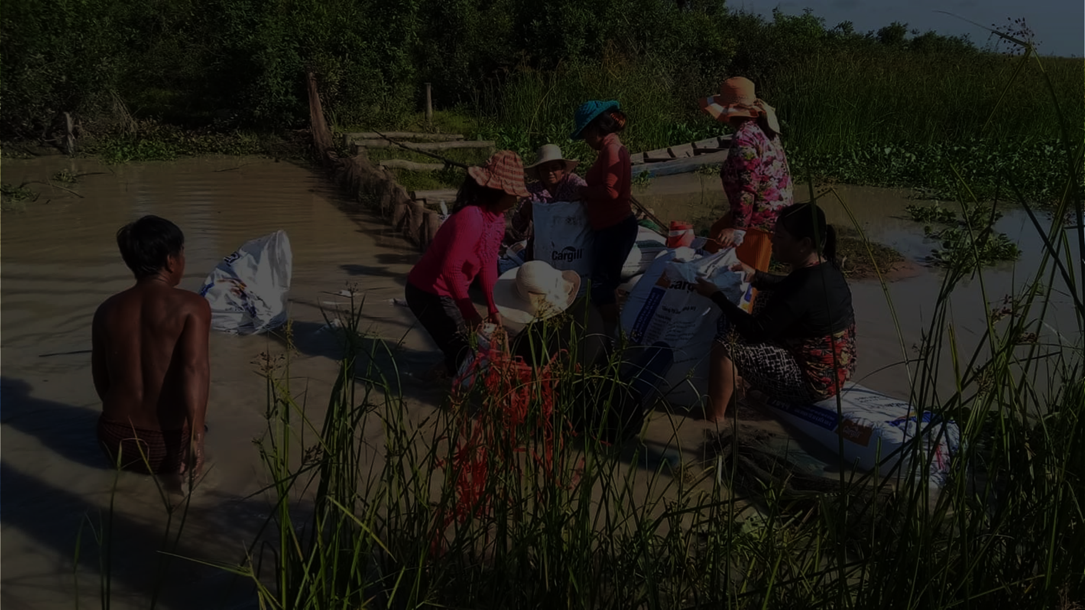
MODULE 2 | FRAMEWORK
GENDER CONTEXT
What women currently do (& why) +
what they could potentially do
Understanding the current context of gender and conservation
This helps you understand:
Women’s roles in their communities and households
Women’s involvement in conservation
Barriers to women’s involvement
Opportunities for further involvement
Support needs for empowerment

Slide 12
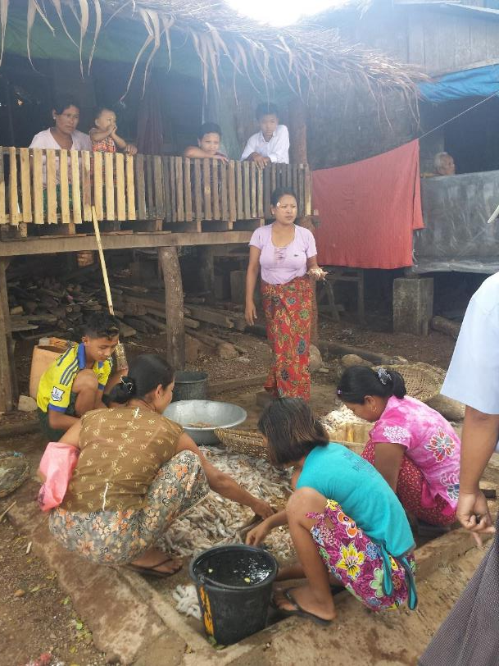
MODULE 2 | FRAMEWORK
GENDER CONTEXT
In many rural communities in the Indo-Burma Hotspot, including indigenous communities:
Gender norms:
Women are supposed to focus on household duties + childcare
Being involved in activities outside of household duties + outside of the community is discouraged
Common conditions:
Women have less access to education than men and relatively low literacy
Unequal employment opportunities
Women feel shy/reluctant to actively participate or speak up
Women are especially vulnerable to land loss – collecting water, plants, and firewood as women’s job
Women sorting through fish catch & tending to children in Mon State, Myanmar. © TSWhitty

Slide 13
MODULE 2 | FRAMEWORK
GENDER CONTEXT
We found that women were very influential as communicators, using a more diplomatic and less confrontational approach than men. It was useful to have men and women involved in designing management activities and approaches, since they brought up different perspectives
WorldFish | Cambodia
Women also have existing + potential strengths in their skills, knowledge, and experience that can contribute to conservation efforts
Within households, women can play active roles – managing household finances
Women are highly involved in work in market chains related to natural resources
Women are seen as strong with financial management, transparency, and accountability, so engaging them in financial positions is a good first step. The project chose to engage women based on their current roles (secretarial and finance) as a starting point for building toward more leadership roles.
FACT | Cambodia

Slide 14
MODULE 2 | FRAMEWORK
GENDER CONTEXT
GENDER ANALYSIS
What women currently do (& why) +
what they could potentially do
Assessment of gender norms & gender roles in households, communities, and specific areas of work (e.g., conservation)
“The process of collecting and interpreting information on the respective roles and responsibilities among women and men in six domains of activity:
One definition:
practices and participation
access to resources
knowledge and beliefs
laws
policies
and regulatory institutions.”
CEPF Gender Toolkit

Slide 15
MODULE 2 | FRAMEWORK
GENDER ANALYSIS
COMMON ELEMENTS INCLUDE:
Gender norms
Perspectives on what women & men should do and can do
Barriers to greater involvement in conservation
Social norms that limit women’s participation?
Logistics – not enough time, limited means of transportation, etc.?
Safety concerns?
Limited skills and confidence?
Gender roles in households & communities (and/or organizations, positions of influence)
Gender roles & experiences in natural resource use and management/ conservation
Opportunities for greater involvement
Possible areas where women could be involved (and what support is needed)
Areas where women are interested in being involved
Means of mitigating barriers & increasing women’s involvement without “causing harm”
Policy support for gender equity
Skills, experience, knowledge
Existing skills, experience, and knowledge from their activities, roles
Potential skills and knowledge that are still needed for greater involvement

Slide 16
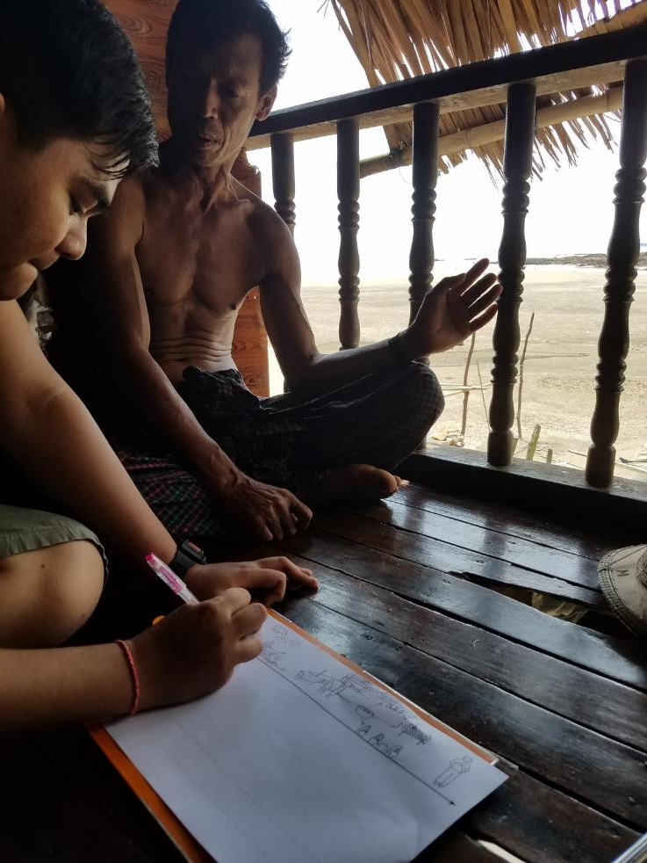
MODULE 2 | FRAMEWORK
GENDER ANALYSIS
Can be conducted through
Interviews
Focus Group Discussions
Reviewing existing data and reports
IMPORTANT CONSIDERATION:
Collect information that is representative of the community
→ men, women, boys, girls of different ethnicities, religions, socioeconomic status, etc.
Documenting men’s and women’s daily fisheries-related activities and experiences in Mon State, Myanmar © TSWhitty

Slide 17
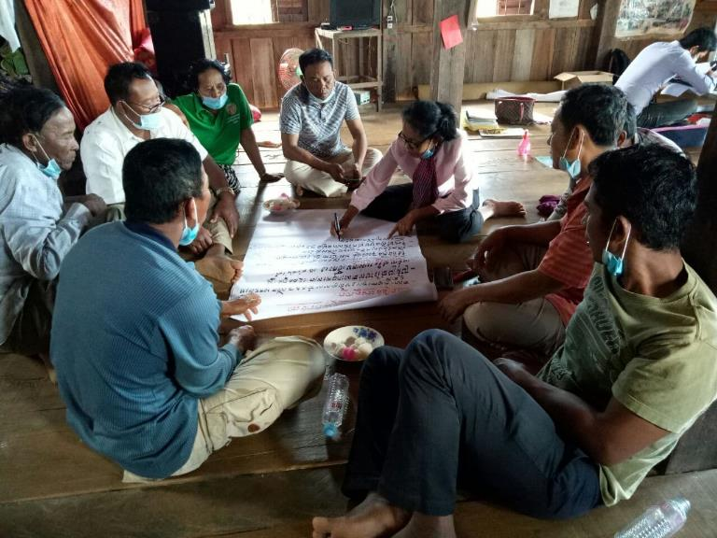
MODULE 2 | FRAMEWORK
how to conduct a
GENDER ANALYSIS
1
Identify your key gender questions – what you need to know in order to better support women’s involvement
There are many approaches, but generally:
2
Review any existing reports or data related to gender roles in households, communities, livelihoods, etc.
3
Choose your methods/toolkits, making sure to adapt to your project
4
Select a representative sample of community members to interview or to join Focus Group Discussions
Women-led discussion to reflect on progress of community fisheries management and fisheries resource conservation. © FACT
5
Analyze the data to synthesize answers to your key questions

Slide 18
MODULE 2 | FRAMEWORK
some tools for
GENDER ANALYSIS
Questionnaire about norms, roles
Resource mapping
Interview + Discussion guides
Structured questionnaire asking about expectations and roles of women, men, girls, boys in the community + natural resource use and management
Making maps of the resources used by women & men – including labeling the resources, how they are used, & by whom
Open questions and/or a list of topics to guide more detailed interviews or group discussions about gender norms, issues, experiences
Seasonal calendar
Journey mapping
Outlining the different activities of women & men over the seasons – since natural resource use often changes with seasons, so do people’s activities
Documenting how women & men experience their days or certain processes (e.g., the process from fishing to selling fish products), including their activities and feelings

Slide 19
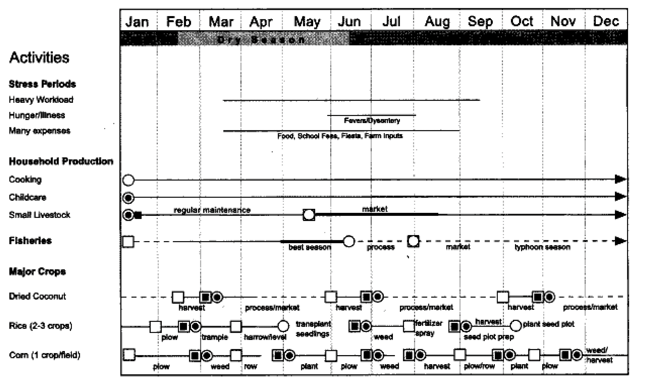
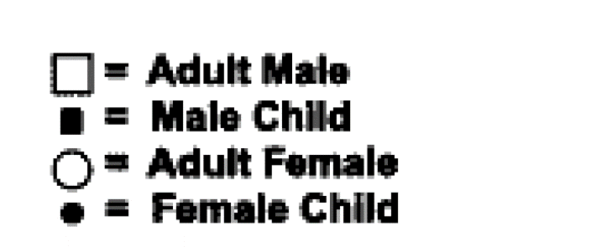
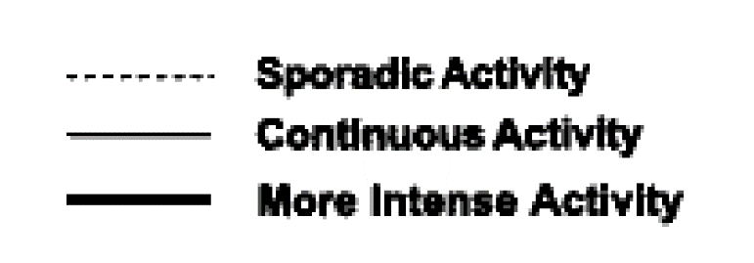
Seasonal calendar
MODULE 2 | FRAMEWORK
Outlining the different activities of women & men over the seasons – since natural resource use often changes with seasons, so do people’s activities
EXAMPLE:
This seasonal calendar documents the activities of men, women, boys, and girls related to household duties, fisheries, and agriculture.
Men’s activities are marked with a white square at the beginning, women’s with a white circle – the line indicates the intensity of their activities.
Notes on the type of activity are also added.

Slide 20
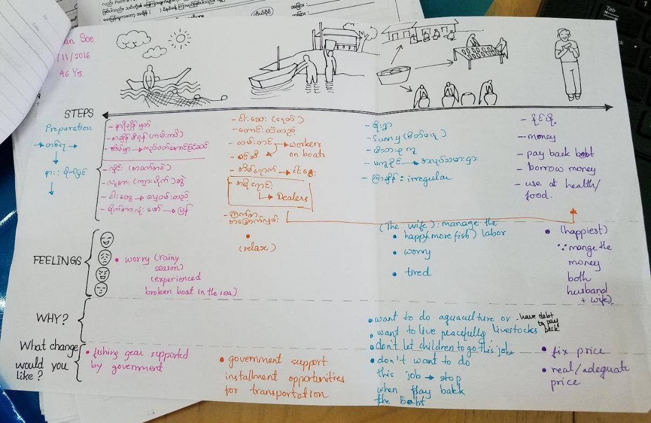
Journey mapping
Documenting how women & men experience their days or certain processes (e.g., the process from fishing to selling fish products), including their activities and feelings
MODULE 2 | FRAMEWORK
EXAMPLE:
This Journey Map sheet asked interview respondents to describe their activities, feelings (& why), and adesired changes during different fisheries activities:
Going out to fish
Unloading catch
Processing fish products
Selling fish and fish products
It was used to understand different experiences of men & women in fisheries in Mon State, Myanmar
Journey Map for fisheries research in Mon State, Myanmar. © TSWhitty

Slide 21
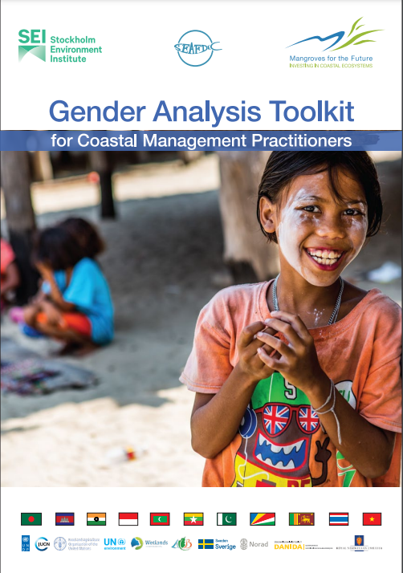
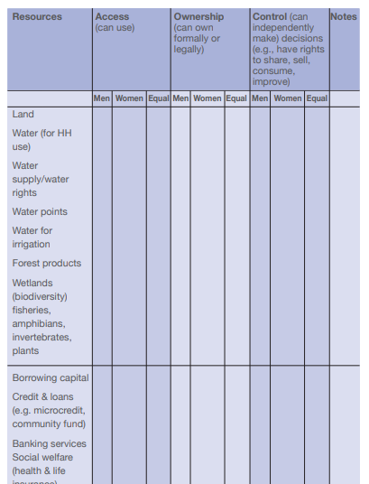
Questionnaire about norms, roles
Interview + Discussion guides
Structured questionnaire asking about expectations and roles of women, men, girls, boys in the community + natural resource use and management
Open questions and/or a list of topics to guide more detailed interviews or group discussions about gender norms, issues, experiences
MODULE 2 | FRAMEWORK
EXAMPLE:
The Mangroves for the Future Gender Analysis Toolkit for Coastal Management Practitioners
This toolkit is an excellent guide through the gender analysis process, and includes interview guides and templates to be filled

Slide 22
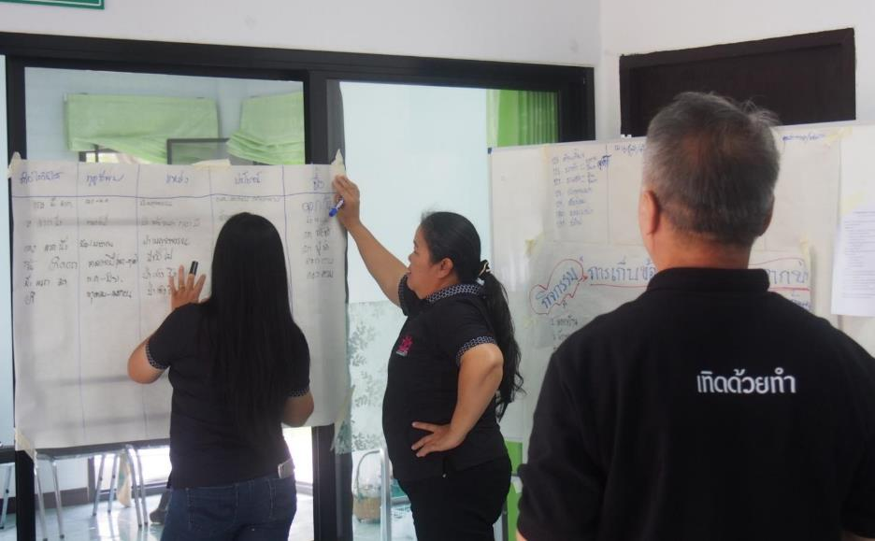
MODULE 2 | FRAMEWORK
There are many toolkits & manuals on gender analysis tools that you can use & adapt for your own project’s needs!
Gender analysis can also be done as PARTICIPATORY RESEARCH
(More in MODULE 3)
Community researchers reviewing data. © Teerapong Pomun, MCI

Slide 23
MODULE 2 | FRAMEWORK
Making involvement more accessible to women
How can you create an environment that enables women’s involvement in conservation?
What are barriers to women’s involvement?
How can these barriers be reduced or adapted to make it easier for women to be involved?
Working to create an enabling environment in communities and institutions

Slide 24
MODULE 2 | FRAMEWORK
Making involvement more accessible to women
Information from your
GENDER ANALYSIS
How can you create an environment that enables women’s involvement in conservation?
What are barriers to women’s involvement?
How can these barriers be reduced or adapted to make it easier for women to be involved?
will help you understand the
barriers facing women
and should help you identify possible ways to work with these challenges!

Slide 25
MODULE 2 | FRAMEWORK
Common Challenges to women include:
Gender norms
Lack of time, energy
Limited experience/confidence
Social pressures that discourage women’s active participation outside of the household or community
Women are often very busy with household duties and other traditional roles – difficult for them to make time for new activities
Without experience in leadership, public speaking, etc., and with limited education, women are often hesitant/shy to participate, and need support to build skills

Slide 26
MODULE 2 | FRAMEWORK
Key questions to consider:
What can our project and organization do to reduce barriers to women’s participation – in our project, in the community, in our organization, in positions of influence?
How can we help women feel more safe and comfortable?
How can we help husbands, parents, other family members support the involvement of women in their families?
More specific questions include:
Where women sit during mixed-gender meetings – often it is at the back of the meeting room
Who is most often talking during meetings, and who is listened to?
Who will women be comfortable talking in front of and collaborating with?
How can men/family members be engaged in supporting women’s involvement?

Slide 27
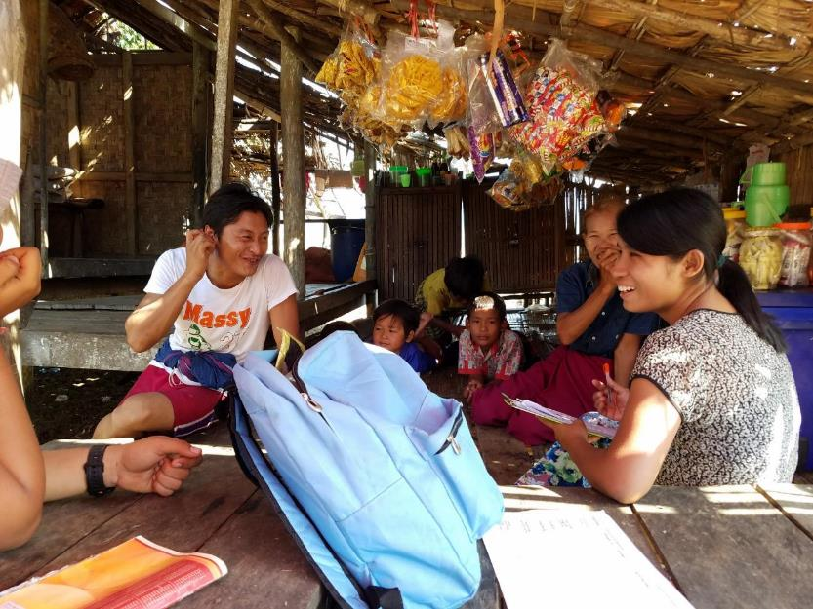
Examples
MODULE 2 | FRAMEWORK
Challenge: Women are shy/hesitant to actively participate in activities
Possible approaches: Hire/appoint female staff and/or community focal points for the project Build confidence and skills through trainings and practical experience Amplify women’s voices: Moderate conversations/discussions to allow space for women to speak, and ensure that their perspectives are considered Offer women-only spaces for certain activities Connect with other women role models, including through women’s networks
Local women, especially Moken women, felt more comfortable being interviewed by a woman researcher/staff member. Myeik, Myanmar. © TSWhitty

Slide 28
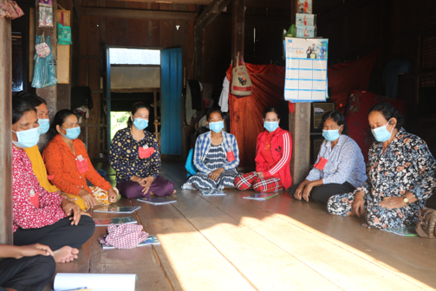
Examples
MODULE 2 | FRAMEWORK
Challenge: Women are shy/hesitant to actively participate in activities
Female staff to engage with women
Assigning female staff to work with & act as role models for women in communities | HA, Cambodia
Female staff investing a lot of time & effort to visit women one-on-one in communities to build connections | HA, Cambodia
Have female staff run the trainings for community women | CIYA, Cambodia
Women-friendly spaces
Offer all-women spaces; when women are comfortable, they have many things to share | MCI, Thailand
Moderate meetings in a way that encourages women, including newcomers, to speak | FACT, Cambodia
Have female staff run the trainings for community women | CIYA, Cambodia
Women in a training on climate change and natural resource management © FACT

Slide 29
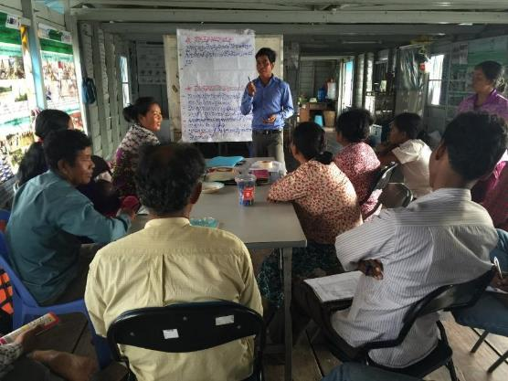
Examples
MODULE 2 | FRAMEWORK
Challenge: Families, husbands concerned about women being involved in activities
Possible approaches: Gender awareness activities aimed at all community members, including husbands and families Discussions with families, husbands, women about concerns and possible solutions Demonstrating women’s capacity, including their ability to produce more income through economic empowerment
Economic empowerment
Encourages grantees to work with women’s inclusion, e.g. through savings groups, small business support, women-focused discussions | SADP, Cambodia
Try to improve livelihoods of women; when they have more income and connections, conditions will change and they will have more influence and opportunities | CI, Cambodia
Women’s Savings Group working with Community Fishery Committee, Cambodia.
© Layhim Vann, CI

Slide 30
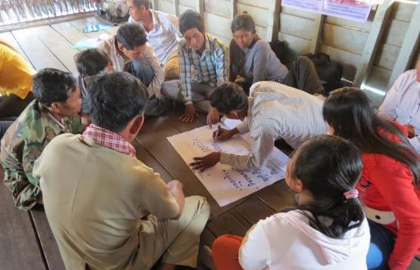
Examples
MODULE 2 | FRAMEWORK
Challenge: Families, husbands concerned about women being involved in activities
Gender and Natural Resource Management training, Cambodia © Conservation International
Including men + families
Include men in trainings on gender issues | FACT, Cambodia
Family forum: brought family members together to analyze gender norms and roles, and to discuss how to broader opportunities to girls and women | HA, Cambodia
Work to prevent/avoid conflict; engage men and women in explaining the purpose of including women in research and advocacy | MCI, Thailand
Women focal people work with families to explain how women will be involved & to build trust – we’ve observed families changing and allowing daughters and wives to join activities more | My Village, Cambodia
During trainings, use stories & role plays showing the importance of women; include outreach to men, including Community Fisheries Committee members and local authorities, to help them understand the importance of gender equality | CI, Cambodia
Not only seek women to participate, but men who will work to support women | CIYA, Cambodia

Slide 31
Examples
MODULE 2 | FRAMEWORK
Challenge: Women’s schedules are busy
Possible approaches: Schedule activities at convenient times for women Provide childcare options at activity venues Consider compensation for their time (but this can be a sensitive issue – be careful!)
Supporting women staff in organizations
Staff well-being project: classes to support mindfulness, meditation; option for 14-day meditation leave | SADP, Cambodia
Space in office for kids; men as well as women can bring their kids | SADP, Cambodia
Staff discussions on managing work with families, across men and women | SADP, Cambodia
Flexibility in their schedule for childcare, maternity leave | 3SPN, Cambodia
Consider gender, age, power dynamics in organizations and across institutions
Challenge: Safety concerns for women
Possible approaches: Provide options for travel companions if safety during travel is a concern Ensure that women’s concerns are taken seriously and that men take a role in helping address these concerns

Slide 32
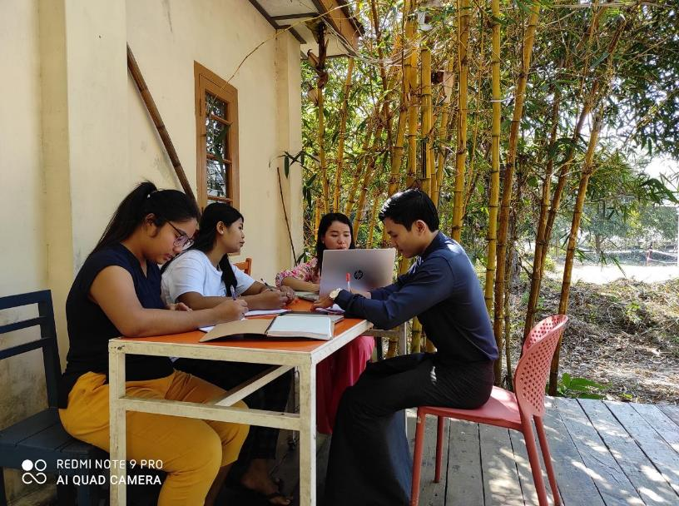
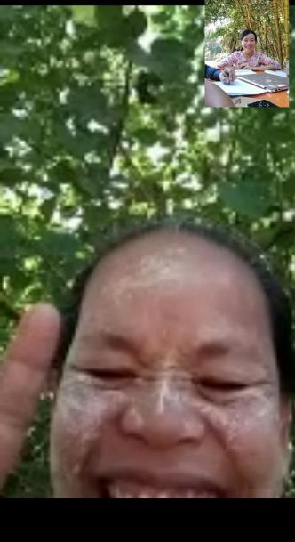
Examples
MODULE 2 | FRAMEWORK
Challenge: Women’s schedules + Safety concerns
Considering women’s needs in planning activities
Work to consult women one-on-one to assess their needs and how to support them | SADP, Cambodia
During COVID19, the switch to remote meetings actually made it easier for women to participate – less expense, more access, no need for risky travel | CIYA, Cambodia
Women sometimes have to travel with kids to provincial meetings; sometimes the husbands or other family join. So we revised our policy to support the logistics & expense for travel of family members | My Village, Cambodia
Young researchers conducting community interviews with women & men by video call. © Yin Yin Htay, Myanmar Coastal Conservation Lab

Slide 33
Examples
MODULE 2 | FRAMEWORK
How projects have created enabling environments
Consulted with women on how to create a more enabling environment, which included:
Meetings with only women – women seemed to be more comfortable talking around other women without men around
Having women share the message of why it’s important to be involved - a powerful way to get more women involved
Ask community focal points to suggest times/days for activities that are most convenient for different community members, including women
Organized community events with flexible schedule – though this can be challenging to plan
WorldFish, Cambodia
When recruiting staff, make special effort to recruit women and indigenous peoples
CIYA, Cambodia
Our consultant leading Community Action Research components will allow extra time to doing household visits, prioritizing speaking with women. This is a more informal space to chat with younger women and single mothers
International Rivers, Cambodia

Slide 34
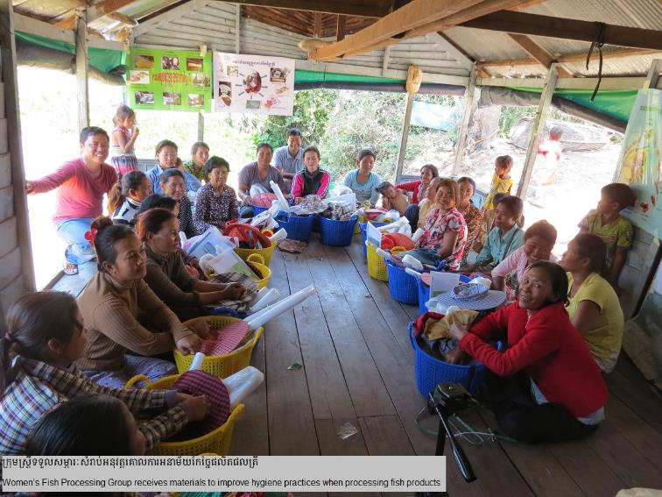
Examples
MODULE 2 | FRAMEWORK
How projects have created enabling environments
Hired a young woman as staff focal point in the communities
Make sure to schedule meetings at times more convenient to women
Encourage women to bring their children/babies to activities
Relied less on literacy (low literacy rates among indigenous communities, especially women, in this area), more on visual materials and more talking than lots of writing
Encouraged more experienced women to stand up, present, and moderate as role models for other women
Represent women at least equally in project outputs like videos and written reports
Share experiences of other communities, inviting local communities from Thailand and Cambodia where women leaders are active as inspiration
Mekong Watch, Cambodia – Lao PDR - Thailand
Women’s Fish Processing Group receiving materials to improve hygiene in fish processing, Srey Chek community, Cambodia.
© Chanthorn Srorn, CI

Slide 35
MODULE 2 | FRAMEWORK
SUPPORTING & BUILDING WOMEN’S SKILLS
For many rural women, limited access to education and lack of opportunities → limited experience, skills, and confidence in public communication, reading & writing, and leadership
So, there is often a need to build skills and confidence!
Building capacity for women’s involvement

Slide 36
MODULE 2 | FRAMEWORK
COMMUNICATION
SUPPORTING & BUILDING WOMEN’S SKILLS
PARTICIPATION IN PUBLIC MEETINGS
For many rural women, limited access to education and lack of opportunities → limited experience, skills, and confidence in public communication, reading & writing, and leadership
So, there is often a need to build skills and confidence!
RESEARCH
PROJECT MANAGEMENT
COMMUNITY ORGANIZING, LEADERSHIP
COMMUNITY RIGHTS, LEGAL FRAMEWORKS

Slide 37
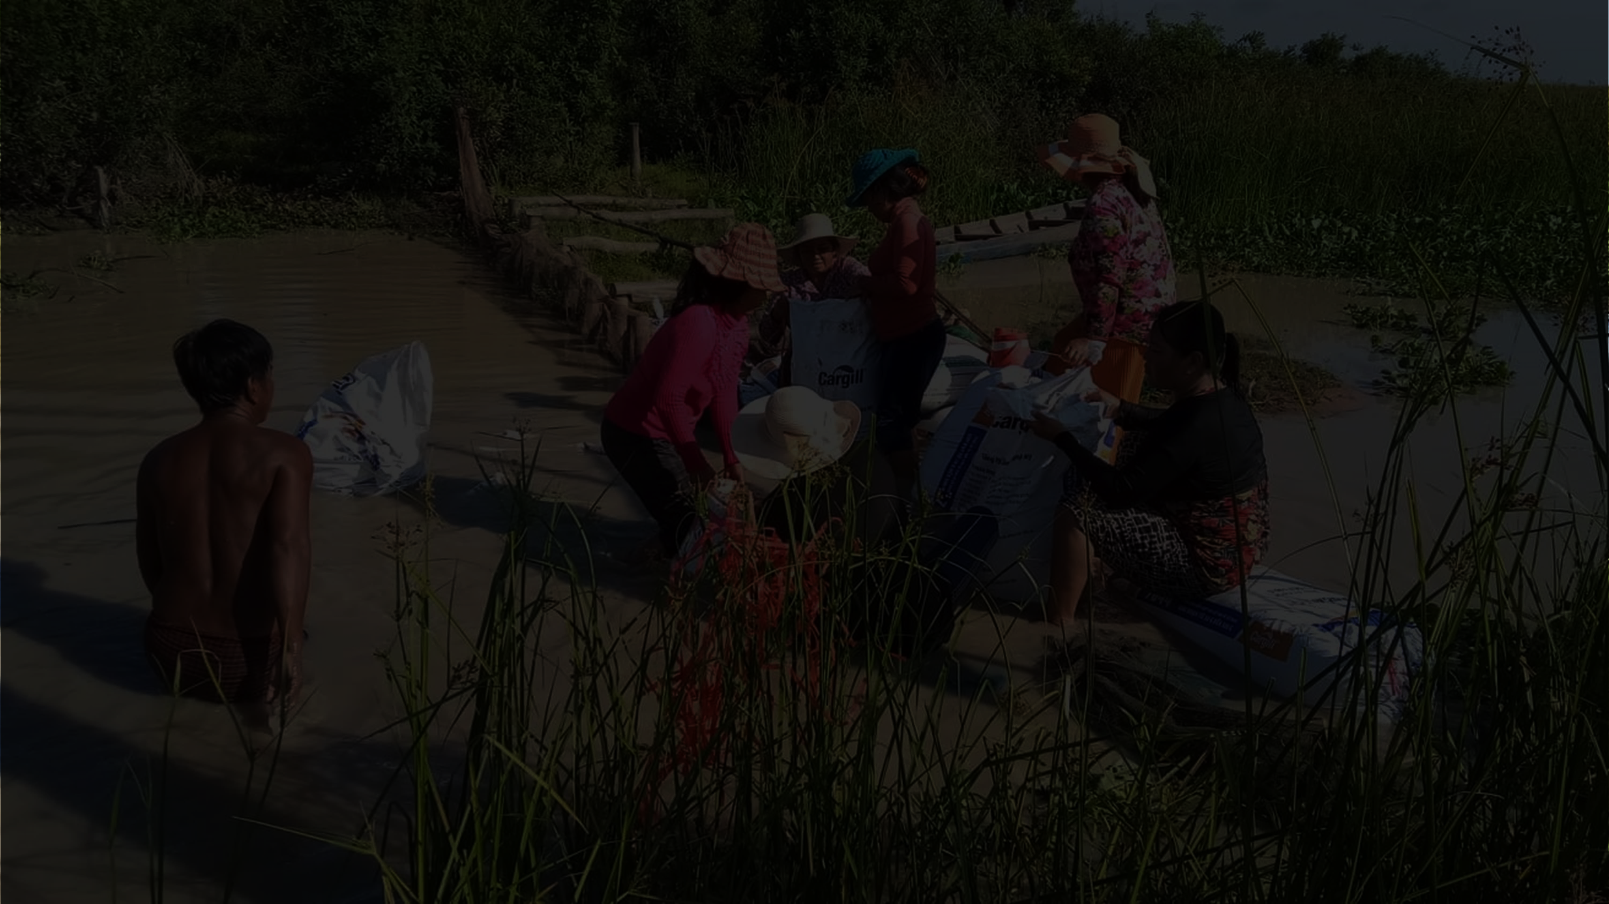
MODULE 2 | FRAMEWORK
SUPPORTING & BUILDING WOMEN’S SKILLS
“Many NGOs advocate for women’s rights, but are weak on the side of building capacity for women. For younger women, in particular, many NGOs raise their awareness of their rights, but without the capacity needed to advocate for those rights.
We need to strengthen their knowledge so they can understand what’s happening with natural resources and the community’s rights, and what they can do to help.”
Anonymous CEPF grantee

Slide 38
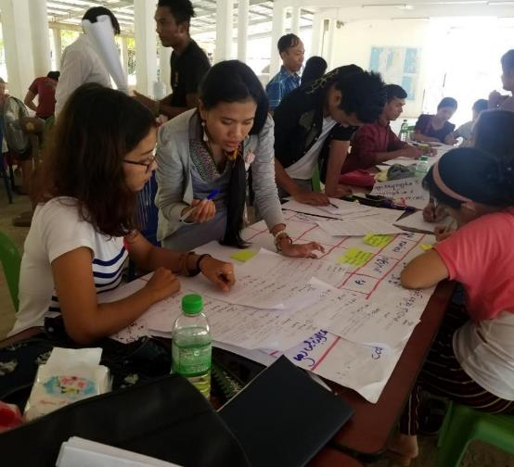
MODULE 2 | FRAMEWORK
Building capacity across institutions
Building organization staff knowledge & skills for gender equity
CONSERVATION ORGANIZATIONS
(NGOs, CSOs)
Trainings staff, including young women, in organizational capacity, project management, funding | Global Environmental Institute (GEI), Myanmar
Recommending women staff as participants to regional workshops and events | GEI, Myanmar
Organization commits to hiring female applicants even if additional training is needed to develop their work skills | CIYA, Cambodia
Raising awareness among staff as well as executive board on gender issues | GreenViet, Vietnam
Staff trained in using CEPF Gender Tracking Tool | FISHBIO, Lao PDR and Cambodia
COMMUNITIES
Young CSO staff attending a training on gender in Natural Resource Management, Myanmar. © TSWhitty
AUTHORITIES, DECISION-MAKERS above village level

Slide 39
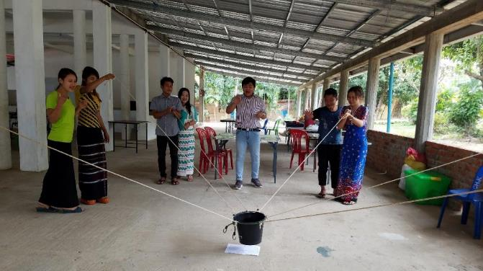
MODULE 2 | FRAMEWORK
Building capacity across institutions
Learning from organizations with experience in gender work
CONSERVATION ORGANIZATIONS
(NGOs, CSOs)
Invested a lot of resources to train our gender focal staff, including sending them to intern with other NGOs that focus on women’s issues – needed to build organizational capacity to work on gender | HA, Cambodia
Planning to launch a women's fellowship program with Women’s Earth Alliance, who have long history of running women's leadership programs | International Rivers, Cambodia – Lao PDR – Thailand - Vietnam
COMMUNITIES
Young CSO staff attending a training on gender in Natural Resource Management, Myanmar; the training was developed with advice from the Mon Women’s Organization. © TSWhitty
AUTHORITIES, DECISION-MAKERS above village level

Slide 40
MODULE 2 | FRAMEWORK
Building capacity across institutions
Trainings on important topics
CONSERVATION ORGANIZATIONS
(NGOs, CSOs)
Trained local communication team in environmental regulations and communication practices | WARECOD, Vietnam
Trainings on land rights and policy so indigenous women know their communities’ rights and how to advocate for them | HA, Cambodia
Trainings on communication, advocacy, negotiation leadership, legal frameworks, livelihood strengthening | FACT, Cambodia
Refresher trainings are important! | FACT, Cambodia
Trainings in research (several groups) – MODULE 3
COMMUNITIES
AUTHORITIES, DECISION-MAKERS above village level
Women attending a training and group discussion on fisheries resource management and climate change. © FACT

Slide 41
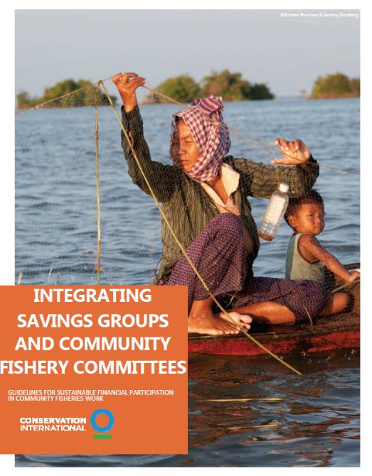
MODULE 2 | FRAMEWORK
Building capacity across institutions
Economic empowerment
CONSERVATION ORGANIZATIONS
(NGOs, CSOs)
Originally tried to engage local women to run in local elections, but this was difficult due to low literacy rates.
We are not equipped to do literacy training, so we are instead working to build their skills through Fish Processing & Savings groups.
These groups use their earnings to support Community Fisheries activities – the Community Fishery Committee presents a proposal for how to use the money
This economic empowerment is an entry point into making decisions
This changes previous assumptions that women cannot bring in significant income
Through this process, women build skills step-by-step to prepare them to be CFC members in the future
CI, Cambodia
COMMUNITIES
AUTHORITIES, DECISION-MAKERS above village level

Slide 42
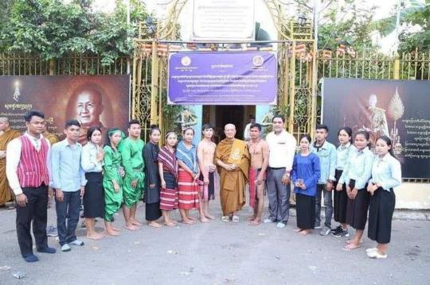
MODULE 2 | FRAMEWORK
Building capacity across institutions
Investing in education for more diverse future leaders
CONSERVATION ORGANIZATIONS
(NGOs, CSOs)
Support educational opportunities for indigenous youths, including women – access to high school, practical experience with projects, and university; now some alumni women have become lawyers | HA, Cambodia
Supported education of 7 indigenous women who are now environmental lawyers | CIYA, Cambodia
Youth participants in CIYA’s education support program. © CIYA
COMMUNITIES
Supporting women in media
Working to engage female journalists in activities to raise capacity for environmental reporting | Center for People and Nature Reconciliation (PAN), Vietnam
AUTHORITIES, DECISION-MAKERS above village level

Slide 43
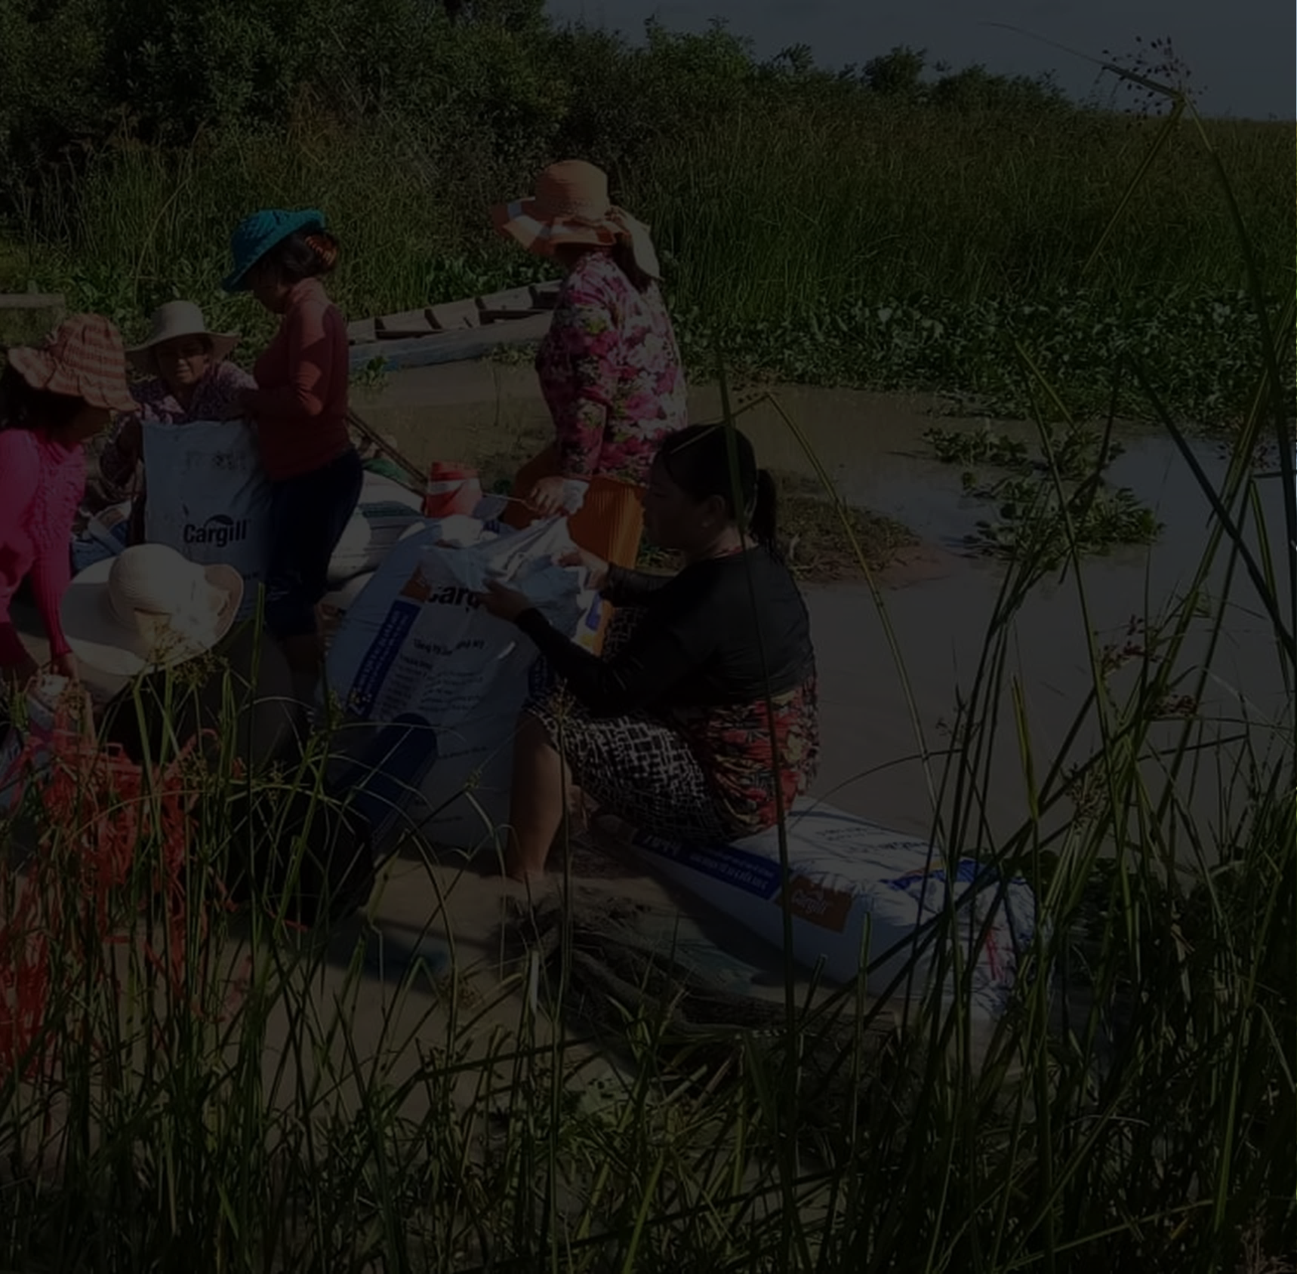
MODULE 2 | FRAMEWORK
Meaningful involvement:
How can women’s involvement continue and grow into the future?
In project activities, assess how women are involved, and facilitate their meaningful participation
How can we promote & support more meaningful inclusion of women?
What is the current situation for women here?
How can we make it more possible for women to be involved?
How can we build capacity for women’s involvement?
In your GENDER ANALYSIS and project implementation:
Pay attention to how women are participating in activities
Assess if this participation is meaningful & addresses your gender goals through monitoring & evaluation.
Goal: Women are actively involved in conservation

Slide 44
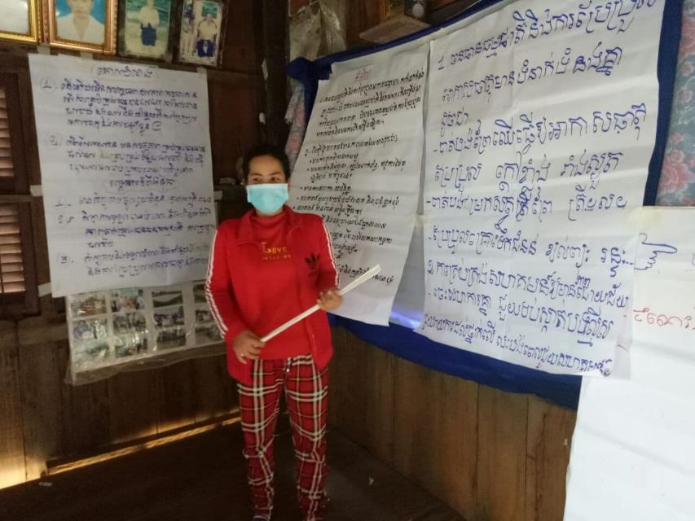
MODULE 2 | FRAMEWORK
Meaningful involvement
There are important differences between attendance, participation, and leadership.
“Inclusion” is more than inviting women to participate!
It means facilitating the active participation of women in activities and decision-making.
Woman presenting results of group discussion. © FACT

Slide 45
MODULE 2 | FRAMEWORK
Meaningful involvement
There are important differences between attendance, participation, and leadership.
“Inclusion” is more than inviting women to participate!
It means facilitating the active participation of women in activities and decision-making.
Example
From FISHBIO’s work in Lao PDR:
Women do attend meetings, but are often mostly involved in supporting roles, e.g. cooking for other attendees
We would like to see women more involved in decision-making and leadership roles
We currently work to involve women in research – recording fisheries logbooks, fish tag monitoring, reporting on social media – since all of the fish go to women for cooking and selling.

Slide 46
MODULE 2 | FRAMEWORK
how to assess if your work has improved women’s
Meaningful involvement
MONITORING & EVALUATION
You can assess the outcomes from your work on gender by using
QUANTITATIVE and
QUALITATIVE
methods
1
QUANTITATIVE monitoring
A common example of a quantitative indicator of gender inclusion is the # and % of activity participants of each gender
This requires sex disaggregated data:
i.e., collection of data for men and data for women.
Aggregated data: 50 participants
Sex disaggregated data: 38 men, 12 women participants
Other examples of indicators to monitor:
#/% of leadership positions held by women
# of women trained in key skills

Slide 47
MODULE 2 | FRAMEWORK
how to assess if your work has improved women’s
Meaningful involvement
MONITORING & EVALUATION
You can assess the outcomes from your work on gender by using
QUANTITATIVE and
QUALITATIVE
methods
2
QUALITATIVE methods:
Gives you more rich information than quantitative – can help you understand women and men’s experiences and impacts as a result of gender-focused work
Many methods for this, usually through interviews and focus group discussions. Examples include:
Collecting stories from men and women about their experiences
Discussing women’s experiences in focus groups, including identifying ways to improve inclusion
Assessment with participants (men and women) about how they have benefitted from project activities

Slide 48
MODULE 2 | FRAMEWORK
Meaningful involvement
examples of
Cambodia | FACT
A lot of success stories for women we work with!
More women have been elected as commune council and local authorities; e.g. one of the most active local fisheries activists was elected to the District Council
Women are able to facilitate meetings, produce and submit reports to Commune Councils, and advocate to the public, media, and national Fisheries Administration
Change in mindsets: Women who gained knowledge and skills became more confident & motivated to take care of community issues and capable of mobilizing communities against threats, e.g. illegal fishing or land encroachment
Men’s attitudes have changed, too: as they see that women have the capacity to be strong and informed, they grow more willing to collaborate and listen
We engage women in monitoring & evaluation to ensure that women’s perspectives are included in assessing project progress and impacts
Women-led discussion to reflect on progress of community fisheries management and fisheries resource conservation. © FACT

Slide 49
MODULE 2 | FRAMEWORK
Establishing sustained ways of working
How can women’s involvement continue and grow into the future?
How can women’s involvement be mainstreamed in long-term work at this site?
How can we promote & support more meaningful inclusion of women?
How can you institutionalize women’s involvement – and the work needed to establish empowering environments and support capacity – so that it can continue even beyond the current grant cycle?
What is the current situation for women here?
How can we make it more possible for women to be involved?
How can we build capacity for women’s involvement?
Goal: Women are actively involved in conservation

Slide 50
MODULE 2 | FRAMEWORK
Establishing sustained ways of working
Incorporate gender issues in institutional policies (e.g., community committees, organization’s strategies, lobby for institutions to establish or update gender guidelines/policies)
Support mechanisms for maintaining & sharing skills and knowledge
Support/facilitate connections to other communities and institutions supporting women’s involvement – especially women’s networks (more in Module 3)
Collaborate with organizations that specialize in gender, human rights, community organizing
Have a long-term strategy for community engagement for gender equality, since this work requires time for trust-building and working with traditional norms
How can women’s involvement be mainstreamed in long-term work at this site?
How can you institutionalize women’s involvement – and the work needed to establish empowering environments and support capacity – so that it can continue even beyond the current grant cycle?

Slide 51
MODULE 2 | FRAMEWORK
examples of
Establishing sustained ways of working
Coordinating gender work across projects
Working across sectors
WorldFish | Cambodia
Many benefits from engaging women weren’t directly from one project, but from synergies across different projects and areas of work
Work with women under their CEPF grant set the stage for future events and interactions – part of a longer-term process
FACT | Cambodia
Learned a lot from other donors, including Oxfam, while implementing projects funded by CEPF and others
From experience in Lao PDR
Engaging with government institutions with gender as an “entry point” has opened up new spaces to work on environmental issues
We propose collaboration with government departments to work on gender mainstreaming to align with international commitments to gender equality
This has made it easier for us to approach politically sensitive topics like addressing hydropower project impacts to natural resources & communities

Slide 52
MODULE 2 | FRAMEWORK
examples of
Establishing sustained ways of working
Having a long-term vision
Allocating resources to gender mainstreaming
HA | Cambodia
Started working on gender in 2009, and continuing today; have seen a chance in men and women’s perspectives, with more involvement by women (and families allowing for more involvement). However, there is still more change
We support high school and college education of indigenous youths to build their long-term capacity. They exchange their knowledge with indigenous women in the village, who share their traditional knowledge in collaboration with the students
International Rivers | Mekong Basin
Designing programs and budgets to allow us to support and enable women’s needs
e.g., budgeting for additional travel support needed for travel companions for women
e.g., translators for participants who are not fluent in the project language

Slide 53
This framework can help you think through gender integration in your work
MODULE 2 | FRAMEWORK
Sustained ways of working
From attendance to influence
Gender analysis
Enabling Environment
Building Capacity
Goal: Women are actively involved in conservation

