Slide 1
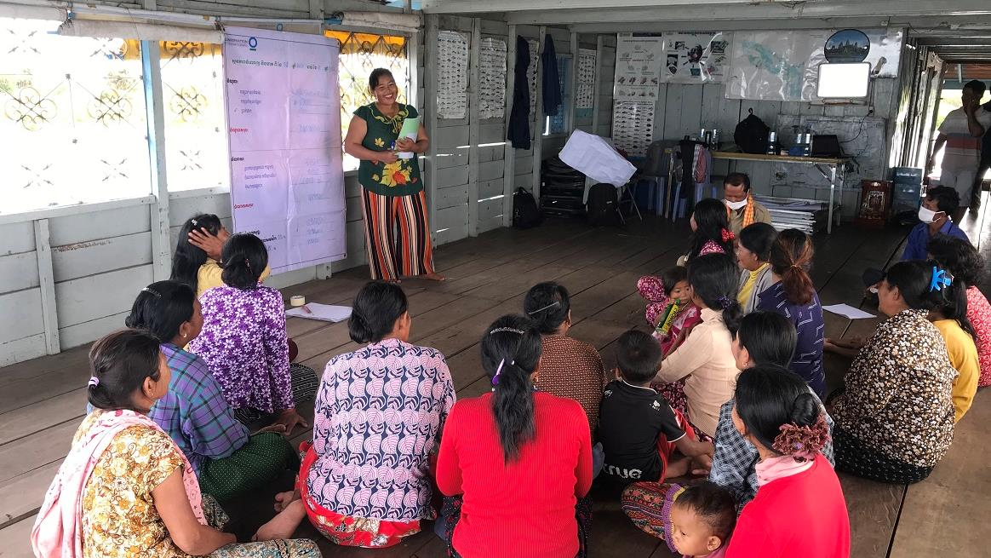



Women’s savings group meeting in Ou Akol, Cambodia.
© Sokrith Heng, Conservation International
Empowering women in conservation
KNOWLEDGE PRODUCT
Keiruna
inc
TRAINING MODULES

Slide 2
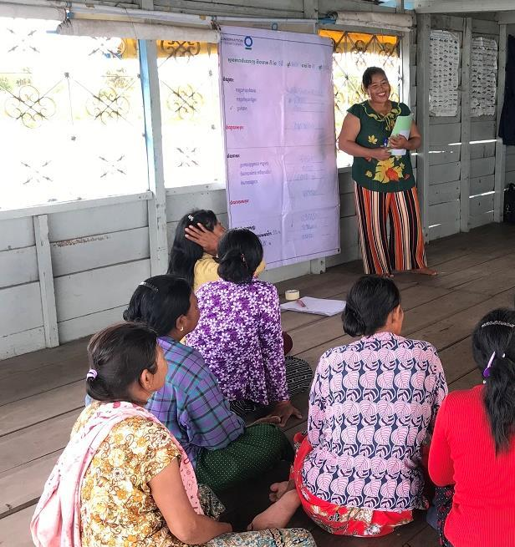

About
This knowledge product is based on experiences of CEPF Grantees in the Indo-Burma Hotspot, and is meant to provide useful information and guidelines for supporting women in conservation. Licensed under CC BY-NC 4.0.
Funded as a part of the CEPF "Building on Success" learning resource series, which aims to promote effective conservation practices across the planet.
Empowering women in conservation
How to use this knowledge product
This is a training with 3 modules that can be self-guided or delivered by a trainer to a group, with extra explanations in the optional Training Script document.
For more in-depth information on any of the topics covered, there are many useful references available, including those in the Annex (Further Learning).
CEPF is a joint initiative of
l’Agence Française de Développement, Conservation International, the European Union, the Global Environment Facility, the Government of Japan and the World Bank.
Published 2021 | Author: Tara Sayuri Whitty, PhD. @ Keiruna Inc

Slide 3
EMPOWERING WOMEN IN CONSERVATION
Modules
Module 1
Module 2
Module 3
Annex
Why gender is important in conservation
Context, Rationale, and Key Considerations
Framework:
Working to empower women in conservation
Ways of thinking & Working in projects
Further learning:
Useful resources

Slide 4
EMPOWERING WOMEN IN CONSERVATION
Module 3
Ways of thinking & working in projects
Women facilitating a group discussion on fisheries resource management and climate change. © FACT

Slide 5
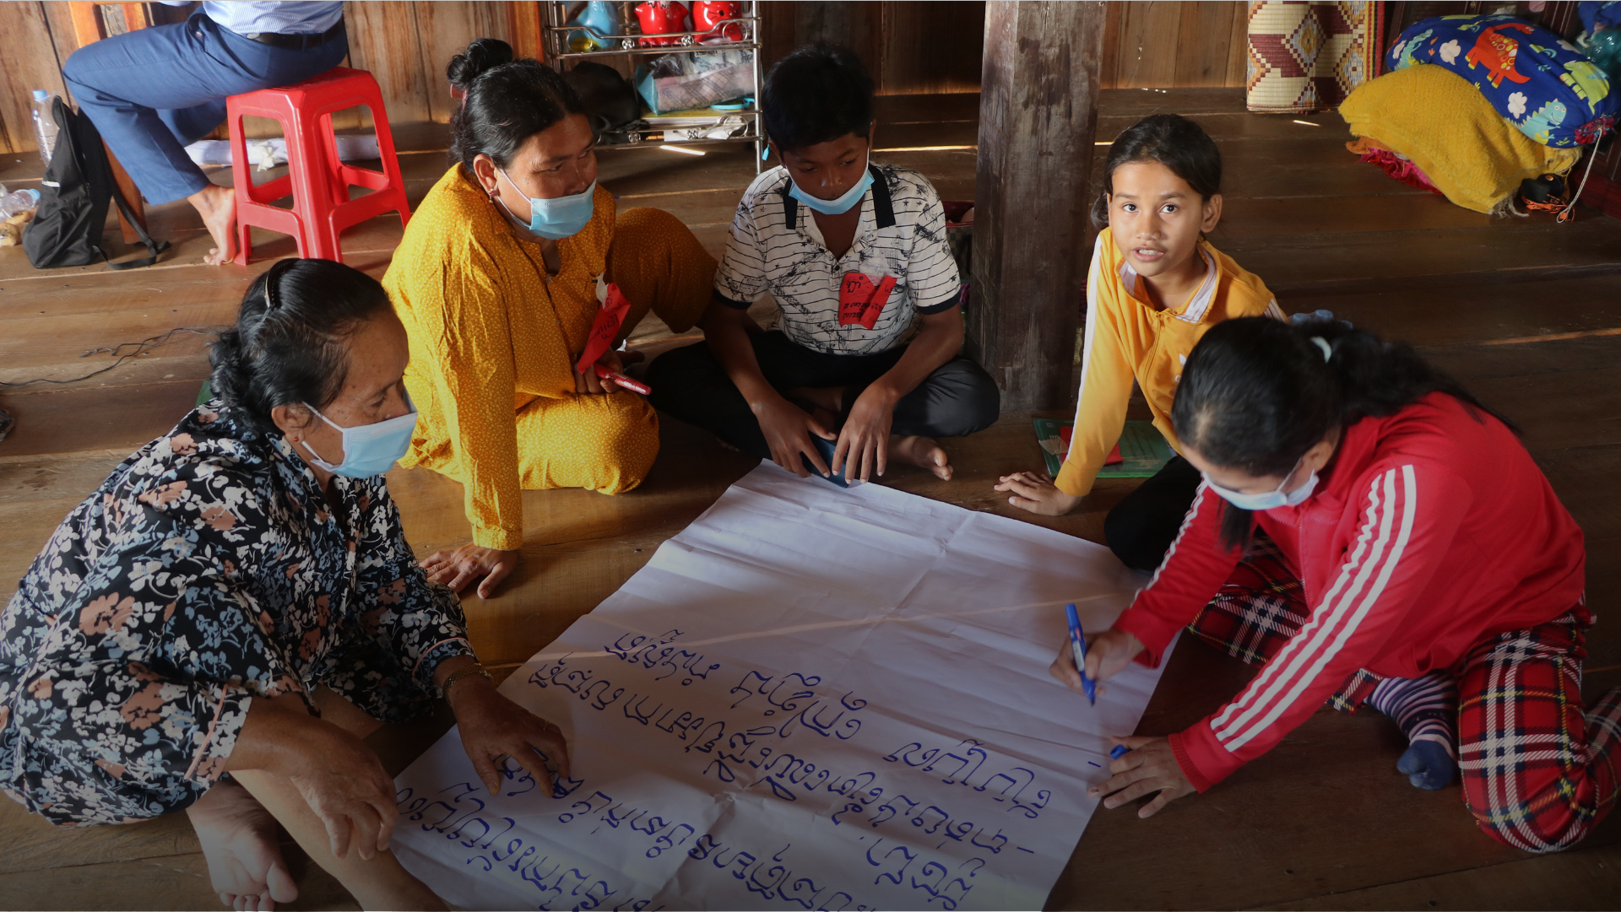
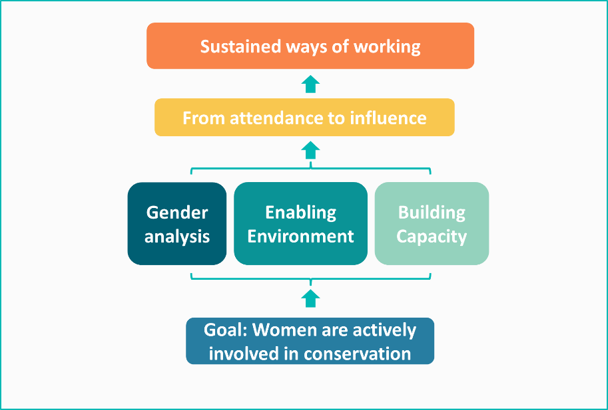
MODULE 3 | WAYS OF WORKING
Use this framework to help guide how you work to support women’s involvement in conservation

Slide 6

MODULE 3 | WAYS OF WORKING
...and incorporate mindful assessment of how your project supports women, using
EMPATHY
If you work to “put yourself in the shoes” of women involved in your project, you can better assess how to make your project more accessible and effective for women.
You can do this through:
Empathy
experiences
Working to deeply understand and relate to the experiences, feelings, and needs of someone else
pressures
interests
motivations
relationships
commitments
Gender Analysis
Stakeholder Discussions & Feedback
Interviews/conversations with women
Monitoring & Evaluation
fears
ambitions

Slide 7
MODULE 3 | WAYS OF WORKING
...and incorporate mindful assessment of how your project supports women, using
EMPATHY
Empathy
experiences
Working to deeply understand and relate to the experiences, feelings, and needs of someone else
pressures
interests
motivations
relationships
commitments
This is a good general practice whenever you are engaging with people – men, women, youths, indigenous peoples, authorities, etc.
This can be incorporated in your gender analysis, project planning, activity development, monitoring & evaluations!
fears
ambitions

Slide 8
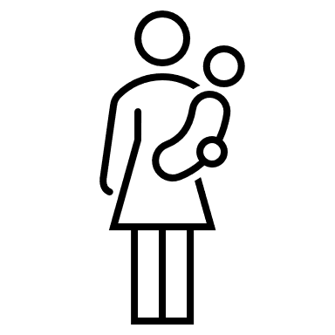






Empathizing with women in your project & organization
MODULE 3 | WAYS OF WORKING
Example – considering how their experience/perspectives might make their involvement in project activities difficult
Time needed for tending to household, childcare, livelihood
Concern about safety and expense of traveling to activities
Gender norms discouraging women’s involvement outside of household
Don’t think that their involvement is important
Fear of disapproval from family, neighbors
Shy to speak in front of mixed men-women groups
Lack of confidence in public speaking

Slide 9


Empathizing with women in your project & organization
MODULE 3 | WAYS OF WORKING
Example – considering how their experience/perspectives might make their involvement in project activities difficult
→ and what possible solutions might be!
Scheduling activities at most convenient times for women
Have participants travel in groups
Covering the costs of a travel companion (e.g. family member)
Providing childcare at the activity site
Providing financial support for travel
Livelihood strengthening support
Connect to other women role models, networks
Gender focal person – project staff and/or community member
Training in importance of women in conservation & communities
Gender sensitivity trainings and engagement with communities, including husbands and parents
Have women-only spaces available
Trainings + practical experience in public speaking and other skills
Public platforms for sharing their voices

Slide 10
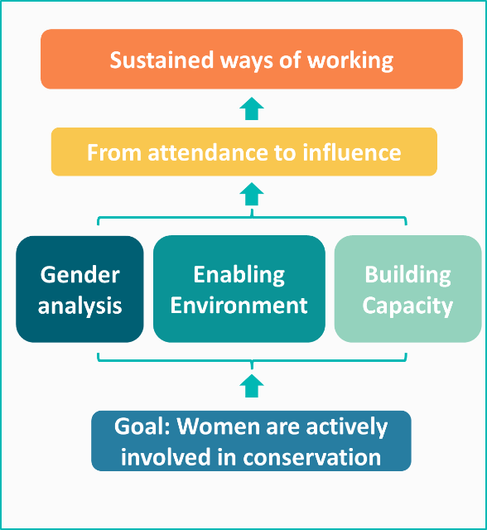
MODULE 3 | WAYS OF WORKING
Assessing accessibility, inclusivity, and impacts of activities
Use the framework as a guide to think through important questions about how your work will involve & impact women.
examples below:
Will women be meaningfully involved in this activity?
Do the target women have the skills needed to participate actively (or do we need to build them first)?
Will we be able to evaluate participation and impacts of this activity? (and how?)
PLANNED ACTIVITY
Will women be able to participate safely, comfortably, and without disrupting their other commitments?
Does this fit into a long-term plan for women’s involvement in conservation? (and how?)
Does this contribute to our goal of empowering women? (and how?)
Does this activity consider the local context, and is it appropriate*?
Does this activity leverage women’s skills, potential skills, experiences, and interests?
*Are there safeguards in case there might be negative social/domestic impacts from this activity?

Slide 11
MODULE 3 | WAYS OF WORKING
Assessing accessibility, inclusiveness, and impacts of activities
Use the framework as a guide to think through important questions about how your work will involve & impact women.
examples below:
Will women be meaningfully involved in this activity?
If the answer to any of these questions is “NO”:
Why not?
And how can we (responsibly) change this?
Do the target women have the skills needed to participate actively (or do we need to build them first)?
Will we be able to evaluate participation and impacts of this activity? (and how?)
PLANNED ACTIVITY
Will women be able to participate safely, comfortably, and without disrupting their other commitments?
Does this fit into a long-term plan for women’s involvement in conservation? (and how?)
Does this contribute to our goal of empowering women? (and how?)
Does this activity consider the local context, and is it appropriate*?
Does this activity leverage women’s skills, potential skills, experiences, and interests?
*Are there safeguards in case there are negative social/domestic impacts from this activity?

Slide 12

MODULE 3 | WAYS OF WORKING
Incorporating this framework into planning & implementation
The steps in the framework will generally be overlapping and will be revisited throughout the project cycle.
Where possible, these steps should be incorporated in project planning to design & propose an optimally inclusive project – but if this is not possible, they should be incorporated as early as possible.
project planning
activities
assessment

Slide 13

MODULE 3 | WAYS OF WORKING
Incorporating this framework into planning & implementation
EXAMPLES
Consult with communities (including women) on project design and goals
Engage community in gender trainings, discussions
Connect with women’s networks across communities
Involve community members in gender analysis research
Opportunities/
platforms for women to share their voices
Develop project policies/guidelines for gender-related practices
Collect stories, accounts from women and men about impacts
Trainings to build needed skills
Design a project that fits with a longer-term strategy for gender inclusion
Collect gender disaggregated data on participants and impacts
Facilitate women’s participation in activities
project planning
activities
assessment

Slide 14
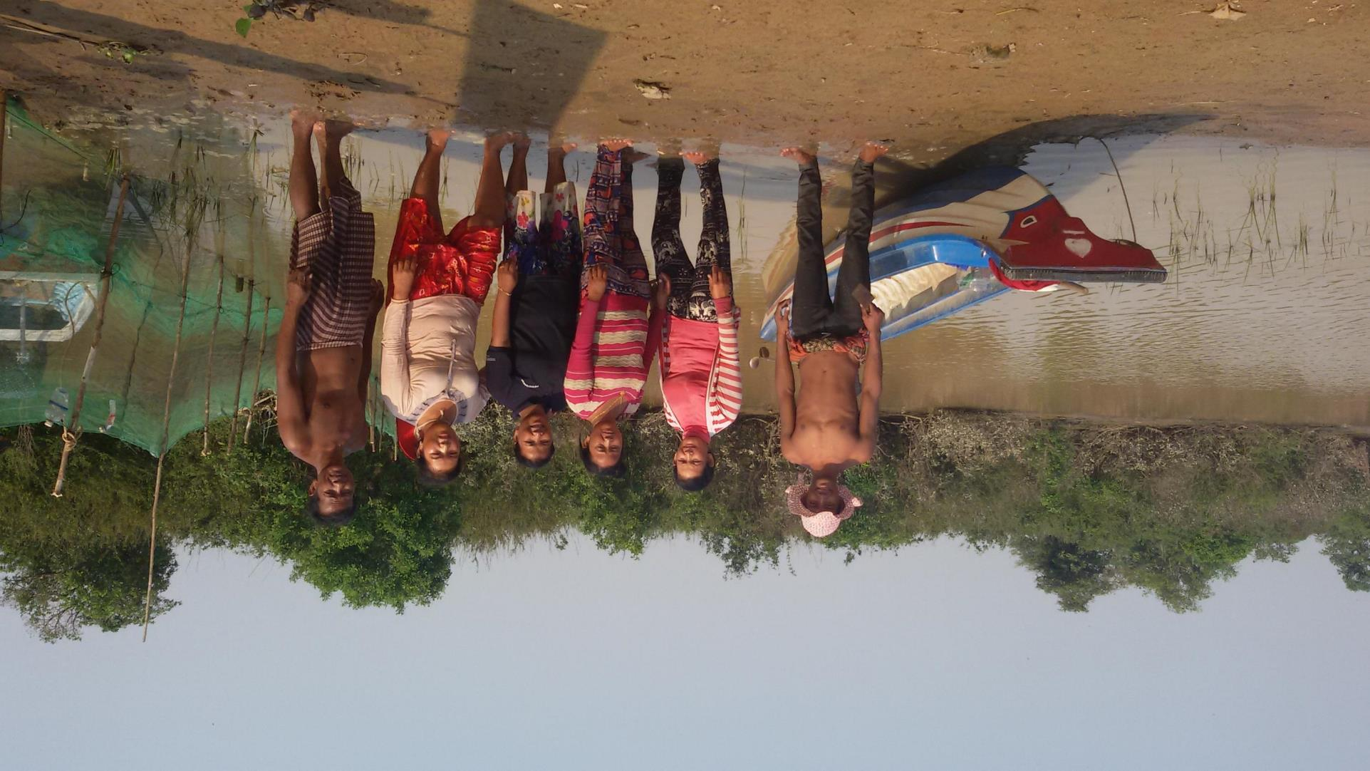
Women & men guarding Ou Akol community conservation area in Cambodia
© Conservation International
MODULE 3 | WAYS OF WORKING
Each organization needs to embed gender strategy as a core of implementation strategy for their organization and project.
Once you embed this, you will consider gender issues in every stage of the project and observe how to support women as needed.
Cambodian Rural Development Team (CRDT)

Slide 15
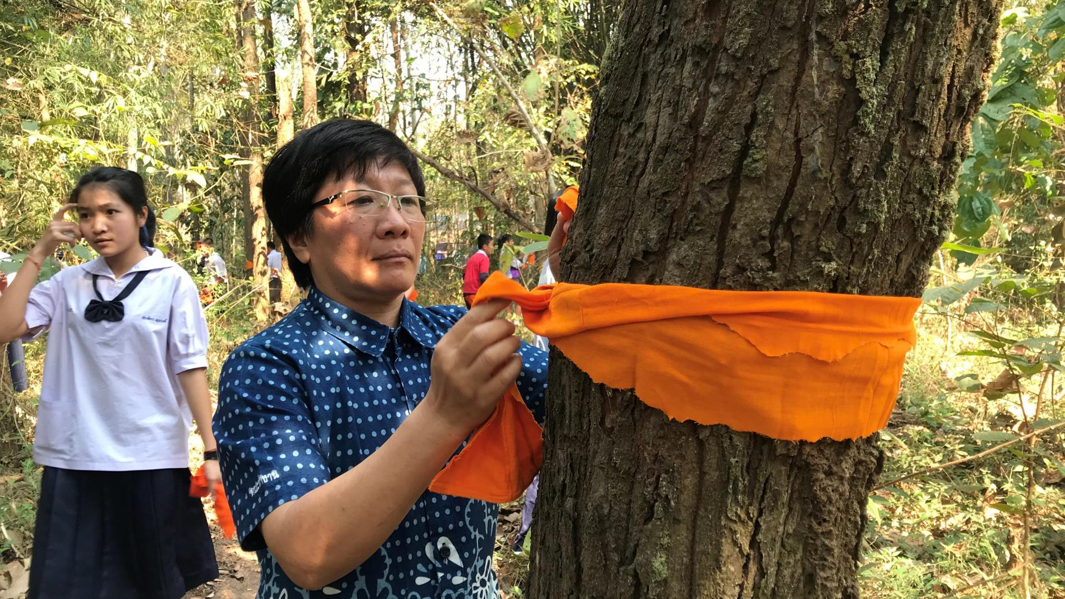



Important
approaches:
MODULE 3 | WAYS OF WORKING
PARTICIPATORY RESEARCH
WOMEN’S GROUPS & NETWORKS
AMPLIFYING WOMEN’S VOICES
Tree ordination in Thailand – a Buddhist blessing of trees.
© Teerapong Pomun, MCI

Slide 16
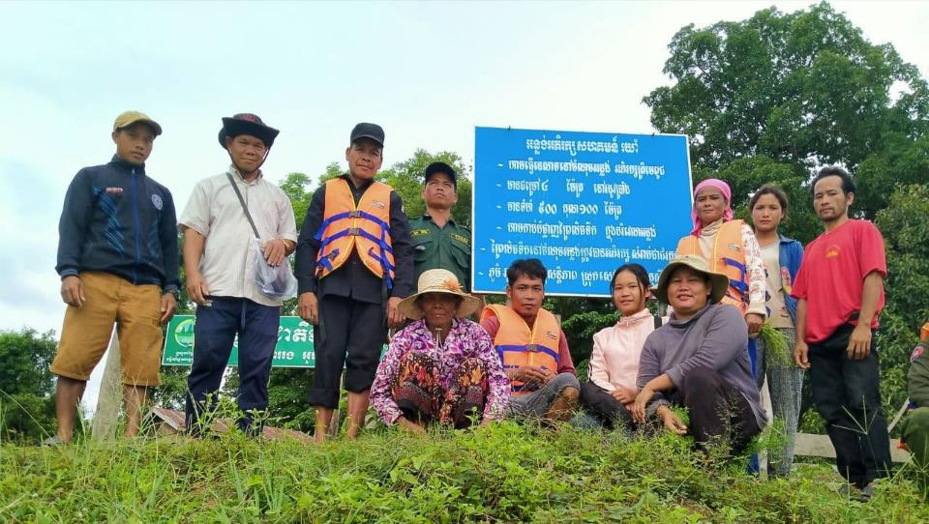
PARTICIPATORY RESEARCH
MODULE 3 | WAYS OF WORKING
My Village, Cambodia
Engages women in gender analysis & local knowledge research to inform project planning
Analyze barriers to participation for women and men, and plan how to reduce those barriers
Women & men monitor changes to ecosystems and community
Women develop their plans for the community based on the needs identified in the research
Train them in situational and actor analysis so they can identify and engage with key actors involved in issues
We support these women’s plans with small budget and facilitate engagement with other stakeholders
Local Research team
© O’Chay village, My Village

Slide 17
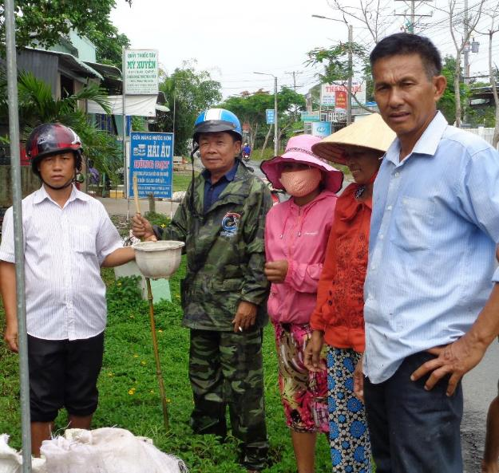
PARTICIPATORY RESEARCH
MODULE 3 | WAYS OF WORKING
WARECOD, Vietnam
Use participatory Local Ecological Knowledge research as a method to help raise awareness of the value of men and women’s roles + build women’s confidence
→ Trained local research teams to do Local Ecological Knowledge and Participatory Rural Appraisal research, including research project planning, discussing needed actions, and reporting research to their own communities, the public, and local authorities
Research teams include women & men of different ethnicities and ages
Make the research plan together & divide research team into small groups for specific topics
Discuss the information they collected, how to apply it, how it is meaningful
Local team presents to local authorities & public (with women encouraged to present)
Can use research to monitor risks & impacts of developments on resources
Local Knowledge research group during a cleanup event
© WARECOD
Now women & men community members can gather information, analyze and synthesize information, and have their voices heard when they present it

Slide 18
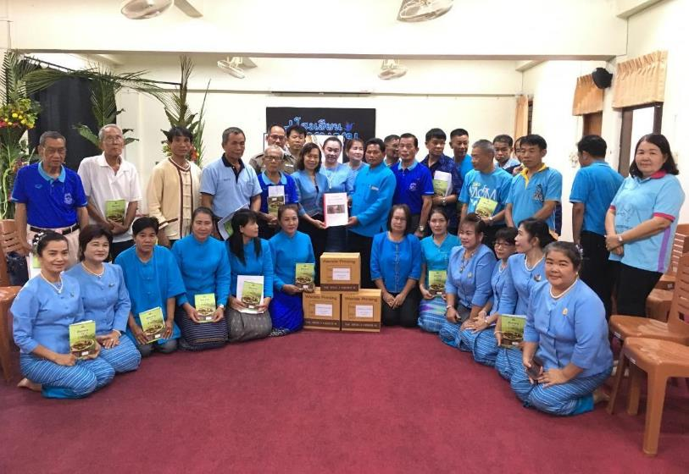
PARTICIPATORY RESEARCH
MODULE 3 | WAYS OF WORKING
MCI, Thailand – Ing River Basin
Trained & engaged women in Participatory Action Research (PAR) based on local knowledge, including women’s roles in natural resource use & management.
Women lead data collection on local food from edible plants in the Community Forests, with MCI staff as research assistants to the women
MCI prints books of research findings to distribute to community and local authorities, with local women researchers listed as research team
The book is the women’s knowledge and publication
Organize seminar to launch the book to authorities, organizations
These publications & sharing sessions have raised the profile of women’s groups in the Ing River Basin & built women’s confidence in communication and advocacy
Women own the research.
MCI tells them: “This is your knowledge, this is your power; we are just the ones to help record and summarize it.”
Event launching women’s natural resource research publication
© Teerapong Pomun, MCI

Slide 19
WOMEN’S GROUPS & NETWORKS
MODULE 3 | WAYS OF WORKING
The driving idea: to empower women economically and in terms of understanding the importance of their roles in society, and build experience in working with all levels of people and authority → They can learn to participate in groups, communicate, and make decisions
Cambodian Rural Development Team (CRDT)
CRDT supported the formation of livelihood-related community-based organizations, including savings groups mainly for women. These groups pool money from members, allowing for loans to be made to selected members for investment in livelihoods.
Part of the profits from interest are used to support conservation activities, including patrolling, advocacy, & coordination.
“After working with us for a few years, some of our community members have become elected commune council members and even a deputy commune council leader.
“Women grew from being shy to being actively involved and elected to local government. They are more confident and willing to speak up.”
“When you build the capacity of mothers, the children also benefit. It shapes the children's attitudes, opens mind toward more education in future generations. Now you can see our society become more open and accepting.” CRDT

Slide 20
WOMEN’S GROUPS & NETWORKS
MODULE 3 | WAYS OF WORKING
Mekong Community Institute (MCI), Ing River Basin, Thailand
Connected with the already-existing Phayao Women’s Network (PWN). PWN was already a strong network working on strengthening women’s voices in politics & leadership, but not in conservation.
→ Expanded the network beyond Phayao province to Chiang Rai Province along Ing River
Goal: Strengthening women’s networks & growing connections across networks
Learned from PWN how to work with women & applied it to environmental issues
This aligned with MCI’s previous work with other NGOs to establish a community network, People’s Council of Ing River Basin
Linked women’s groups in communities in Chiang Rai province to the PWN to share knowledge, form connections, and to think more about women’s role in conservation
Women have requested more meetings and opportunities to work together, for the Chiang Rai women’s groups to learn more from the PWN
Building network across provincial borders was very important
PWN now works more on environmental issues, as well

Slide 21
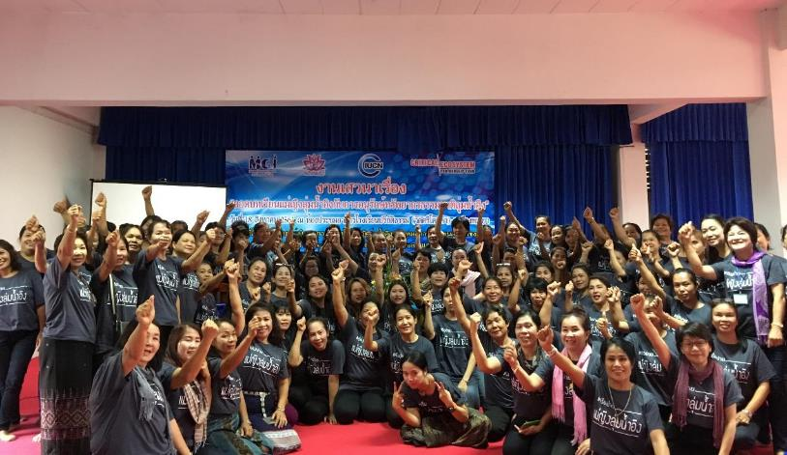
WOMEN’S GROUPS & NETWORKS
MODULE 3 | WAYS OF WORKING
Mekong Community Institute (MCI), Ing River Basin, Thailand
Boon Rueang women’s group for conservation was inspired by PWN
  Boon Rueang has the biggest wetland forest in lower Ing River, managed by the Boon Rueang Wetland Forest Conservation Group – includingthe women’s group
  MCI supported the women’s group with the Conservation Group, including their research, publications, communications with authorities and media, organizing seminars in community, setting up conservation zone, setting up local learning center for visiting researchers
  2020: Boon Rueang Wetland Forest Conservation Group was awarded Equator Prize from UNDP
“Women are inspiring other women through the networks.”
Annual meeting of The Women’s Network in The Ing River Basin for Environmental Conservation. © Teerapong Pomun, MCI

Slide 22
AMPLIFYING WOMEN’S VOICES
MODULE 3 | WAYS OF WORKING
My Village, Cambodia
To support women in sharing their voices, My Village works to build women’s capacity and to create enabling environments in public platforms:
Before public forum, usually hold one meeting with women to prepare: identify/discuss among themselves the issues they want to raise, ensure they have confidence to raise the issue in public forum
Public Forum is a platform of the government; My Village learned that they can proactively work to organize and facilitate these Public Forums to ensure community (including women) inclusion
  Works with communities and discusses with government authority ahead of time to get community concerns on the agenda

